Slide 1
Deep Learning Basics
Recurrent Neural Networks
Francis Steen and Xinyu You
Red Hen Lab
August 2019

Slide 2
A. Context

Slide 3
Context
We have seen how news anchors “initialize” a story by providing contextual information
This initialization activates the specific knowledge structures needed to understand the story
The activated knowledge structures are organized into a narrative structure: an agent, a goal, obstacles to reaching that goal, and strategies to overcome the obstacles

Slide 4
Ebola example
In the ebola story, the narrative involves the intersection of two agents: the Center for Disease Control and a nurse
The goal is to keep nurses from catching ebola
The obstacle is that the disease is highly contagious
The story is about which strategies should be followed to keep nurses safe

Slide 5
Causal reasoning
The day before, the CDC determined that the nurse had not followed the protective procedure — they found a protocol breach
Social media responded that it’s outrageous to blame the nurse, who was risking her life caring for the patients
The CDC accepted that it was their responsibility to keep the nurses safe, and they were reviewing their protocol

Slide 6
Deixis
“they found a protocol breach” — “they” refers to the CDC
“who was risking her life” — “who” and “her” refers to the nurse
Deixis simplifies references to entities that have already been activated
The assumption is that new information will automatically be applied to these activated entities
It would be annoying to specify the entities every time
Notes:
Normal language use assumes that an explicit mention of an entity signals a new activation. If you explicitly mention an entity that’s already been activated, that’s experienced as confusing:
Social media responded that it’s outrageous to blame the nurse; the nurse was risking the nurse’s life caring for the patients.
This makes it sound like there might be a second nurse whose existence must be activated.

Slide 7
Establishing the Ground
By “initializing” a story, a speaker establishes the “ground” or context
This dramatically simplifies the interpretation of the story
The audience does not need to search in a huge network for the relevant meanings of what is said

Slide 8
A Question
You should take your ? .
What is the most likely word in the blank?

Slide 9
A Question
It's raining outside. You should take your ? .
What is the most likely word in the blank?

Slide 10
A Question
It's raining outside. You should take your umbrella.
How?

Slide 11
A Question
It's raining outside. You should take your umbrella.
information
We need information from the distant past to accurately predict the correct word.

Slide 12
B. Sequential Data and Recurrent Networks

Slide 13
Sequence Data
Audio
Text
Video
DNA Sequence
Notes:
image:
https://towardsdatascience.com/dna-sequence-data-analysis-starting-off-in-bioinformatics-3dba4cea04f
https://imag.malavida.com/mvimgbig/download-fs/movavi-video-editor-21019-8.jpg

Slide 14
Sequence modeling
To model sequences, we need to:
Handle variable-length sequences
Track long-term dependencies
Maintain information about order
Share parameters across the sequence

Slide 15
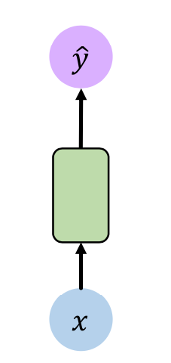
Deep forward neural networks
One to One
x is the input vectors, in blue
ŷ is the output vectors, in purple
Green vectors hold the hidden layer
Assuming that each input is independent, that is, the output of each network depends only on the current input
output vectors
Hidden Layer
input vectors
One to One
Notes:
Image from MIT Course CS1910-L2

Slide 16
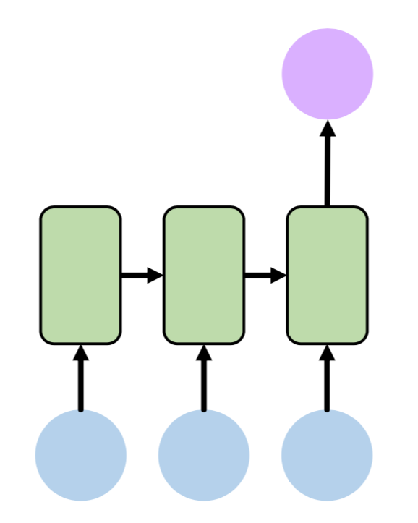
Recurrent neural networks
Many to One
For example:
Input a sequence of words and predict the sentiment associated with it.
Input: the summer holiday begins, I am so happy.
Output: Happy.
Many to One
Notes:
Image from MIT Course CS1910-L2

Slide 17
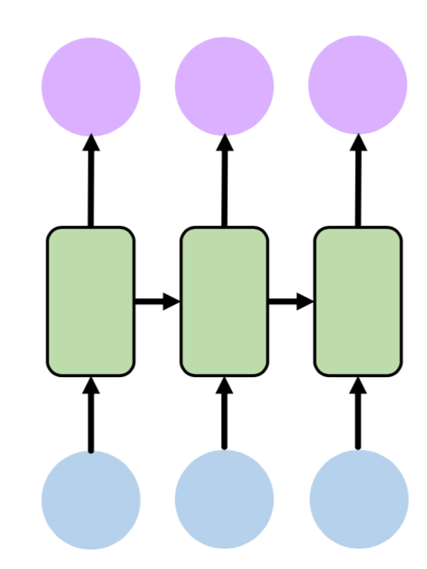
Recurrent neural networks
Many to Many
For example: Q and A system.
Input: which city is the capital of China?
Output: the capital of China is Beijing.
Many to Many
Notes:
Image from MIT Course CS1910-L2

Slide 18
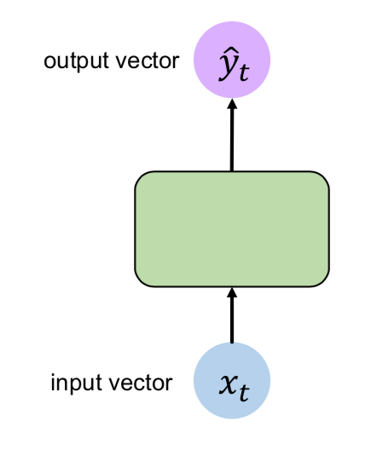
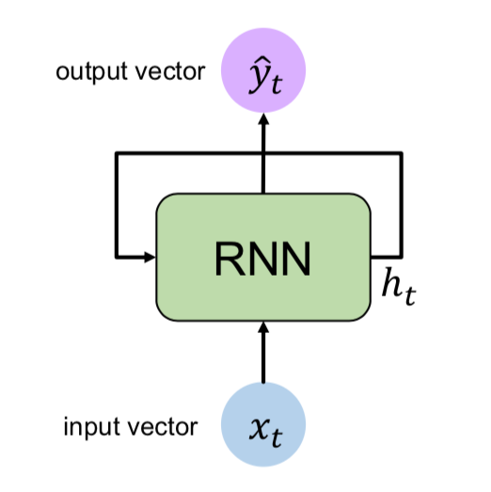
Recurrent neural networks
Adding Loops
Notes:
Images from MIT Course CS1910-L2

Slide 19
Recurrent neural networks
$$h_{t}=f_{w}(h_{t-1},x_{t})$$
Recurrent cell
: hidden state at time t step
$$h_{t}$$
Notes:
Image from MIT Course CS1910-L2

Slide 20
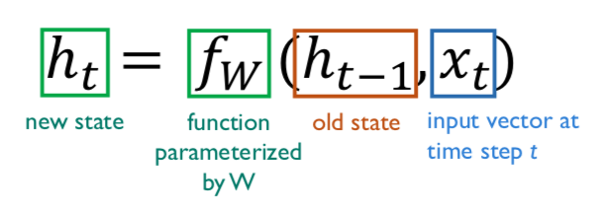
Recurrent neural networks
is the “memory” of the network. It’s calculated based on the previous hidden state and the input at the current step.
$$h_{t}$$
Notes:
Image from MIT Course CS1910-L2

Slide 21
Recurrent neural networks
The same function and set of parameters W are used at every time step
$$f_{w}$$
Notes:
Image from MIT Course CS1910-L2

Slide 22
Recurrent neural networks
Two weight matrices
Input vector
Previous state
$$x_{t}$$
$$h_{t-1}$$
Notes:
Image from MIT Course CS1910-L2

Slide 23
Recurrent neural networks
Notes:
ŷ_t is the output at step t. For example, if we wanted to predict the next word in a sentence, it would be a vector of probabilities across our vocabulary.
Image from MIT Course CS1910-L2

Slide 24
RNNs: computational graph across time
x0, x1, x2 … xt are the inputs
W_xh is the weight of inputs
Notes:
If the sequence we care about is a sentence of 5 words, the network would be unrolled into a 5-layer neural network, one layer for each word.
Image from MIT Course CS1910-L2

Slide 25
RNNs: computational graph across time
W_hh is the weight of hidden state cell.
Notes:
Image from MIT Course CS1910-L2

Slide 26
RNNs: computational graph across time
W_hy is the weight of outputs.
Notes:
Images from MIT Course CS1910-L2

Slide 27
Recurrent neural networks
RNNs are called recurrent because they perform the same task for every element of a sequence, with the output being depended on the previous computations.
With hidden state cell, they have a “memory” which captures information about what has been calculated so far.
Unlike a traditional deep neural network, which uses different parameters at each layer, a RNN shares the same parameters (W_hh, W_xh, W_hy) across all steps. This means we are performing the same task at each step, just with different inputs. This greatly reduces the total number of parameters we need to learn.
Notes:
Refer: http://www.wildml.com/2015/09/recurrent-neural-networks-tutorial-part-1-introduction-to-rnns/

Slide 28
The Problems Of RNNs
RNNs can learn to use the past information when the gap between the relevant information and the place that it’s needed is small.
But when the gap between the relevant information is large, RNNs are unable to learn to connect the relevant information!
Notes:
the clouds are in the __ , the RNNs can easily predict is sky.
The little boy is born in France, His mother is a doctor, and his father …, the boy speak ___.
It’s hard for RNNs to predict correctly in this situation.

Slide 29
C. Long Short Term Memory Networks

Slide 30
LSTM networks
Long Short Term Memory networks (LSTMs) are a special kind of RNN, are a special kind of RNN, capable of learning long-term dependencies

Slide 31
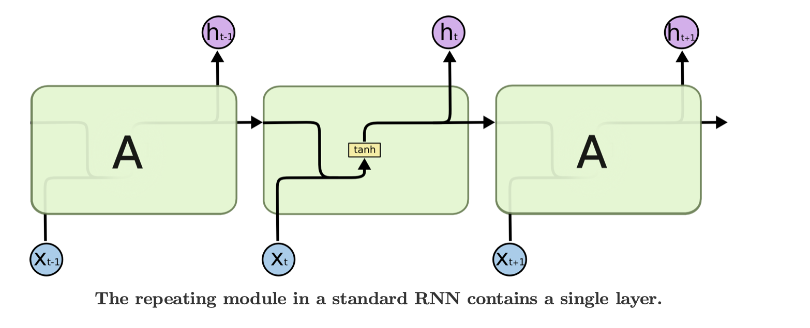
Standard RNNs VS LSTMs
In standard RNNs, this repeating module will have a very simple structure, such as a single tanh layer.
Notes:
Image url: http://colah.github.io/posts/2015-08-Understanding-LSTMs/img/LSTM3-SimpleRNN.png

Slide 32
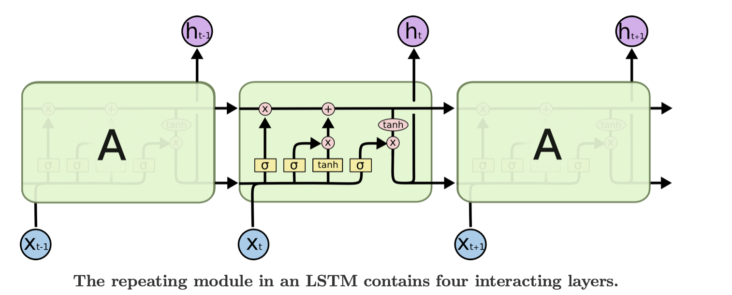
Standard RNNs VS LSTMs
In LSTMs, the repeating module has four neural network layers, instead of one, interacting in a very special way.
Notes:
http://colah.github.io/posts/2015-08-Understanding-LSTMs/img/LSTM3-chain.png

Slide 33
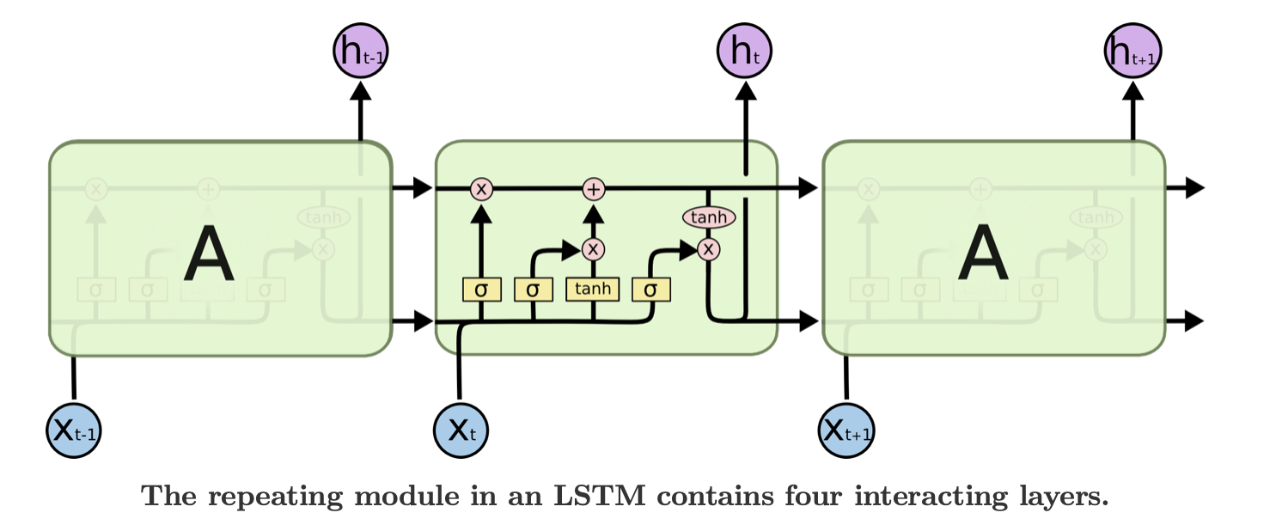
Symbols of LSTMs
Each line carries an entire vector, from the output of one node to the inputs of others.
The pink circles represent pointwise operations, like vector addition, while the yellow boxes are learned neural network layers.
Lines merging denote concatenation, while a line forking denote its content being copied and the copies going to different locations.

Slide 34
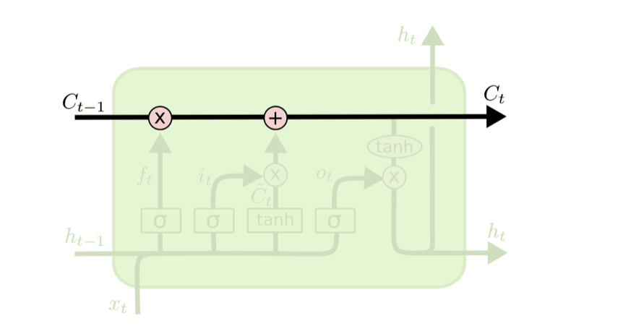
The Core Idea Behind LSTMs
Cell state is the horizontal line running through the top of the diagram, which is the key to LSTMs
Notes:
http://colah.github.io/posts/2015-08-Understanding-LSTMs/img/LSTM3-chain.png

Slide 35
The Core Idea Behind LSTMs
Cell state runs straight down the entire chain, with only some minor linear interactions. It’s very easy for information to just flow along it unchanged.
Notes:
Cell state is kind of like a conveyor belt.

Slide 36
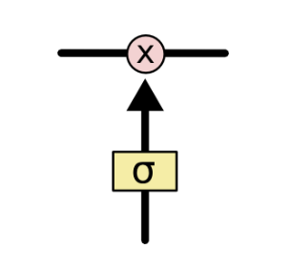
The Core Idea Behind LSTMs
Gates are a way to optionally let information through. They are composed out of a sigmoid neural net layer and a pointwise multiplication operation.
Notes:
The sigmoid layer outputs numbers between zero and one, describing how much of each component should be let through. A value of zero means “let nothing through,” while a value of one means “let everything through!”

Slide 37
The Core Idea Behind LSTMs
The LSTM use gates remove or add information to the cell state.
Notes:
http://colah.github.io/posts/2015-08-Understanding-LSTMs/img/LSTM3-chain.png

Slide 38
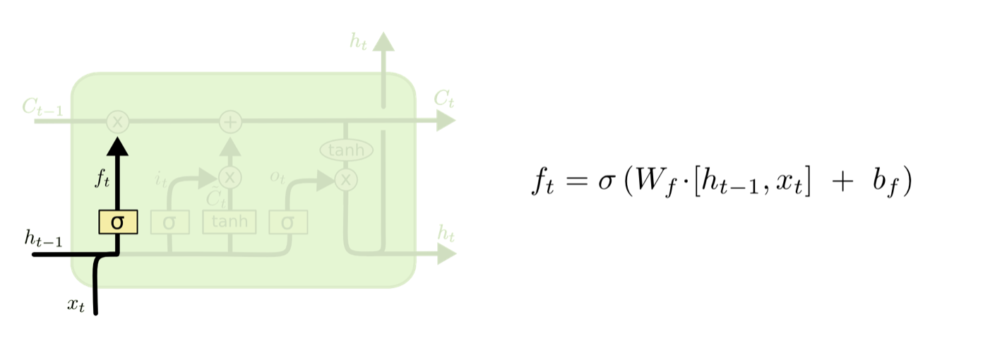
Step-by-Step LSTM
The first step in our LSTM is to decide what information we’re going to throw away from the cell state.
Notes:
It looks at ht−1 and xt,
and outputs a number between 0 and 1 for each number in the cell state Ct−1.
1 represents “completely keep this” while a 0 represents “completely get rid of this.”

Slide 39
Step-by-Step LSTM
The second step is to decide what new information we’re going to store in the cell state.
Notes:
This has two parts.
First, a sigmoid layer called the “input gate layer” decides which values we’ll update.
Next, a tanh layer creates a vector of new candidate values, C̃ t, that could be added to the state. In the next step, we’ll combine these two to create an update to the state.

Slide 40
Step-by-Step LSTM
The third step is update the old cell state into the new cell state
Notes:
The previous steps already decided what to do, we just need to actually do it.
We multiply the old state by ft, forgetting the things we decided to forget earlier.
Then we add it∗C̃ t. This is the new candidate values, scaled by how much we decided to update each state value.

Slide 41
Step-by-Step LSTM
Finally, we need to decide what we’re going to output
Notes:
This output will be based on our cell state, but will be a filtered version.
First, we run a sigmoid layer which decides what parts of the cell state we’re going to output.
Then, we put the cell state through tanh (to push the values to be between −1 and 1) and multiply it by the output of the sigmoid gate, so that we only output the parts we decided to.

Slide 42
LSTMs: key concepts
Maintain a separate cell state from what is outputted
Use gates to control the flow of information • Forget gate gets rid of irrelevant information • Selectively update cell state • Output gate returns a filtered version of the cell state

Slide 43
D. RNN Applications

Slide 44
Language Model
Notes:
Ref: https://nndl.github.io/

Slide 45
Writing a poem

Slide 46
Machine Translate
An RNN for coding
Another RNN for decoding

Slide 47
Captioning pictures

Slide 48
Visual Question Answering (VQA)
VQA: Given an image and a natural language question about the image, the task is to provide an accurate natural language answer

Slide 49
Dialogue system

Slide 50
E. Mixture-of-Experts Networks

Slide 51
Conditional computation
Conditional computation, where parts of the network are active on a per-example basis, has been proposed in theory as a way of dramatically increasing model capacity without a proportional increase in computation.
Outrageously Large Neural Networks: The Sparsely-Gated Mixture-of-Experts Layer
Noam Shazeer, Azalia Mirhoseini, Krzysztof Maziarz, Andy Davis, Quoc Le, Geoffrey Hinton, Jeff Dean (2017)

Slide 52
1000x improvements
In this work, we address these challenges and finally realize the promise of conditional computation, achieving greater than 1000x improvements in model capacity with only minor losses in computational efficiency on modern GPU clusters
We introduce a Sparsely-Gated Mixture-of-Experts layer (MoE), consisting of up to thousands of feed-forward sub-networks
A trainable gating network determines a sparse combination of these experts to use for each example.

Slide 53
Mixture-of-Experts MoE

Slide 54
Language modeling
We apply the MoE to the tasks of language modeling and machine translation, where model capacity is critical for absorbing the vast quantities of knowledge available in the training corpora
We present model architectures in which a MoE with up to 137 billion parameters is applied convolutionally between stacked LSTM layers
On large language modeling and machine translation benchmarks, these models achieve significantly better results than state-of-the-art at lower computational cost

Slide 55
F. Future of AI

Slide 56
New Paradigms Needed
Ultimately, major progress in artificial intelligence will come about through systems that combine representation learning with complex reasoning
Although deep learning and simple reasoning have been used for speech and handwriting recognition for a long time, new paradigms are needed to replace rule-based manipulation of symbolic expressions by operations on large vectors Yann LeCun, Yoshua Bengio, & Geoffrey Hinton, “Deep Learning.” Nature, 2015

Slide 57
Non-annotated Data
Deep learning is certainly limited in its current form, because almost all the successful applications of it use supervised learning with human-annotated data
We need to find ways to train large neural nets from “raw” non-annotated data so they capture the regularities of real world Yann LeCun, Director of AI Research at Facebook and Professor at NYU, Quora, July 29, 2016

Slide 58
Ditch Back-Propagation
Rumelhart, D. E., Hinton, G. E., and Williams, R. J. (1986) Learning representations by back-propagating errors. Nature, 323, 533-536.
Geoffrey Hinton is a professor emeritus at the University of Toronto and a Google researcher
He is now "deeply suspicious" of back-propagation, the workhorse method that underlies most of the advances we are seeing in the AI field today
"My view is throw it all away and start again”

Slide 59
Unsupervised Learning
Hinton suggested that, to get to where neural networks are able to become intelligent on their own, what is known as "unsupervised learning," "I suspect that means getting rid of back-propagation."
"I don't think it's how the brain works," he said. "We clearly don't need all the labeled data." Axios, Sep 15, 2017

Slide 60
Hinton on Neural Networks
Notes:
Geoffrey Hinton talk "What is wrong with convolutional neural nets?” https://www.youtube.com/watch?v=rTawFwUvnLE MIT Fall Colloquium Series, December 4, 2014

Slide 65
Exercises
For a new approach to the MNIST dataset: A Tensorflow implementation of CapsNet based on Geoffrey Hinton's paper Dynamic Routing Between Capsules (https://arxiv.org/abs/1710.09829): https://github.com/naturomics/CapsNet-Tensorflow

Slide 66
Thank you!

