Slide 1
Deep Learning Basics
Convolutional Neural Networks
Francis Steen and Xinyu You
Red Hen Lab
August 2019

Slide 2
Content
A Brief History of CNNs
Why we need CNNs?
The Structure of CNNs
Convolution
Convolution operation
Padding
Stride
Pooling
Some typical CNNs
Example: Dog or Cat?

Slide 3
A. A Brief History of CNNs

Slide 4
Convolutional Neural Networks
A convolutional neural network (CNN, or ConvNet) is a class of Feedforward Neural Network.
It is put forward by the influence of biological Receptive Field mechanism.

Slide 5
Receptive fields
Work by Hubel and Wiesel in the 1950s and 1960s showed that cat and monkey visual cortices contain neurons that individually respond to small regions of the visual field.
The receptive field is a portion of the sensory cortex that elicit neuronal responses when stimulated.
Notes:
Image source: https://goodpsychology.wordpress.com/2013/03/13/235/

Slide 6
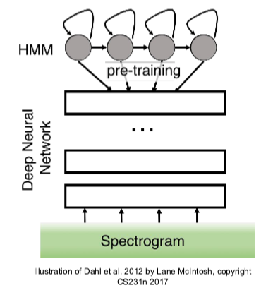
First strong results
Acoustic Modeling using Deep Belief Networks, Abdel-rahman Mohamed, George Dahl, Geoffrey Hinton, 2010
Context-Dependent Pre-trained Deep Neural Networks for Large Vocabulary Speech Recognition, George Dahl, Dong Yu, Li Deng, Alex Acero, 2012
ImageNet classification with deep convolutional neural networks
Alex Krizhevsky, Ilya Sutskever, Geoffrey E Hinton, 2012
Notes:
Source from: http://cs231n.stanford.edu/slides/2019/cs231n_2019_lecture05.pdf

Slide 7
B. Why do we need CNNs?

Slide 8
Why do we need CNNs?
The calculation of the fully connected layer is too large
Location Information will get lost in forward neural network

Slide 9
Combinatorial explosion
The calculation of the fully connected layer is too large
Suppose there is a 32 weight × 32 height × 3 dimension image as input, and the output dimension is 28×28×6.
So, 32×32×3=3072 , 28 × 28 × 6 = 4704.
If we construct a forward neural network, one layer contains 3072 units, the next layer contains 4074 units. The two layers are connected to each other, and then the weight matrix is calculated, which is equal to 4074×3072≈14 million
yellow, red and blue channel
height
width
Notes:
For a computer, an image is just an array of values. Typically it’s a 3-dimensional (RGB) matrix of pixel values. Each pixel has a specific value of red, green and blue that represents the color of a given pixel.
This means for a 32×32×3 dimension image, we need more than 14 million parameters to train the network. A 32×32×3 dimension image is very small.
If we use a 1000×1000x3 dimension image, we need more than 1 billion parameters!

Slide 10
Losing location information
In a fully connected network, relative locations are lost
The image is usually a three-dimensional shape in the direction of height, length, and channel. However, when inputting to the full connection layer, we need to flatten the 3D data into 1D data.
The image is a 3D shape that contains important spatial information. For example, spatially adjacent pixels are similar values, and each channel of the RBG has a close correlation, and there is no correlation between pixels that are far apart.

Slide 11
Why we need CNNs
The calculation of the fully connected (affine) layer is too large
Location Information will lose in forward neural network
CNNs can solve those problems!

Slide 12
C. The Structure of CNNs

Slide 13
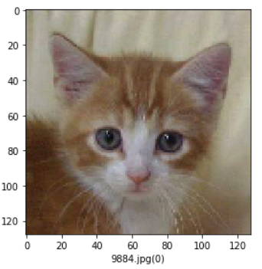
The Structure of CNNs
DNNs
CNNs

Slide 14
The Structure of CNNs
Two new layers:
Convolutional Layer
Pooling Layer

Slide 15
C1. Convolution

Slide 16
Convolution
Convolution is just another mathematical operation.
Notes:
Let’s say we have a pattern or a stamp that we want to repeat at regular intervals on a sheet of paper, a very convenient way to do this is to perform a convolution of the pattern with a regular grid on the paper. Think about hovering the stamp (or kernel) above the paper and moving it along a grid before pushing it into the page at each interval.
This idea of wanting to repeat a pattern (kernel) across some domain comes up a lot in the realm of signal processing and computer vision. In fact, if you’ve ever used a graphics package such as Photoshop, Inkscape or GIMP, you’ll have seen many kernels before. The list of ‘filters’ such as ‘blur’, ‘sharpen’ and ‘edge-detection’ are all done with a convolution of a kernel or filter with the image that you’re looking at.
https://mlnotebook.github.io/post/CNN1/

Slide 17
Convolution operation
First, we have a 4x4 input data and 3x3 filter.
0 | 25 | 75 | 80 | 80
0 | 75 | 80 | 80 | 80
0 | 75 | 80 | 80 | 80
0 | 70 | 75 | 80 | 80
0 | 0 | 0 | 0 | 0
-1 | 0 | 1
-2 | 0 | 2
-1 | 0 | 1
*
=
Input data
4 x 4
Filter
3 x 3
Notes:
Fliter: weights

Slide 18
Convolution operation
For input data, we apply the filter window.
0 | 25 | 75 | 80 | 80
0 | 75 | 80 | 80 | 80
0 | 75 | 80 | 80 | 80
0 | 70 | 75 | 80 | 80
0 | 0 | 0 | 0 | 0
-1 | 0 | 1
-2 | 0 | 2
-1 | 0 | 1
*
=
Input data
4 x 4
Filter
3 x 3

Slide 19
Convolution operation
Take the product of two corresponding Numbers
0 | 25 | 75 | 80 | 80
0 | 75 | 80 | 80 | 80
0 | 75 | 80 | 80 | 80
0 | 70 | 75 | 80 | 80
0 | 0 | 0 | 0 | 0
-1 | 0 | 1
-2 | 0 | 2
-1 | 0 | 1
-1*0 = 0, 25*0 = 0, 75*1 = 75
-2*0 = 0, 0*75= 0, 2*80 = 160
-2*0 = 0, 0*75= 0, 1*80 = 160
*
=
Input data
4 x 4
Filter
3 x 3

Slide 20
Convolution operation
-1*0 = 0, 25*0 = 0, 75*1 = 75
-2*0 = 0, 0*75= 0, 2*80 = 160
-2*0 = 0, 0*75= 0, 1*80 = 160
0 | 25 | 75 | 80 | 80
0 | 75 | 80 | 80 | 80
0 | 75 | 80 | 80 | 80
0 | 70 | 75 | 80 | 80
0 | 0 | 0 | 0 | 0
-1 | 0 | 1
-2 | 0 | 2
-1 | 0 | 1
0 | 0 | 75
0 | 0 | 80
0 | 0 | 80
*
=
Input data
4 x 4
Filter
3 x 3

Slide 21
Convolution operation
Finally, sum them up
0 | 25 | 75 | 80 | 80
0 | 75 | 80 | 80 | 80
0 | 75 | 80 | 80 | 80
0 | 70 | 75 | 80 | 80
0 | 0 | 0 | 0 | 0
-1 | 0 | 1
-2 | 0 | 2
-1 | 0 | 1
0 | 0 | 75
0 | 0 | 80
0 | 0 | 80
0+0+75+
0+0+80+
0+0+80= 335
*
=
$$∑$$
Input data
4 x 4
Filter
3 x 3

Slide 22
Convolution operation
0 | 25 | 75 | 80 | 80
0 | 75 | 80 | 80 | 80
0 | 75 | 80 | 80 | 80
0 | 70 | 75 | 80 | 80
0 | 0 | 0 | 0 | 0
 | 335
-1 | 0 | 1
-2 | 0 | 2
-1 | 0 | 1
0 | 0 | 75
0 | 0 | 80
0 | 0 | 80
*
=
$$∑$$
Input data
4 x 4
Filter
3 x 3

Slide 23
Convolution operation
This is the process of convolution operation, we give it a new sign
*
0 | 25 | 75 | 80 | 80
0 | 75 | 80 | 80 | 80
0 | 75 | 80 | 80 | 80
0 | 70 | 75 | 80 | 80
0 | 0 | 0 | 0 | 0
 | 335
-1 | 0 | 1
-2 | 0 | 2
-1 | 0 | 1
0 | 0 | 75
0 | 0 | 80
0 | 0 | 80
*
=
$$∑$$
*
Convolution Operation

Slide 24
Convolution operation
For input data, the convolution operation slides the filter window at certain intervals to compute the output.
Let’s do see how it works step by step.

Slide 25
Convolution operation
For input data, the convolution operation slides the filter window at certain intervals to compute output.
0 | 25 | 75 | 80 | 80
0 | 75 | 80 | 80 | 80
0 | 75 | 80 | 80 | 80
0 | 70 | 75 | 80 | 80
0 | 0 | 0 | 0 | 0
 | 335
-1 | 0 | 1
-2 | 0 | 2
-1 | 0 | 1
*

Slide 26
Convolution operation
Convolution Operation
0 | 25 | 75 | 80 | 80
0 | 75 | 80 | 80 | 80
0 | 75 | 80 | 80 | 80
0 | 70 | 75 | 80 | 80
0 | 0 | 0 | 0 | 0
 | 335
-1 | 0 | 1
-2 | 0 | 2
-1 | 0 | 1
*
75+160+80

Slide 27
Convolution operation
Convolution Operation
0 | 25 | 75 | 80 | 80
0 | 75 | 80 | 80 | 80
0 | 75 | 80 | 80 | 80
0 | 70 | 75 | 80 | 80
0 | 0 | 0 | 0 | 0
 | 335 | 70
-1 | 0 | 1
-2 | 0 | 2
-1 | 0 | 1
*
-25 + 80+75*(-2) + 160 -75 +80

Slide 28
Convolution operation
Convolution Operation
0 | 25 | 75 | 80 | 80
0 | 75 | 80 | 80 | 80
0 | 75 | 80 | 80 | 80
0 | 70 | 75 | 80 | 80
0 | 0 | 0 | 0 | 0
 | 335 | 70 | 5
-1 | 0 | 1
-2 | 0 | 2
-1 | 0 | 1
*
-75 + 80+80*(-2) + 160 -80 +80

Slide 29
Convolution operation
Convolution Operation
0 | 25 | 75 | 80 | 80
0 | 75 | 80 | 80 | 80
0 | 75 | 80 | 80 | 80
0 | 70 | 75 | 80 | 80
0 | 0 | 0 | 0 | 0
 | 335 | 70 | 5
 | 315
-1 | 0 | 1
-2 | 0 | 2
-1 | 0 | 1
*
80 + 160 + 75

Slide 30
Convolution operation
Convolution Operation
0 | 25 | 75 | 80 | 80
0 | 75 | 80 | 80 | 80
0 | 75 | 80 | 80 | 80
0 | 70 | 75 | 80 | 80
0 | 0 | 0 | 0 | 0
 | 335 | 70 | 5
 | 315 | 20
-1 | 0 | 1
-2 | 0 | 2
-1 | 0 | 1
*
-75 + 80 + 75*(-2) +160 - 75 + 80

Slide 31
Convolution operation
Convolution Operation
0 | 25 | 75 | 80 | 80
0 | 75 | 80 | 80 | 80
0 | 75 | 80 | 80 | 80
0 | 70 | 75 | 80 | 80
0 | 0 | 0 | 0 | 0
 | 335 | 70 | 5
 | 315 | 20 | 5
-1 | 0 | 1
-2 | 0 | 2
-1 | 0 | 1
*
-80 + 80 + 80*(-2) +160 - 75 + 80

Slide 32
Convolution operation
Convolution Operation
0 | 25 | 75 | 80 | 80
0 | 75 | 80 | 80 | 80
0 | 75 | 80 | 80 | 80
0 | 70 | 75 | 80 | 80
0 | 0 | 0 | 0 | 0
 | 335 | 70 | 5
 | 315 | 20 | 5
 | 230
-1 | 0 | 1
-2 | 0 | 2
-1 | 0 | 1
*
80 + 75*2

Slide 33
Convolution operation
Convolution Operation
0 | 25 | 75 | 80 | 80
0 | 75 | 80 | 80 | 80
0 | 75 | 80 | 80 | 80
0 | 70 | 75 | 80 | 80
0 | 0 | 0 | 0 | 0
 | 335 | 70 | 5
 | 315 | 20 | 5
 | 230 | 15
-1 | 0 | 1
-2 | 0 | 2
-1 | 0 | 1
*
-75+80+75*(-2) +80*2

Slide 34
Convolution operation
Convolution Operation
0 | 25 | 75 | 80 | 80
0 | 75 | 80 | 80 | 80
0 | 75 | 80 | 80 | 80
0 | 70 | 75 | 80 | 80
0 | 0 | 0 | 0 | 0
 | 335 | 70 | 5
 | 315 | 20 | 5
 | 230 | 15 | 10
-1 | 0 | 1
-2 | 0 | 2
-1 | 0 | 1
*
-80+80+75*(-2) +80*2

Slide 35
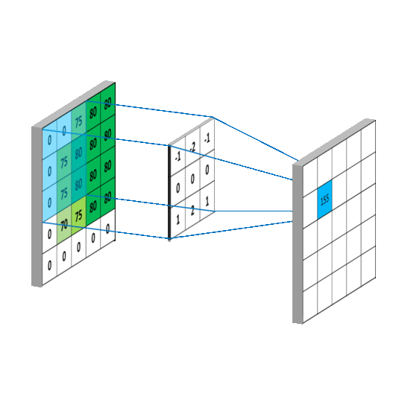
Convolution operation
*
Click to Play
Convolution Operation

Slide 36
Bias
Add Bias to Each of element
0 | 25 | 75 | 80 | 80
0 | 75 | 80 | 80 | 80
0 | 75 | 80 | 80 | 80
0 | 70 | 75 | 80 | 80
0 | 0 | 0 | 0 | 0
-1 | 0 | 1
-2 | 0 | 2
-1 | 0 | 1
335 | 70 | 5
315 | 20 | 5
230 | 15 | 10
340 | 75 | 10
320 | 25 | 10
235 | 20 | 15
*
+
5
Input data
4 x 4
Filter
3 x 3
Bias
Output

Slide 37
Convolutional Layer
0 | 25 | 75 | 80 | 80
0 | 75 | 80 | 80 | 80
0 | 75 | 80 | 80 | 80
0 | 70 | 75 | 80 | 80
0 | 0 | 0 | 0 | 0
-1 | 0 | 1
-2 | 0 | 2
-1 | 0 | 1
335 | 70 | 5
315 | 20 | 5
230 | 15 | 10
340 | 75 | 10
320 | 25 | 10
235 | 20 | 15
*
+
5
Input
Filter (weights)
Bias
Output

Slide 38
Why we need CNNs
If each filter is 5 × 5, a filter has 25 parameters, plus the Bia parameter, then each filter has 26 parameters. There are a total of 6 filters, so the total number of parameters is 156. Far less than the equivalent fully-collected layer, which has 14 million parameters.
When the input data is an image, the convolutional layer will be 3D. The data is received in the form of input data and is also output to the next layer in the form of 3D data. Therefore, in CNNs, it’s possible to correctly understand data having shapes such as images.

Slide 39
Padding
What’s the problem?
Only use one time
of this edge element 0 to calculate
Use several times
of this central element 80 to calculate
0 | 25 | 75 | 80 | 80
0 | 75 | 80 | 80 | 80
0 | 75 | 80 | 80 | 80
0 | 70 | 75 | 80 | 80
0 | 0 | 0 | 0 | 0
0 | 25 | 75 | 80 | 80
0 | 75 | 80 | 80 | 80
0 | 75 | 80 | 80 | 80
0 | 70 | 75 | 80 | 80
0 | 0 | 0 | 0 | 0

Slide 40
Padding
We lose edge information in this way.
How to solve this problem?
Only use one time
of this edge element 0 to calculate
Use several times
of this central element 80 to calculate
0 | 25 | 75 | 80 | 80
0 | 75 | 80 | 80 | 80
0 | 75 | 80 | 80 | 80
0 | 70 | 75 | 80 | 80
0 | 0 | 0 | 0 | 0
0 | 25 | 75 | 80 | 80
0 | 75 | 80 | 80 | 80
0 | 75 | 80 | 80 | 80
0 | 70 | 75 | 80 | 80
0 | 0 | 0 | 0 | 0

Slide 41
Padding
Padding it with a margin of 2!
This means padding around with a margin of 2 pixel.
Now, we use several times
of this edge element 0 to calculate too.
0 | 0 | 0 | 0 | 0 | 0 | 0 | 0 | 0
0 | 0 | 0 | 0 | 0 | 0 | 0 | 0 | 0
0 | 0 | 0 | 25 | 75 | 80 | 80 | 0 | 0
0 | 0 | 0 | 75 | 80 | 80 | 80 | 0 | 0
0 | 0 | 0 | 75 | 80 | 80 | 80 | 0 | 0
0 | 0 | 0 | 70 | 75 | 80 | 80 | 0 | 0
0 | 0 | 0 | 0 | 0 | 0 | 0 | 0 | 0
0 | 0 | 0 | 0 | 0 | 0 | 0 | 0 | 0
0 | 0 | 0 | 0 | 0 | 0 | 0 | 0 | 0
0 | 75
 | 335 | 70 | 5
 | 315 | 20 | 5
 | 230 | 15 | 10
-1 | 0 | 1
-2 | 0 | 2
-1 | 0 | 1
*

Slide 42
Padding

Slide 43
Stride
Stride is the amount by which the filter is moved as it passes over the image.
0 | 0 | 0 | 0 | 0 | 0 | 0 | 0 | 0
0 | 0 | 0 | 0 | 0 | 0 | 0 | 0 | 0
0 | 0 | 0 | 25 | 75 | 80 | 80 | 0 | 0
0 | 0 | 0 | 75 | 80 | 80 | 80 | 0 | 0
0 | 0 | 0 | 75 | 80 | 80 | 80 | 0 | 0
0 | 0 | 0 | 70 | 75 | 80 | 80 | 0 | 0
0 | 0 | 0 | 0 | 0 | 0 | 0 | 0 | 0
0 | 0 | 0 | 0 | 0 | 0 | 0 | 0 | 0
0 | 0 | 0 | 0 | 0 | 0 | 0 | 0 | 0
Stride = 2
Notes:
https://www.quora.com/What-does-stride-mean-in-the-context-of-convolutional-neural-networks

Slide 44
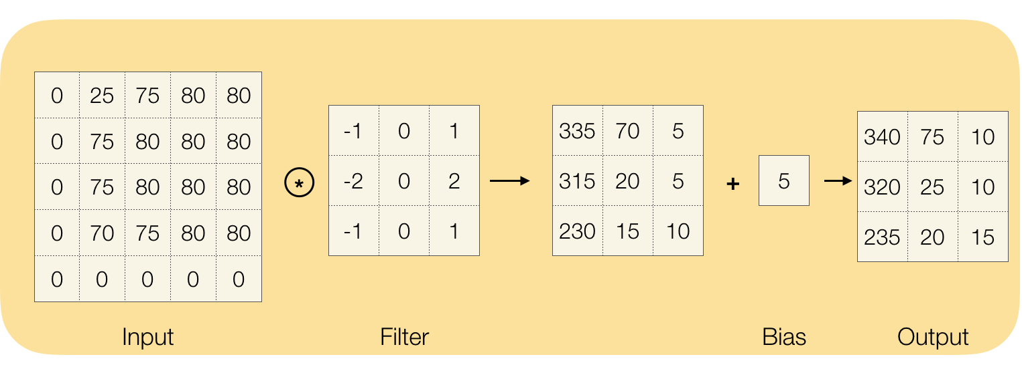
Convolutional Layer
model = Sequential()
model.add(Conv2D(32, (3, 3), activation='relu', input_shape=(IMAGE_WIDTH, IMAGE_HEIGHT, IMAGE_CHANNELS)))

Slide 45
C2. Pooling

Slide 46
Pooling
It is common to periodically insert a Pooling layer in-between successive Conv layers in a ConvNet architecture
Its function is to progressively reduce the spatial size of the representation to reduce the amount of parameters and computation in the network, and hence to also control overfitting
Notes:
http://cs231n.github.io/convolutional-networks/#pool

Slide 47
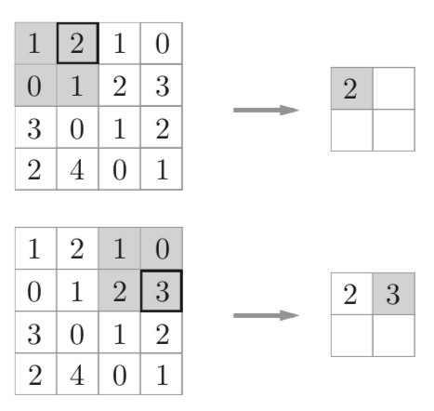
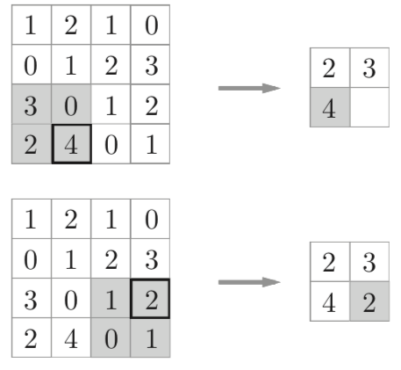
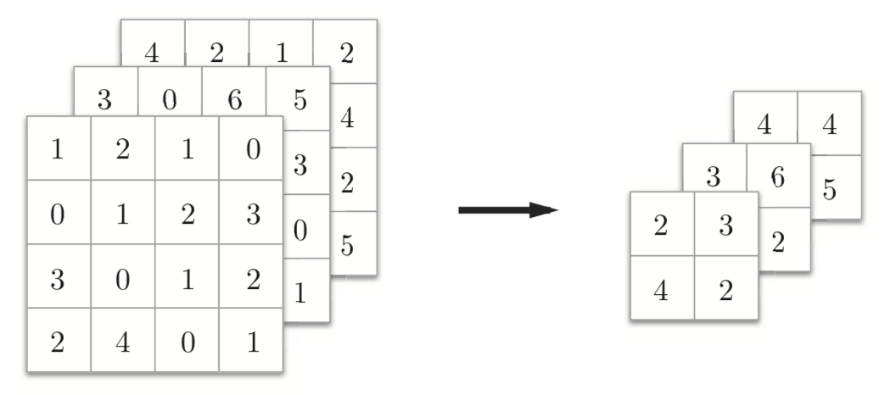
Max Pooling
The Pooling Layer operates independently on every depth slice of the input and resizes it spatially, using the MAX operation.
The most common form is a pooling layer with filters of size 2x2 applied with a stride of 2 downsamples every depth slice in the input by 2 along both width and height, discarding 75% of the activations.
The depth dimension remains unchanged.
Notes:
http://cs231n.github.io/convolutional-networks/#pool

Slide 48
Code
model = Sequential()
model.add(Conv2D(32, (3, 3), activation='relu', input_shape=(IMAGE_WIDTH, IMAGE_HEIGHT, IMAGE_CHANNELS)))
model.add(BatchNormalization())
model.add(MaxPooling2D(pool_size=(2, 2)))
model.add(Dropout(0.25))

Slide 49
Some typical CNNs

Slide 50
Some typical CNNs
LeNet
AlexNet
GoogleLeNet
VGGNet
ResNet

Slide 51
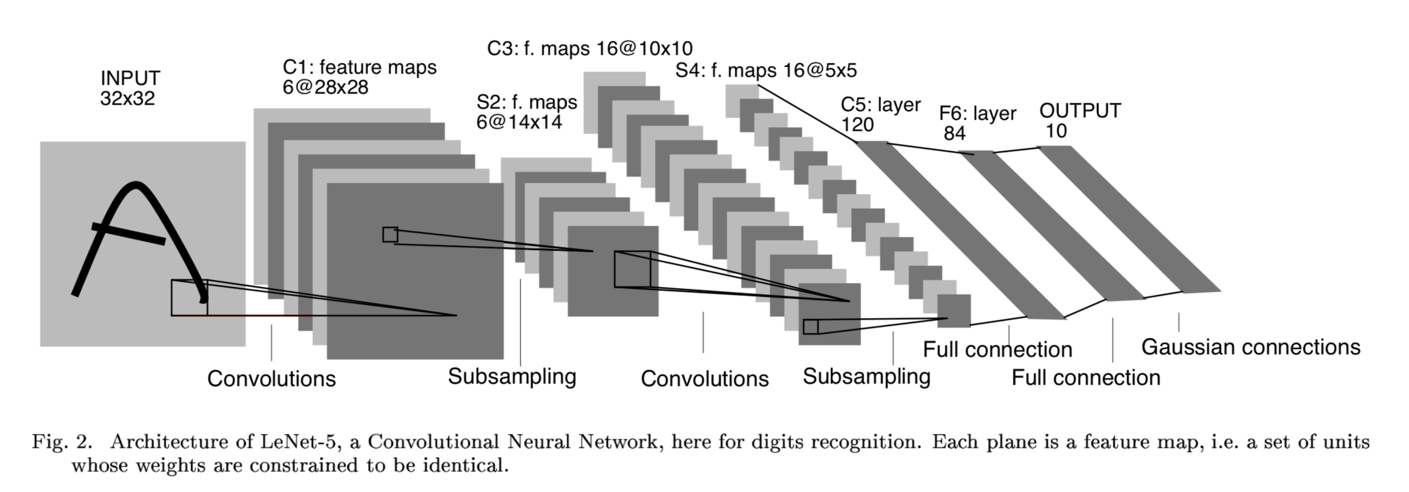
LeNet
The first successful applications of Convolutional Networks were developed by Yann LeCun in 1990’s. Of these, the best known is the LeNet architecture that was used to read zip codes, digits, etc.
Notes:
From
http://cs231n.github.io/convolutional-networks/#case
http://yann.lecun.com/exdb/publis/pdf/lecun-98.pdf

Slide 52
AlexNet
2012 ILSVRC winner （top 5 error of 16% compared to runner-up with 26% error）
Notes:
The first work that popularized Convolutional Networks in Computer Vision was the AlexNet, developed by Alex Krizhevsky, Ilya Sutskever and Geoff Hinton. The AlexNet was submitted to the ImageNet ILSVRC challenge in 2012 and significantly outperformed the second runner-up (top 5 error of 16% compared to runner-up with 26% error). The Network had a very similar architecture to LeNet, but was deeper, bigger, and featured Convolutional Layers stacked on top of each other (previously it was common to only have a single CONV layer always immediately followed by a POOL layer).
From
http://cs231n.github.io/convolutional-networks/#case
http://yann.lecun.com/exdb/publis/pdf/lecun-98.pdf

Slide 53
GoogLeNet
The ILSVRC 2014 winner
Provide an Inception Module that dramatically reduced the number of parameters in the network (4M, compared to AlexNet with 60M)
Notes:
The ILSVRC 2014 winner was a Convolutional Network from Szegedy et al. from Google. Its main contribution was the development of an Inception Module that dramatically reduced the number of parameters in the network (4M, compared to AlexNet with 60M). Additionally, this paper uses Average Pooling instead of Fully Connected layers at the top of the ConvNet, eliminating a large amount of parameters that do not seem to matter much. There are also several followup versions to the GoogLeNet, most recently Inception-v4.
From
http://cs231n.github.io/convolutional-networks/#case
http://yann.lecun.com/exdb/publis/pdf/lecun-98.pdf

Slide 54
VGGNet
It shows that the depth of the network is a critical component for good performance.
A downside of the VGGNet is that it is more expensive to evaluate and uses a lot more memory and parameters (140M).
Notes:
The runner-up in ILSVRC 2014 was the network from Karen Simonyan and Andrew Zisserman that became known as the VGGNet. Its main contribution was in showing that the depth of the network is a critical component for good performance. Their final best network contains 16 CONV/FC layers and, appealingly, features an extremely homogeneous architecture that only performs 3x3 convolutions and 2x2 pooling from the beginning to the end. Their pretrained model is available for plug and play use in Caffe. A downside of the VGGNet is that it is more expensive to evaluate and uses a lot more memory and parameters (140M). Most of these parameters are in the first fully connected layer, and it was since found that these FC layers can be removed with no performance downgrade, significantly reducing the number of necessary parameters.
From
http://cs231n.github.io/convolutional-networks/#case
http://yann.lecun.com/exdb/publis/pdf/lecun-98.pdf

Slide 55
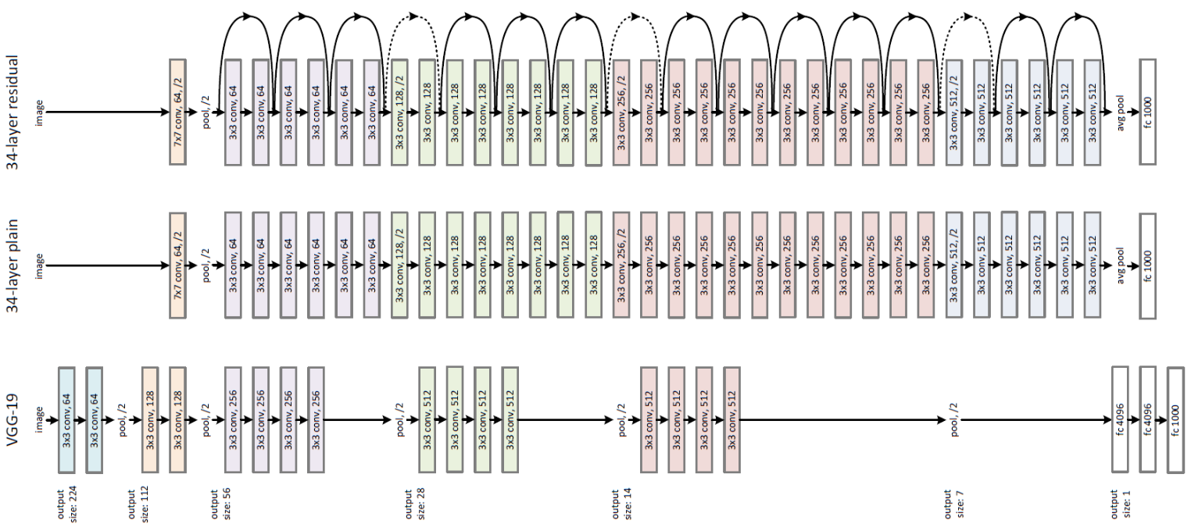
ResNet
The winner of ILSVRC 2015
It features special skip connections and a heavy use of batch normalization.
Notes:
Residual Network developed by Kaiming He et al. was the winner of ILSVRC 2015. It features special skip connections and a heavy use of batch normalization. The architecture is also missing fully connected layers at the end of the network. The reader is also referred to Kaiming’s presentation (video, slides), and some recent experiments that reproduce these networks in Torch. ResNets are currently by far state of the art Convolutional Neural Network models and are the default choice for using ConvNets in practice (as of May 10, 2016). In particular, also see more recent developments that tweak the original architecture from Kaiming He et al. Identity Mappings in Deep Residual Networks (published March 2016).
From
http://cs231n.github.io/convolutional-networks/#case
http://yann.lecun.com/exdb/publis/pdf/lecun-98.pdf

Slide 56
Exercise: dog or cat?

Slide 57
Exercise: dog or cat?
https://www.kaggle.com/uysimty/keras-cnn-dog-or-cat-classification
Notes:
Image source: https://towardsdatascience.com/image-classifier-cats-vs-dogs-with-convolutional-neural-networks-cnns-and-google-colabs-4e9af21ae7a8

Slide 58
Thanks!

