Slide 1
Deep Learning Basics
3: Training Neural Networks
Francis Steen and Xinyu You
Red Hen Lab
August 2019

Slide 2
A. Loss function
How well does the neural network predict

Slide 3
Learning: Finding the right weights and biases
Notes:
Last time, we talk about the MNIST…
One key concept is learning to find the right weights and bias.
So what are the right means? And how can we find them?
http://yann.lecun.com/exdb/mnist/

Slide 4
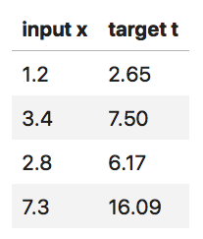
Loss function
How different between the target value and predict output value? We use a loss function to measure it.
A simple neural network example:
x
w
y
t
input
output
target
Notes:
Here $x$ is input, $w$ is weight, $y$ is the network's output and $t$ is the target value of the training data.
The table shows four columns of data. What we know now is the input $x$ and the target value of the training data $t$. The neural network will output the $y$ value.

Slide 5
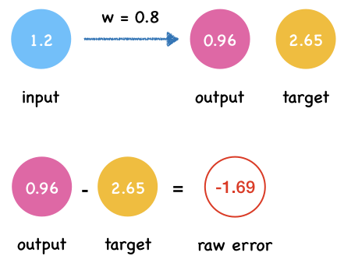
Loss (or cost) function
1. First, we randomly set the value of w to 0.8.
2. Get the predict output.
3. Calculate the difference between the actual value y and the target value t
raw error = actual value - target value

Slide 6
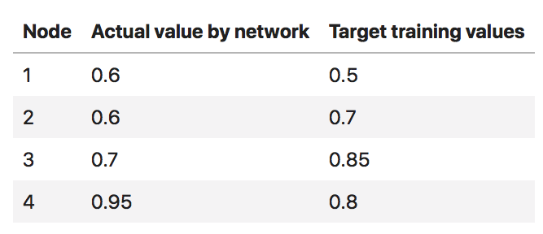
The Problem with raw error
Suppose we have a set of data.

Slide 7
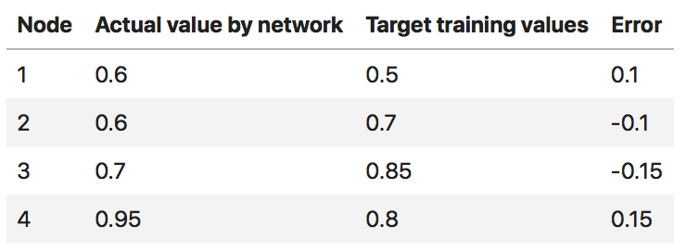
The Problem with raw error
If we calculate raw error to measure the performance of neural network.
$$L=0.1+(-0.1)+(-0.15)+(0.15)=0$$
How to solve this?
Notes:
As you can see, the positive and negative errors cancel each other out. So the total error become 0 which suggest the neural network makes no mistakes which is not true.
How will you solve this problem?

Slide 8
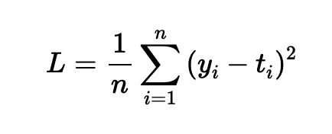
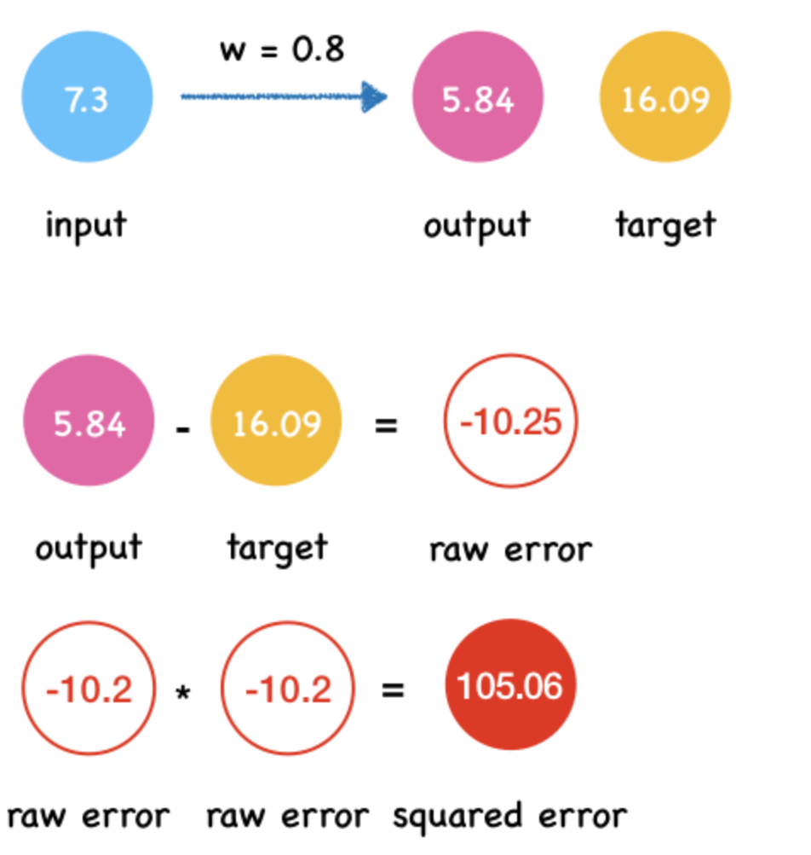
Mean Squared Error
The form of mathematical expressions of MAE:
Calculate the difference between the actual value y and the target value t using MSE:

Slide 9
The result of MSE
$$L=((0.1)^{2}+(-0.1)^{2}+(-0.15)^{2}+(0.15)^{2})/4=0.016$$

Slide 10
The Example
Notes:
Last time, we talk about the MNIST…
One key concept is learning to find the right weights and bias.
So what are the right means? And how can we find them?
http://yann.lecun.com/exdb/mnist/

Slide 11
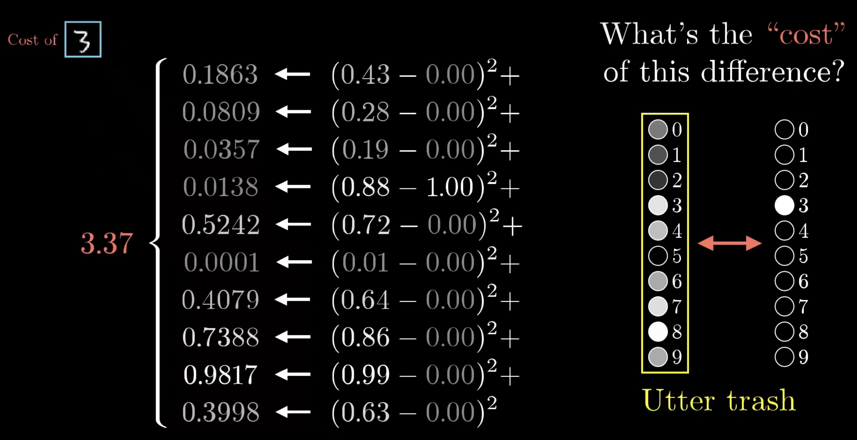
The Example
Notes:
Last time, we talk about the MNIST…
One key concept is learning to find the right weights and bias.
So what are the right means? And how can we find them?
http://yann.lecun.com/exdb/mnist/

Slide 12
The Example
Hard to compute the result directly
Notes:
Last time, we talk about the MNIST…
One key concept is learning to find the right weights and bias.
So what are the right means? And how can we find them?
http://yann.lecun.com/exdb/mnist/

Slide 13
A. Gradient Descent
Learning to minimize error

Slide 14
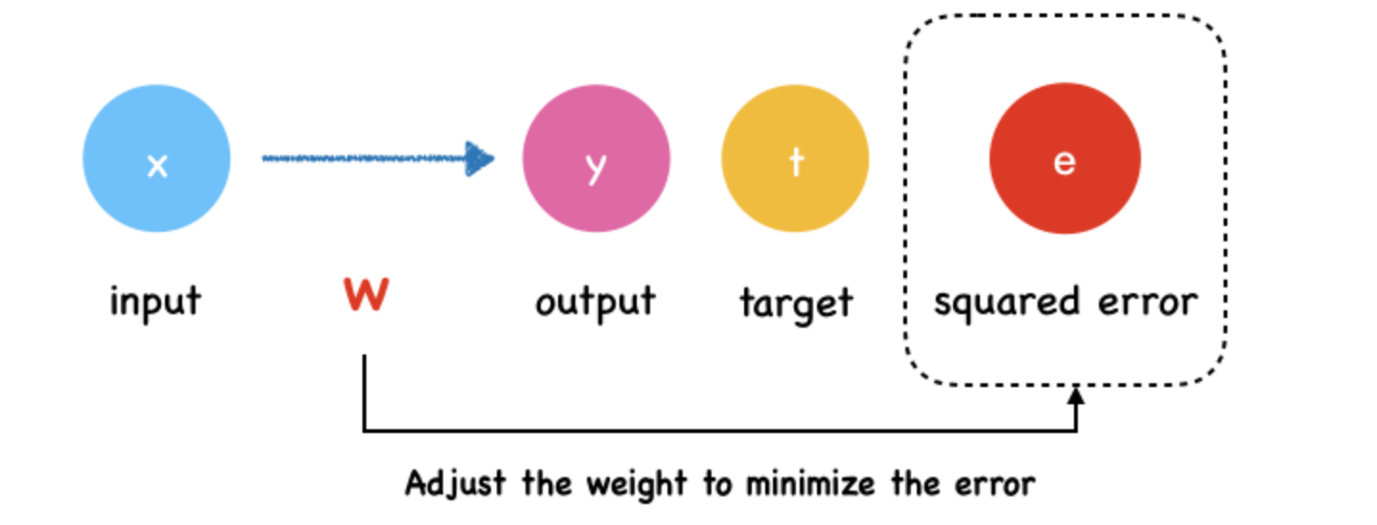
The Goal of neural network
The goal of neural network is adjust the weight to minimize the output of loss function.

Slide 15
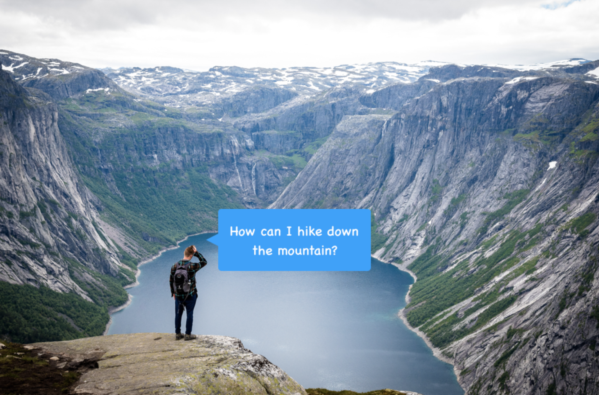
What is Gradient Descent?
The classic mountaineering example
Suppose you are at the peek of a mountain and need to reach a lake which is in the valley of the mountain.
It's on dark nights and you have zero visibility to see where you are headed. The only thing you have is a torch to see a short distance.
So, what approach will you take to reach the lake? Take a few minutes to think about this.
Notes:
Suppose you are at the peek of a mountain and need to reach a lake which is in the valley of the mountain. It's on dark nights and you have zero visibility to see where you are headed. The only thing you have is a torch to see a short distance. So, what approach will you take to reach the lake? Take a few minutes to think about this.
You may use the torch to look around the ground beneath your feet. Then you can figure out where it is going downward and take small steps in that direction. In this way, you keep following the path that is descending, step by step, you’re likely to reach the lake at the valley.

Slide 16
What is Gradient Descent?
The classic mountaineering example
You may use the torch to look around the ground beneath your feet.
Then you can figure out where it is going downward and take small steps in that direction.
In this way, you keep following the path that is descending, step by step, you’re likely to reach the lake at the valley.
Notes:
Suppose you are at the peek of a mountain and need to reach a lake which is in the valley of the mountain. It's on dark nights and you have zero visibility to see where you are headed. The only thing you have is a torch to see a short distance. So, what approach will you take to reach the lake? Take a few minutes to think about this.
You may use the torch to look around the ground beneath your feet. Then you can figure out where it is going downward and take small steps in that direction. In this way, you keep following the path that is descending, step by step, you’re likely to reach the lake at the valley.

Slide 17
Simple Example
Here we still begin with a simple neural network.
Notes:
The input layer has a input $x$ and the output layer has an output $y$. $t$ is the target value.

Slide 18
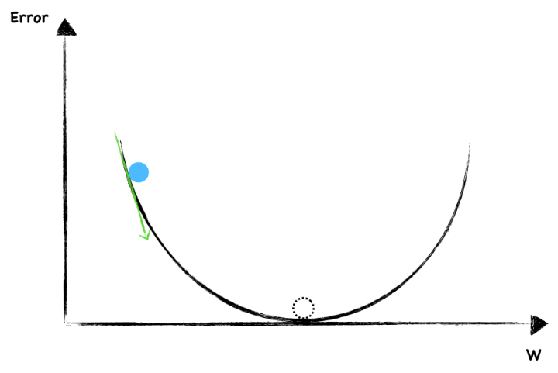
Simple Example
Say the following graph shows a function where y-axis is the error, we are going to find the right w to minimize it.

Slide 19
Simple Example
Say the following graph shows a function where y-axis is the error, we are going to find the right w to minimize it.
The dotted circle is where error equal to 0 and that's where we want to be as close as possible.

Slide 20
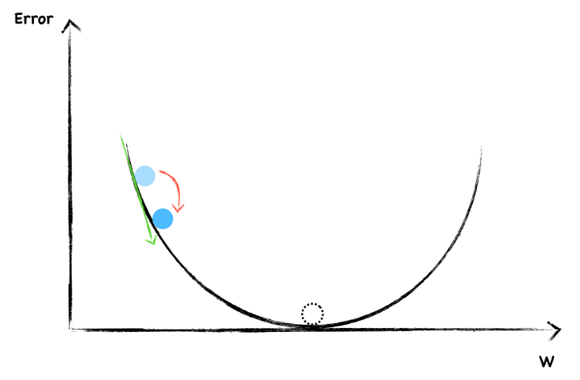
Simple Example
To start, we randomly choose a value of w. The blue dot represent current weight and error.
Now, let's look around to see which direction should we go. The slope help us to do that. This is a negative gradient, so we increase the w a little.

Slide 21
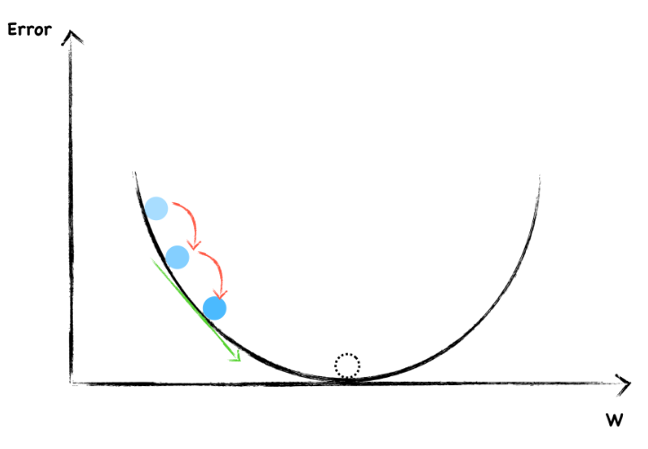
Simple Example
Again, this is a negative slope, we continue increase w.
Each time, we adjust the weight the same size step by step. In this way, if we're lucky, we're probably arrived at the bottom.

Slide 22
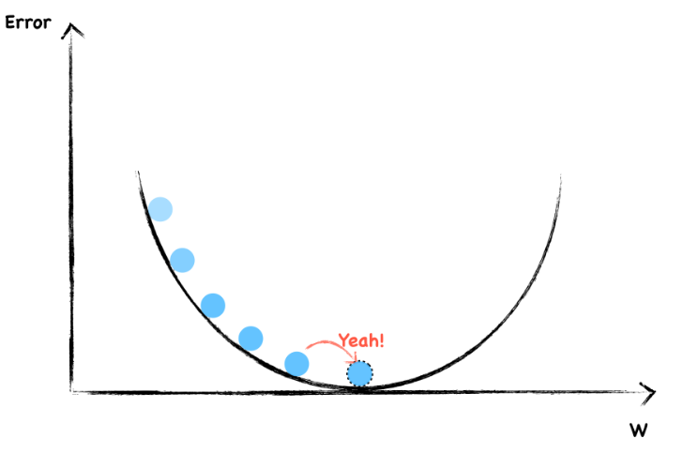
Simple Example
Each time, we adjust the weight the same size step by step. In this way, if we're lucky, we're probably arrived at the bottom.

Slide 23
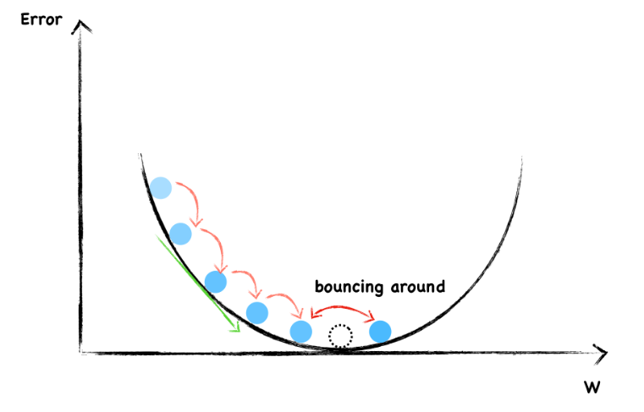
Avoid Overshooting
However, we are likely to overshooting the minimum and forever bouncing around it.
To avoid overshooting, what should we do?

Slide 24
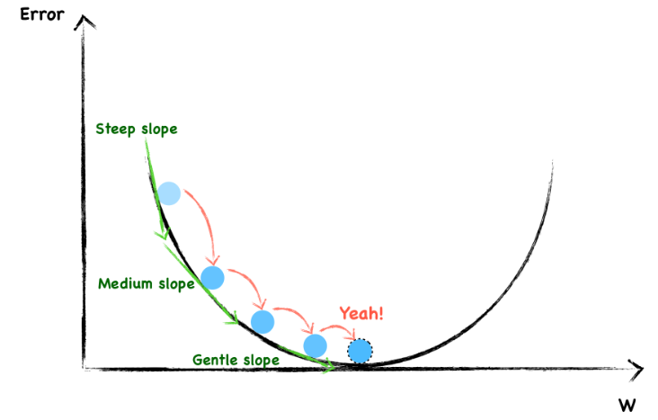
Avoid Overshooting
Well, as you can see, in order not to overshooting through the minimum, we have to take smaller and smaller step towards the end.
Notes:
You may have notice that the steeper the slope, the larger our step and the flatter the slope, the smaller our step.
On the whole, we randomly choose a weight and then changed it in a direction opposite to the gradient. Besides, as we get close to the local bottom, we change the step size according to how steep the slope is. We can use mathematical expression to express the process of weight updating each time.

Slide 25
Update Weight
On the whole, we randomly choose a weight and then changed it in a direction opposite to the gradient.
Besides, as we get close to the local bottom, we change the step size according to how steep the slope is.
Notes:
On the whole, we randomly choose a weight and then changed it in a direction opposite to the gradient. Besides, as we get close to the local bottom, we change the step size according to how steep the slope is. We can use mathematical expression to express the process of weight updating each time.

Slide 26
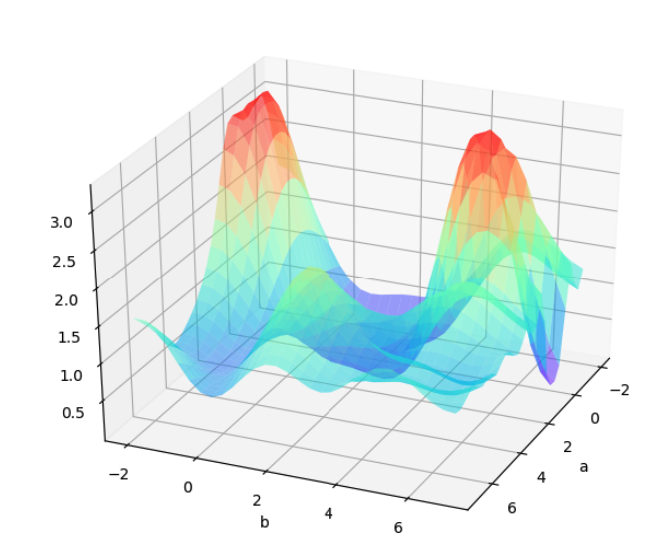
Challenges: Local Minima
For a two layers neural network with two parameters. The loss function may looks like:
Notes:
The resultant loss function doesn't look a nice bowl, with only one minima we can converge to. In fact, such nice santa-like loss functions are called convex functions (functions for which are always curving upwards) , and the loss functions for deep nets are hardly convex.

Slide 27
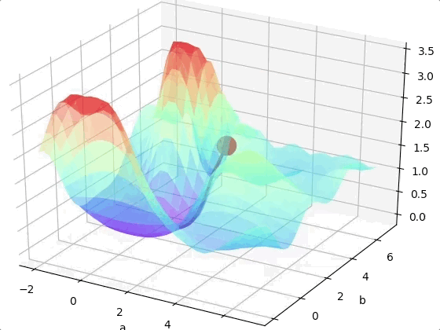
Challenges: Local Minima
If we are lucky we may reach the global minimum from a random initial point.
Click to play.
Notes:
The resultant loss function doesn't look a nice bowl, with only one minima we can converge to. In fact, such nice santa-like loss functions are called convex functions (functions for which are always curving upwards) , and the loss functions for deep nets are hardly convex.

Slide 28
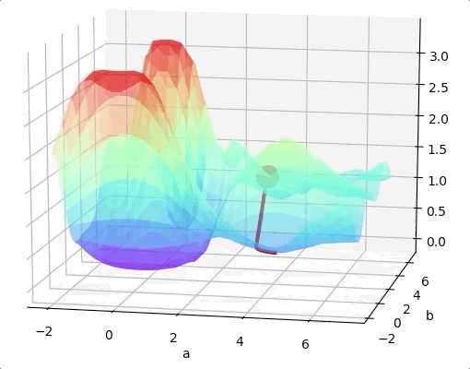
Challenges: Local Minima
However, we may come across to a local minimum.
Click to play.
Notes:
The resultant loss function doesn't look a nice bowl, with only one minima we can converge to. In fact, such nice santa-like loss functions are called convex functions (functions for which are always curving upwards) , and the loss functions for deep nets are hardly convex.

Slide 29
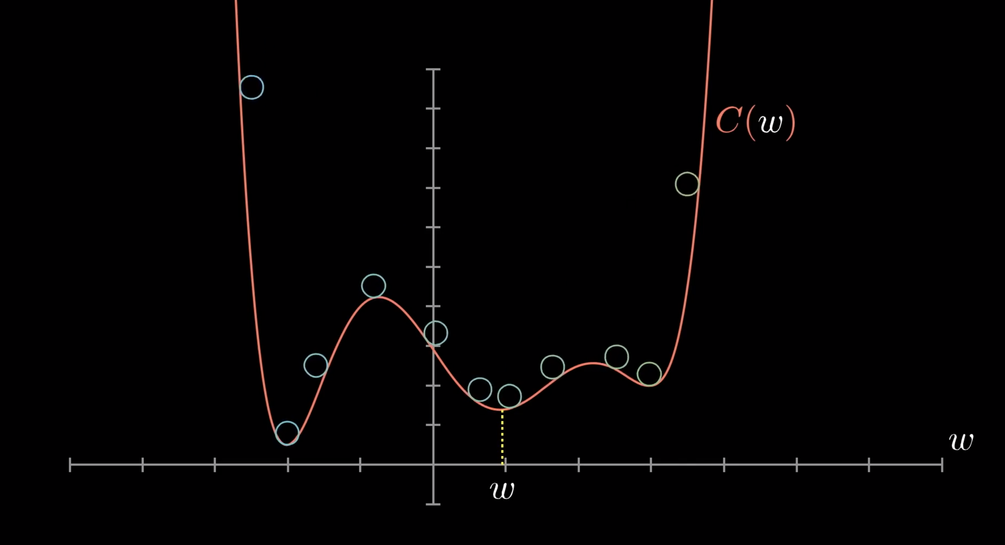
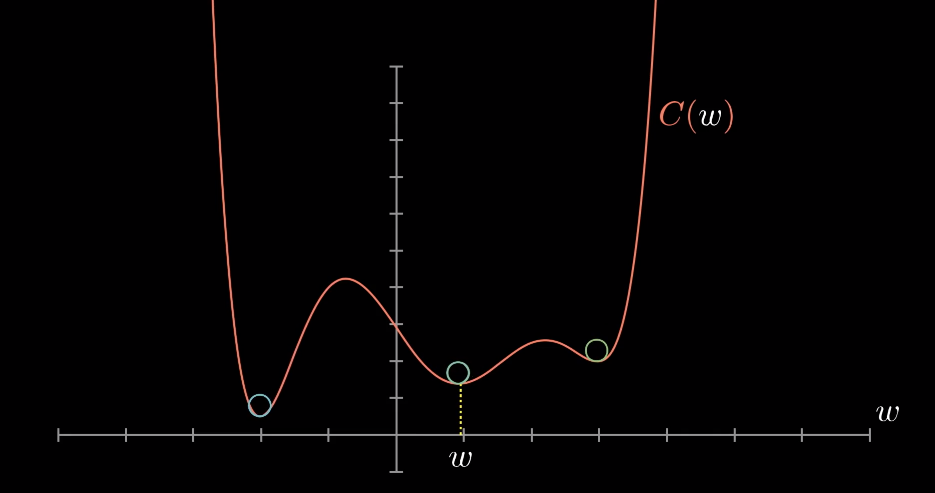
Challenges: Local Minima
One way to solve this problem is run the algorithms multiple times with different initial weights and then choose the the best minimum.
Notes:
The resultant loss function doesn't look a nice bowl, with only one minima we can converge to. In fact, such nice santa-like loss functions are called convex functions (functions for which are always curving upwards) , and the loss functions for deep nets are hardly convex.

