Slide 1
Deep Learning Basics
2: Network Structure
Francis Steen and Xinyu You
Red Hen Lab
August 2019

Slide 2
A. Perceptron
The building blocks of neural networks

Slide 3
Logic-gate neurons
The origins of Neural Networks goes back to 1943, when Warren McCulloch, a neurophysiologist, and a young mathematician, Walter Pitts, wrote a paper on how neurons might work
They proposed that neurons are binary logic gates that receive multiple inputs through their dendrites and convert these to a single output

Slide 5
Classical computationalism
In 1958, the neurobiologist Frank Rosenblatt extended this idea to form an artificial neuron, which he called a Perceptron
It aimed to replicate the function of a neuron, and make it possible to process sensed information, for instance from a camera

Slide 6
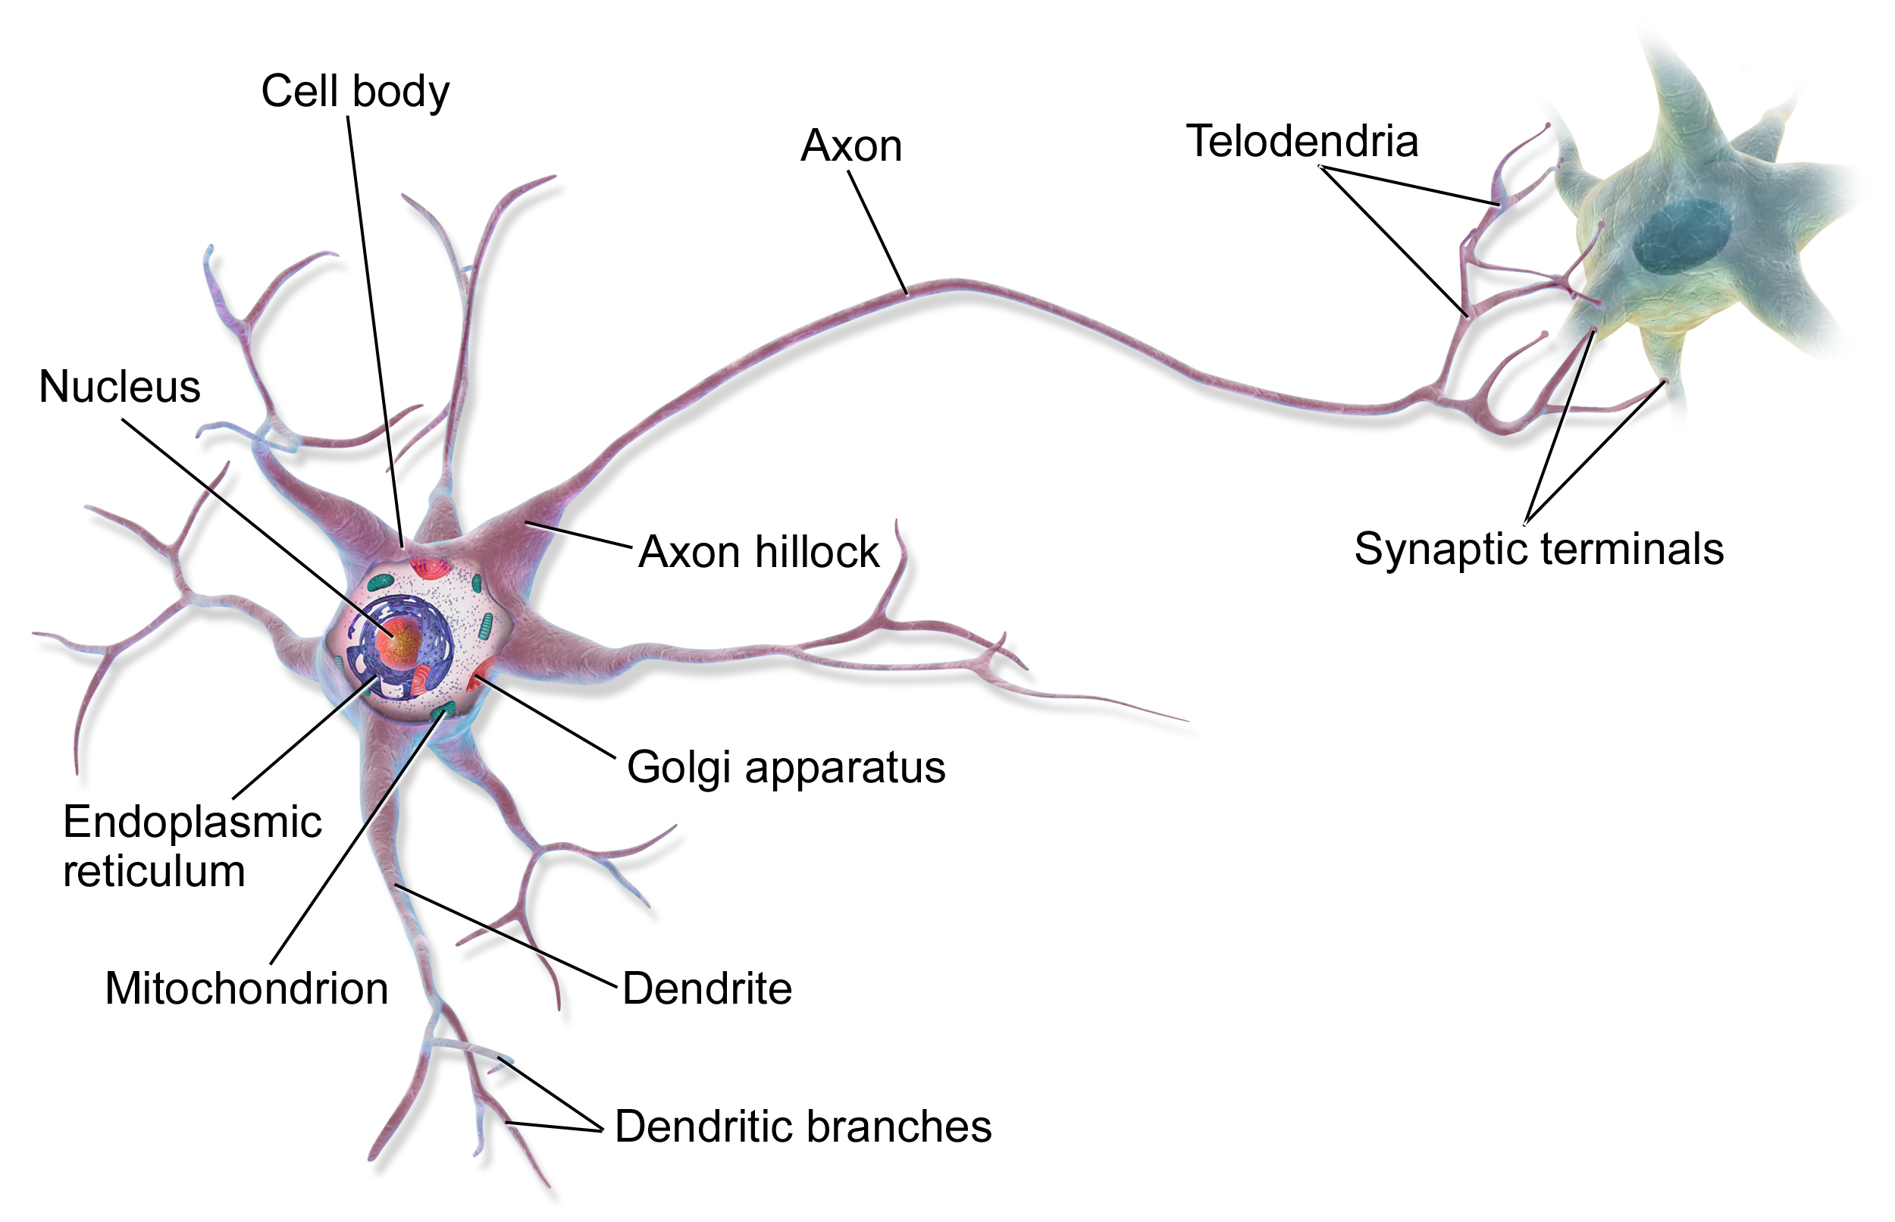
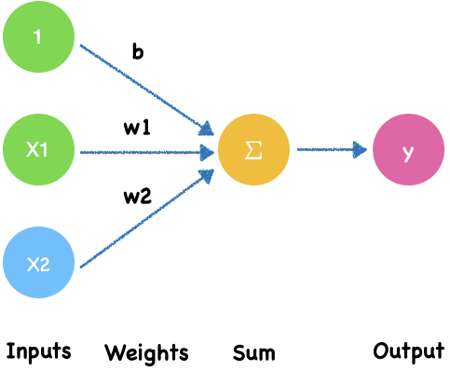
Neuron-like perceptron
Neuron
Perceptron
Notes:
https://www.nature.com/articles/d41586-018-02174-z

Slide 7
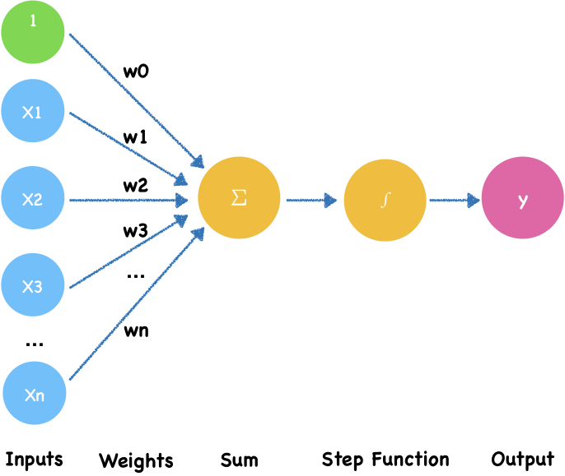
Binary perceptron
Electrical signals -> Input
Electrical signals amounts-> weights
Threshold -> Step Function
W0 is bias.
$$output=\{\begin{matrix}0∑_{i=0}^{n}w_{i}x_{i}≤threshold & \\ 1∑_{i=0}^{n}w_{i}x_{i}>threshold & \end{matrix}$$
Notes:
In a neuron, the dendrite receives electrical signals from the axons of other neurons. In the perceptron, these electrical signals are represented as numerical **input values**, $x_1,x_2, x_3,...,x_n$.
At the synapses between the dendrite and axons, electrical signals are modulated in various amounts. In the perceptron, this corresponds to each of input value is multiplied by a specific value called the **weight**, $w_0, w_1, w_2,...,w_n$.
Finally, a neuron **triggers** an output only when the total strength of the input signals exceeds a certain **threshold**.
A threshold is like the capacity of a water cup. The cup overflows only when it is filled. It's because neurons don't want to transmit small interfering signals, only strong ones do.
This is simulated by calculating the weighted **sum of the inputs**, $ z = w_0 + w_1x_1 + w_2x_2 + ... + w_nx_n$, and applying a **step function** $f(z)$ on the sum to determine its output $y$.

Slide 8
Binary perceptron
Here W0 is a bias.
It’s a parameter that adjusts how easily a neuron is activated.
It's like wearing flat or high-heeled shoes to achieve a certain height.
For example, you want to look taller. You can take calcium or do stretches. What bias does here is like wearing high-healed shoes.
$$output=\{\begin{matrix}0∑_{i=0}^{n}w_{i}x_{i}≤threshold & \\ 1∑_{i=0}^{n}w_{i}x_{i}>threshold & \end{matrix}$$
Notes:
In a neuron, the dendrite receives electrical signals from the axons of other neurons. In the perceptron, these electrical signals are represented as numerical **input values**, $x_1,x_2, x_3,...,x_n$.
At the synapses between the dendrite and axons, electrical signals are modulated in various amounts. In the perceptron, this corresponds to each of input value is multiplied by a specific value called the **weight**, $w_0, w_1, w_2,...,w_n$.
Finally, a neuron **triggers** an output only when the total strength of the input signals exceeds a certain **threshold**.
A threshold is like the capacity of a water cup. The cup overflows only when it is filled. It's because neurons don't want to transmit small interfering signals, only strong ones do.
This is simulated by calculating the weighted **sum of the inputs**, $ z = w_0 + w_1x_1 + w_2x_2 + ... + w_nx_n$, and applying a **step function** $f(z)$ on the sum to determine its output $y$.

Slide 9
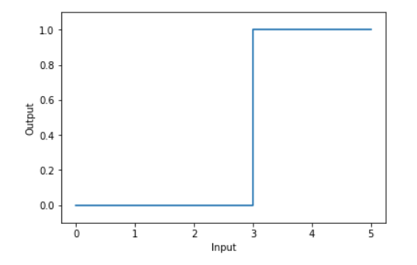
Step Function
threshold = 3
$$output=\{\begin{matrix}0∑_{i=0}^{n}w_{i}x_{i}≤threshold & \\ 1∑_{i=0}^{n}w_{i}x_{i}>threshold & \end{matrix}$$
Notes:
https://www.desmos.com/calculator/oq4vwcjltg

Slide 10
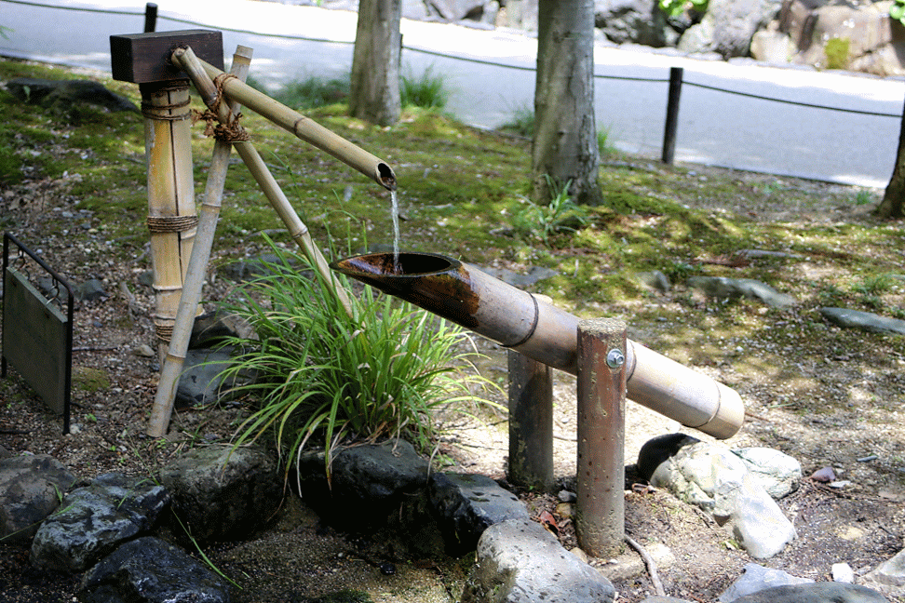
Imagine a leaky boar fountain

Slide 11
A boar fountain step function
A shishi-odoshi (scareboar) or Indonesian boar fountain is used to scare away boar
In Chinese it’s called a 竹筒敲石 or "knocking stone with bamboo drum"
Imagine a leaky one. If the input is too little to tip it over, it just leaks out. If it’s enough, it tips over and makes a loud noise.

Slide 12
Sigmoid neuron

Slide 13
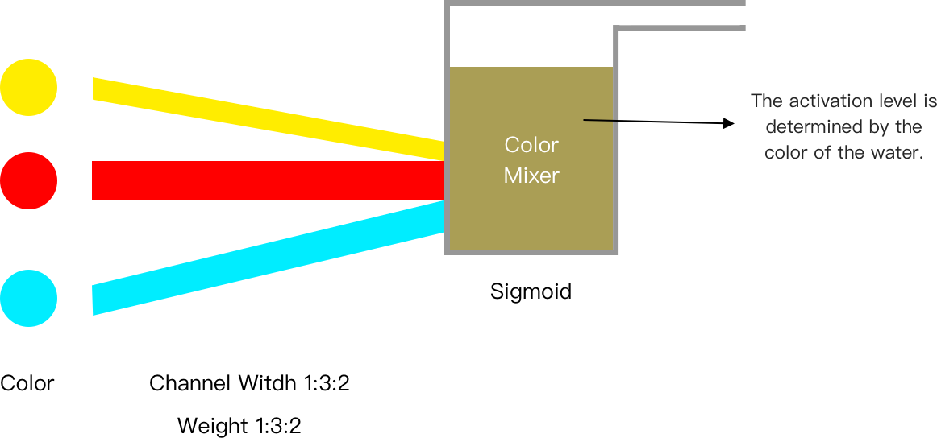
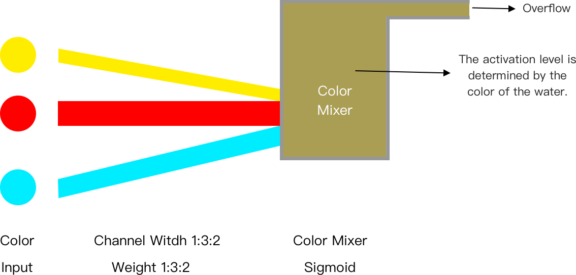
Color Factory
Colored liquids
Colored liquids
Notes:
The image conveys the idea that each input neuron contributes some proportion to the target neuron in the hidden layer. Colored liquids mix by proportion. The extra water overflows; as long as the water is mixed before it overflows, the sigmoid function is respected. In fact this image makes something more clear than the explanation of the sigmoid function itself -- that the proportional contribution from each input cell is retained in the resulting activation level. So we could imagine the colored waters coming in at the bottom of the target neuron, mixing, and then some portion of the mixed water overflows. The activation level is determined by the color of the water.

Slide 14
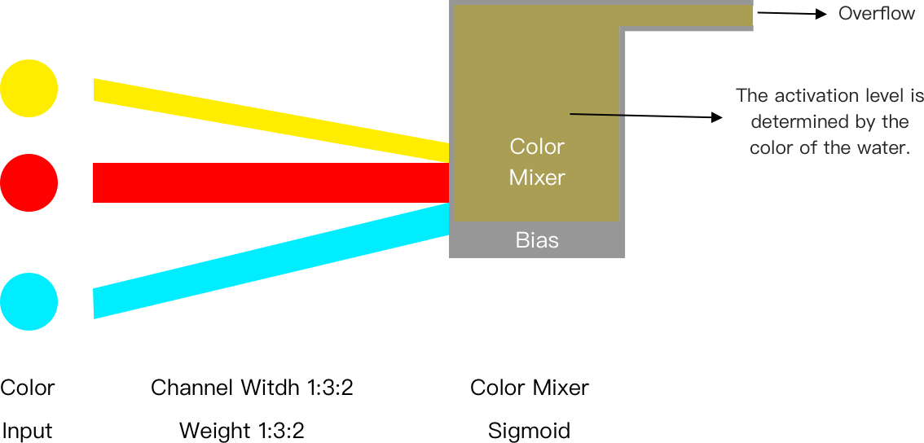
Color Factory
With lager bias, it will be easier to overflow the mixer.

Slide 15
Neurons are more powerful
A door to new forms of AI
Real neurons are far more complex than the perceptron model
Neuroscience studies suggest a powerful information processing capacity within a single neuron, possibly even face recognition
The ability of single neurons to perform complex tasks indicates that the neuron contains far more internal structure than the perceptron model suggests
A deeper understanding of how neurons process information can lead to new forms of AI
Notes:
https://www.nature.com/articles/d41586-018-02174-z

Slide 16
B. Neural Network
Multilayer networks of perceptrons

Slide 17
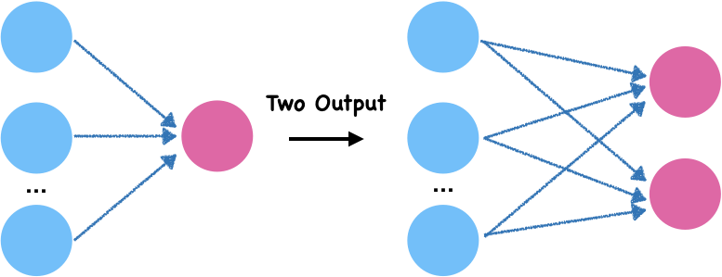
Perceptron networks
Many-to-one and many-to-many connections

Slide 18
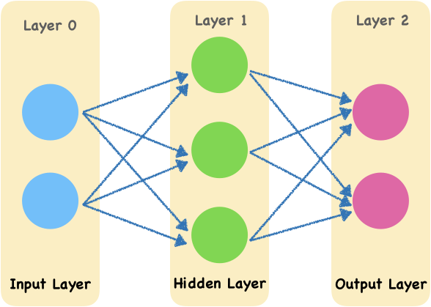
Multilayer perceptron
Multilayer perceptron also named deep feedforward networks.
It adds hidden layers to the previous perceptron.
Notes:
Diagram 3.1 shows an example neural network. To keep the diagram clear, all the weights are unmarked. The leftmost layer 0 is the input layer. The rightmost layer 2 is the output layer. The middle layer 1 is called hidden layer. Here the input layer and output layer have 2 nodes and the hidden layer has 3 nodes. Although there are three layers, only two of them has weight, so we call this network as a two-layer network.

Slide 19
Multilayer perceptron
The leftmost layer 0 is the input layer.
The rightmost layer 2 is the output layer.
The middle layer 1 is called hidden layer.
Here the input layer and output layer have 2 nodes and the hidden layer has 3 nodes.
Although there are three layers, only two of them has weight, so we call this network as a two-layer network.
Notes:
Diagram 3.1 shows an example neural network. To keep the diagram clear, all the weights are unmarked. The leftmost layer 0 is the input layer. The rightmost layer 2 is the output layer. The middle layer 1 is called hidden layer. Here the input layer and output layer have 2 nodes and the hidden layer has 3 nodes. Although there are three layers, only two of them has weight, so we call this network as a two-layer network.

Slide 20
Multilayer perceptron
Animation Process
Layer 0
Layer 1
Layer 2
Input Layer
Hidden Layer
Output Layer

Slide 21
Why is the middle layer called a hidden layer?
The data of the input layer and output layer are strictly observable, while the data value of the hidden layer is learned by the model.
Therefore, we cannot see them in advance. They are "hidden" for us.
Notes:
image source
http://scrummable.com/wp-content/uploads/2017/06/wood-for-trees-1.gif

Slide 22
Activation functions
Space wizard
What is an activation function?
We call the function that takes all the inputs to transform an output the activation function
Notes:
The activation function of the neural network is a group of spatial wizards that twist and flip feature Spaces to find linear boundaries.
Ref:
https://towardsdatascience.com/hyper-parameters-in-action-a524bf5bf1c
https://www.zhihu.com/question/22334626/answer/465380541

Slide 23
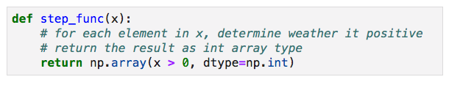
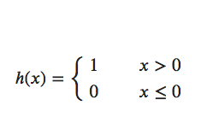
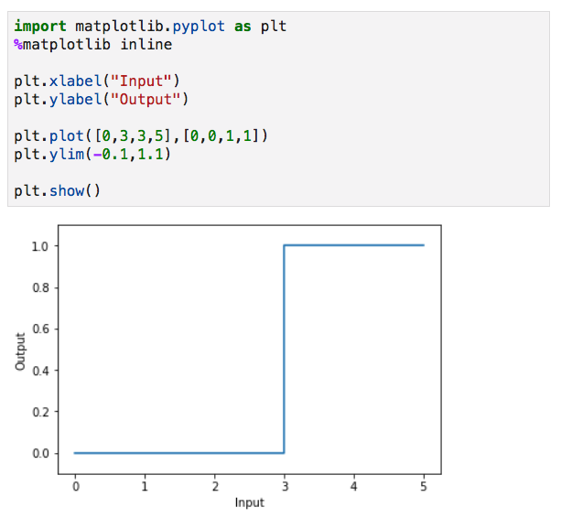
Commonly used activation functions
Step Function
The definition of step function is:
Step is a guy who likes to bounce around and often has a poor performance
Notes:
image:https://towardsdatascience.com/hyper-parameters-in-action-a524bf5bf1c

Slide 24
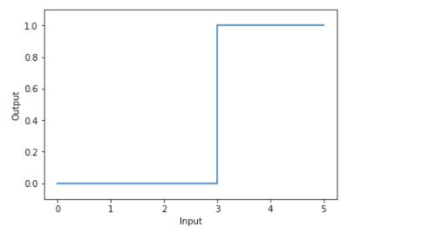
Step Function
Step function works like a leaky shishi-odoshi（竹筒敲石）. It’s a type of water fountain used in Japanese gardens. It consists of a segmented tube, usually of bamboo, pivoted to one side of its balance point. At rest, its heavier end is down and resting against a rock.
竹筒敲石是日本的一种庭院设施。支点架起竹筒，一端下方置石，另一端切口上翘。在切口上滴水， 水积多后该端下垂，水流出，另一端翘起，之后又因重力而落下，击石发出响声。
Notes:
You fill some water into it, but it's not enough to trigger a movement. It just leaks out. then you fill enough water and it moves.
Source:
https://en.wikipedia.org/wiki/Shishi-odoshi
https://upload.wikimedia.org/wikipedia/commons/4/41/Higashiyama_Botanical_Garden_Shishiodoshi_20170617.gif

Slide 25
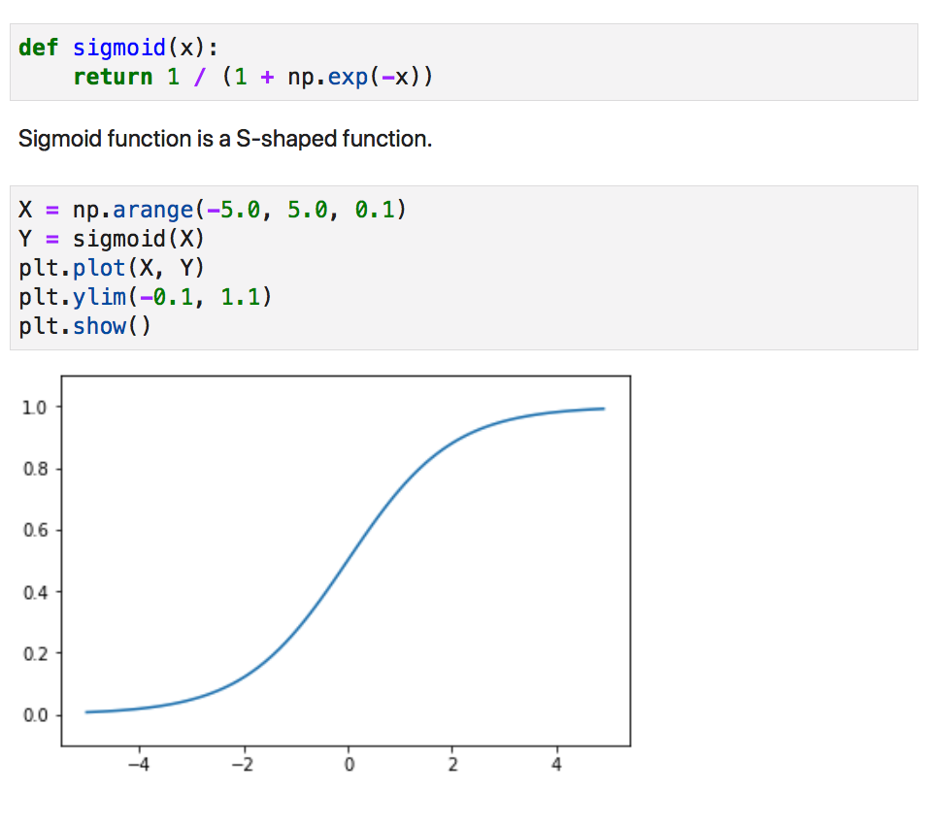
Commonly used activation functions
Sigmoid Function
The definition of sigmoid function is:
$$h(x)=\frac{1}{1+e^{-x}}$$
Sigmoid, a grandmother,
the most senior of the activate functions.
Notes:
image:https://towardsdatascience.com/hyper-parameters-in-action-a524bf5bf1c

Slide 26
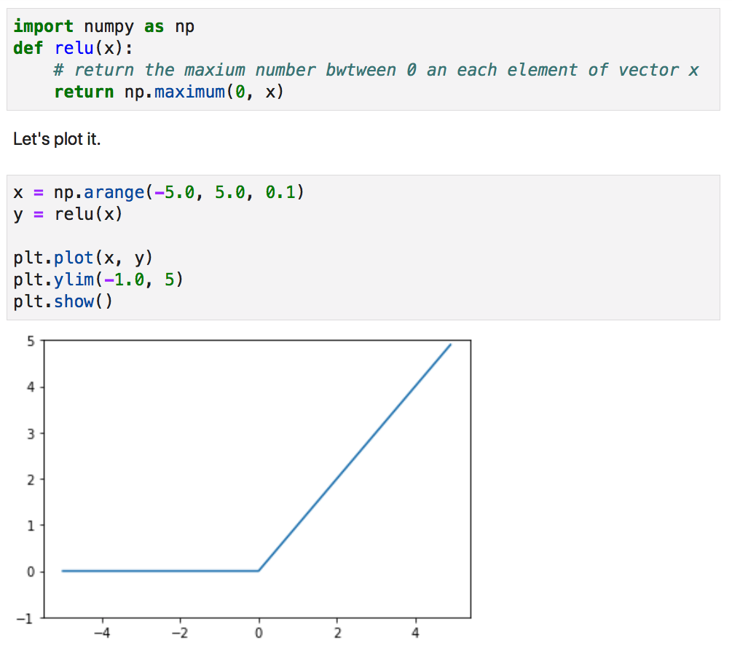
Commonly used activation functions
ReLU Function
The definition of ReLU(rectified linear unit) function is:
$$h(x)=max(x,0)$$
ReLU is a gatekeeper.
Muggles are shut out.
Notes:
image:https://towardsdatascience.com/hyper-parameters-in-action-a524bf5bf1c

Slide 27
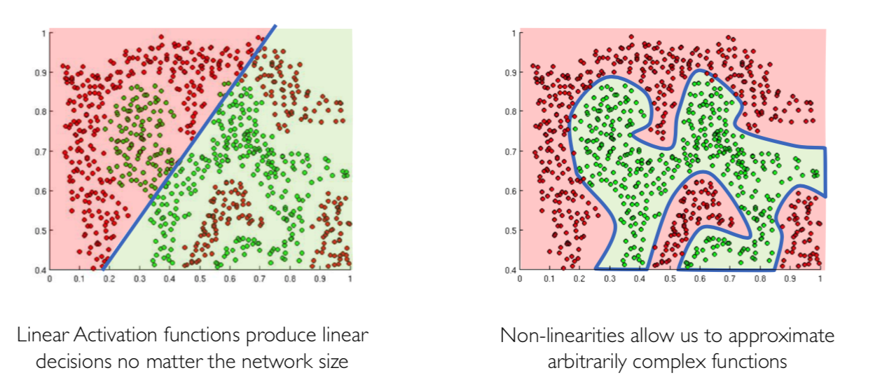
Why must the activation function be non-linear?
All the activation functions we introduced are non-linear functions
Why? Generally speaking, the purpose of activation function is to introduce non-linearities into the network

Slide 28
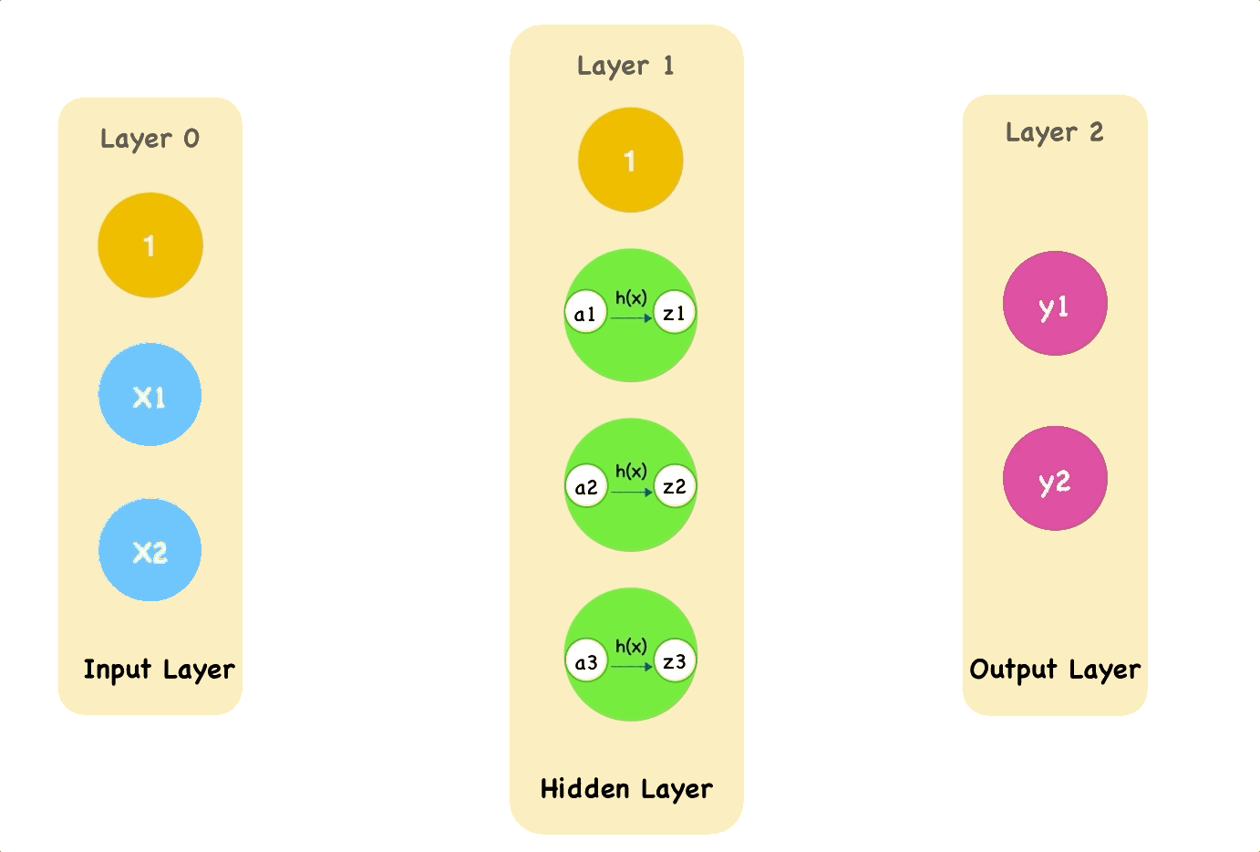
Forward Propagation
This animation shows how the single pass through the network with an activate function h(x):

Slide 29
C. Network Structure
Forward propagation by weights and biases

Slide 30
Example: Handwritten Digits Recognition
The MNIST database of handwritten digits has a training set of 60,000 examples, and a test set of 10,000 examples.
The digits have been size-normalized and centered in a fixed-size image.
Notes:
http://yann.lecun.com/exdb/mnist/

Slide 31
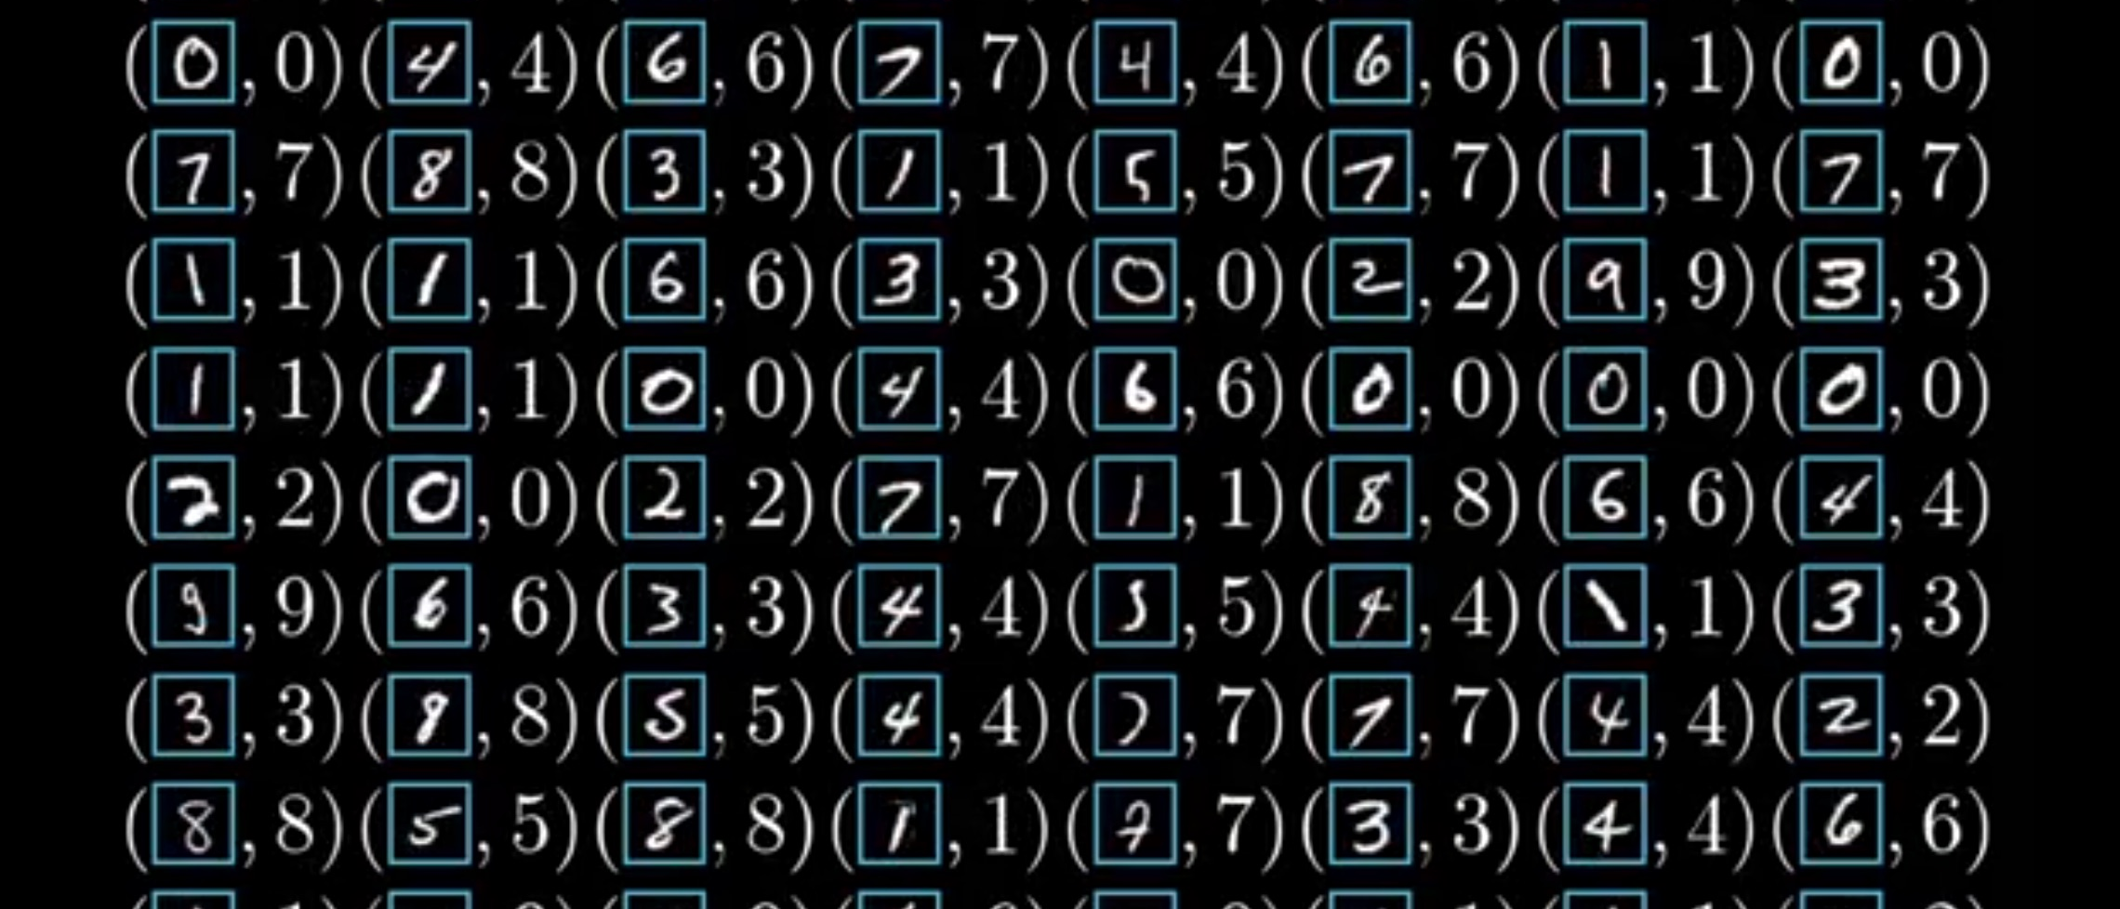
Annotated Handwritten Digits Dataset
The MNIST database of handwritten digits has a training set of 60,000 examples, and a test set of 10,000 examples.
The digits have been size-normalized and centered in a fixed-size image.
Notes:
http://yann.lecun.com/exdb/mnist/

Slide 32


Slide 33
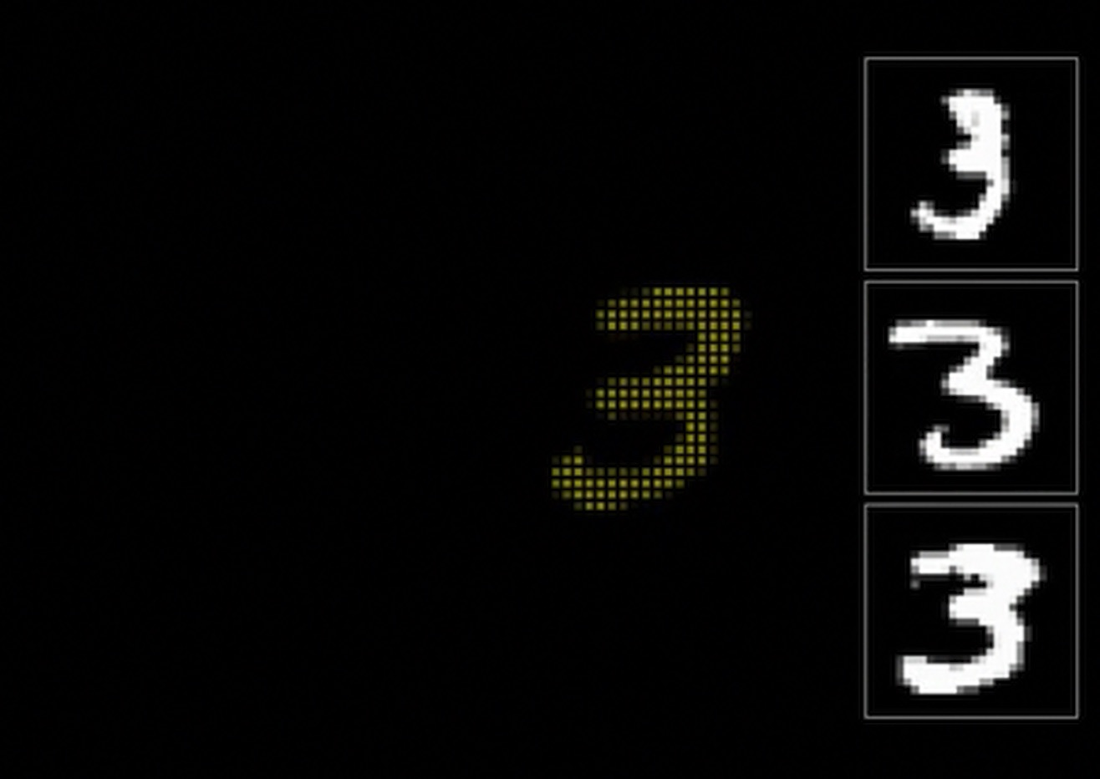

Slide 34
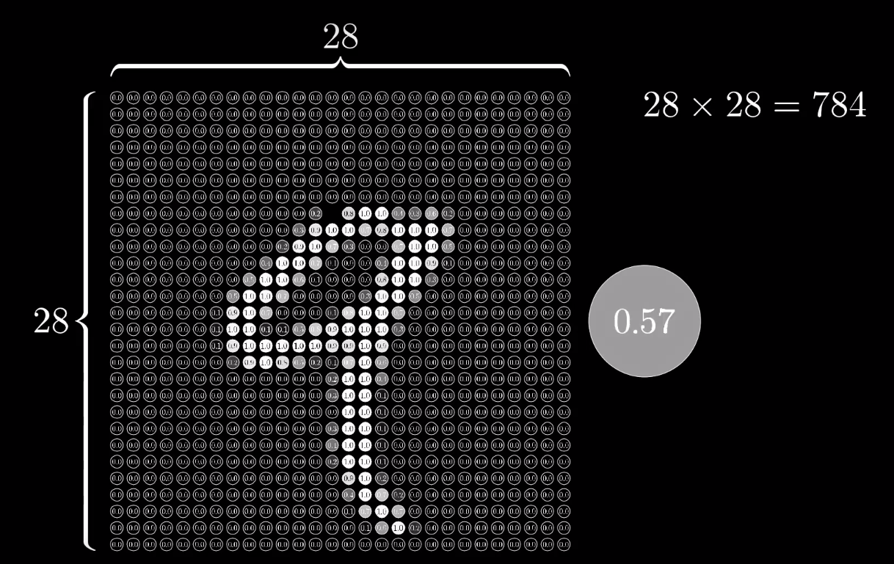
Pixel
Notes:
http://yann.lecun.com/exdb/mnist/

Slide 35
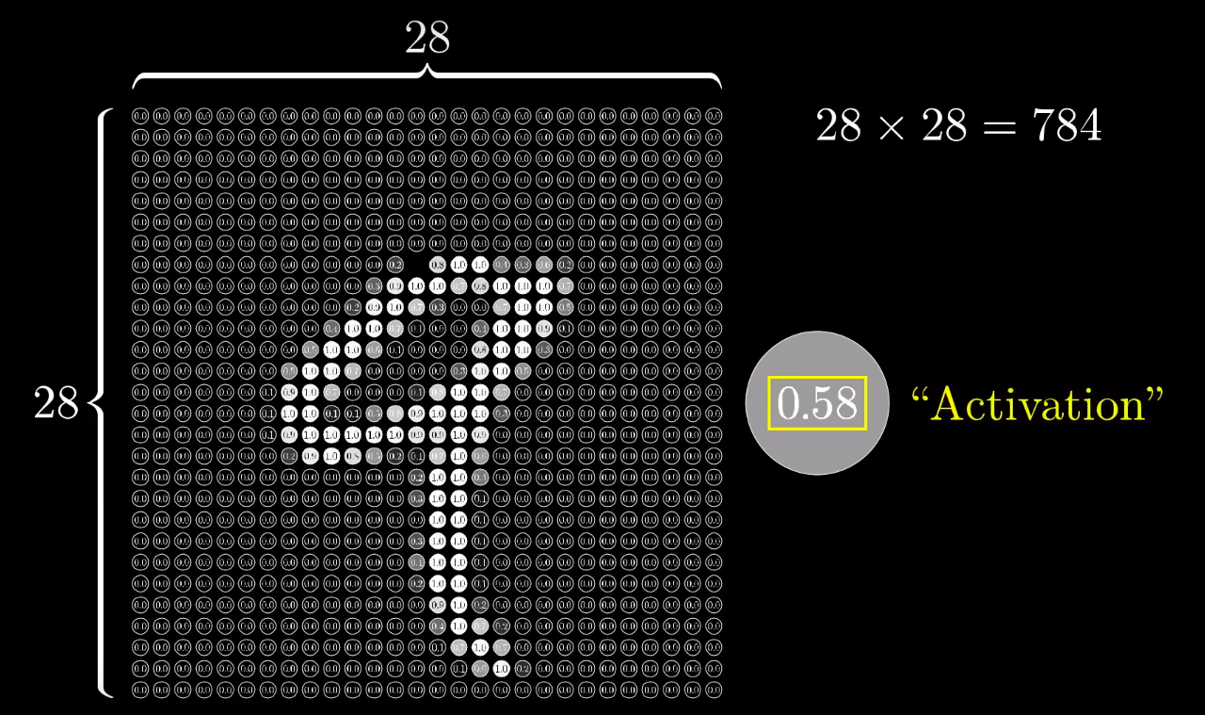
Pixel
Notes:
http://yann.lecun.com/exdb/mnist/

Slide 36
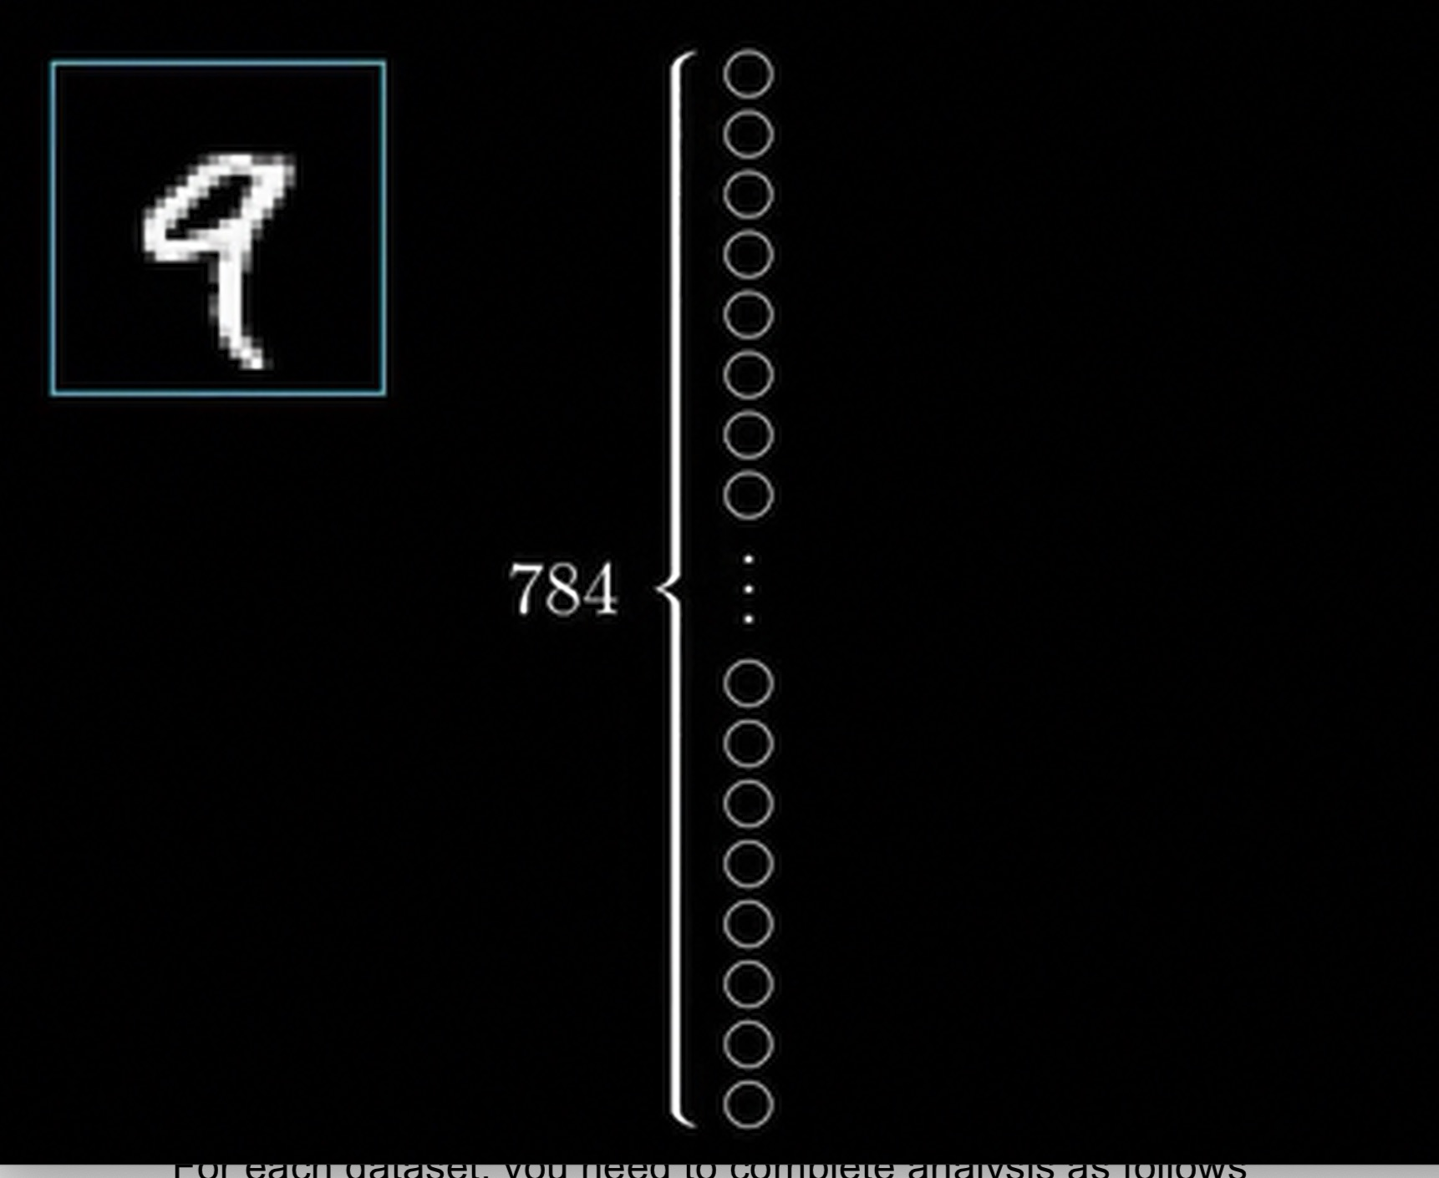

Slide 37
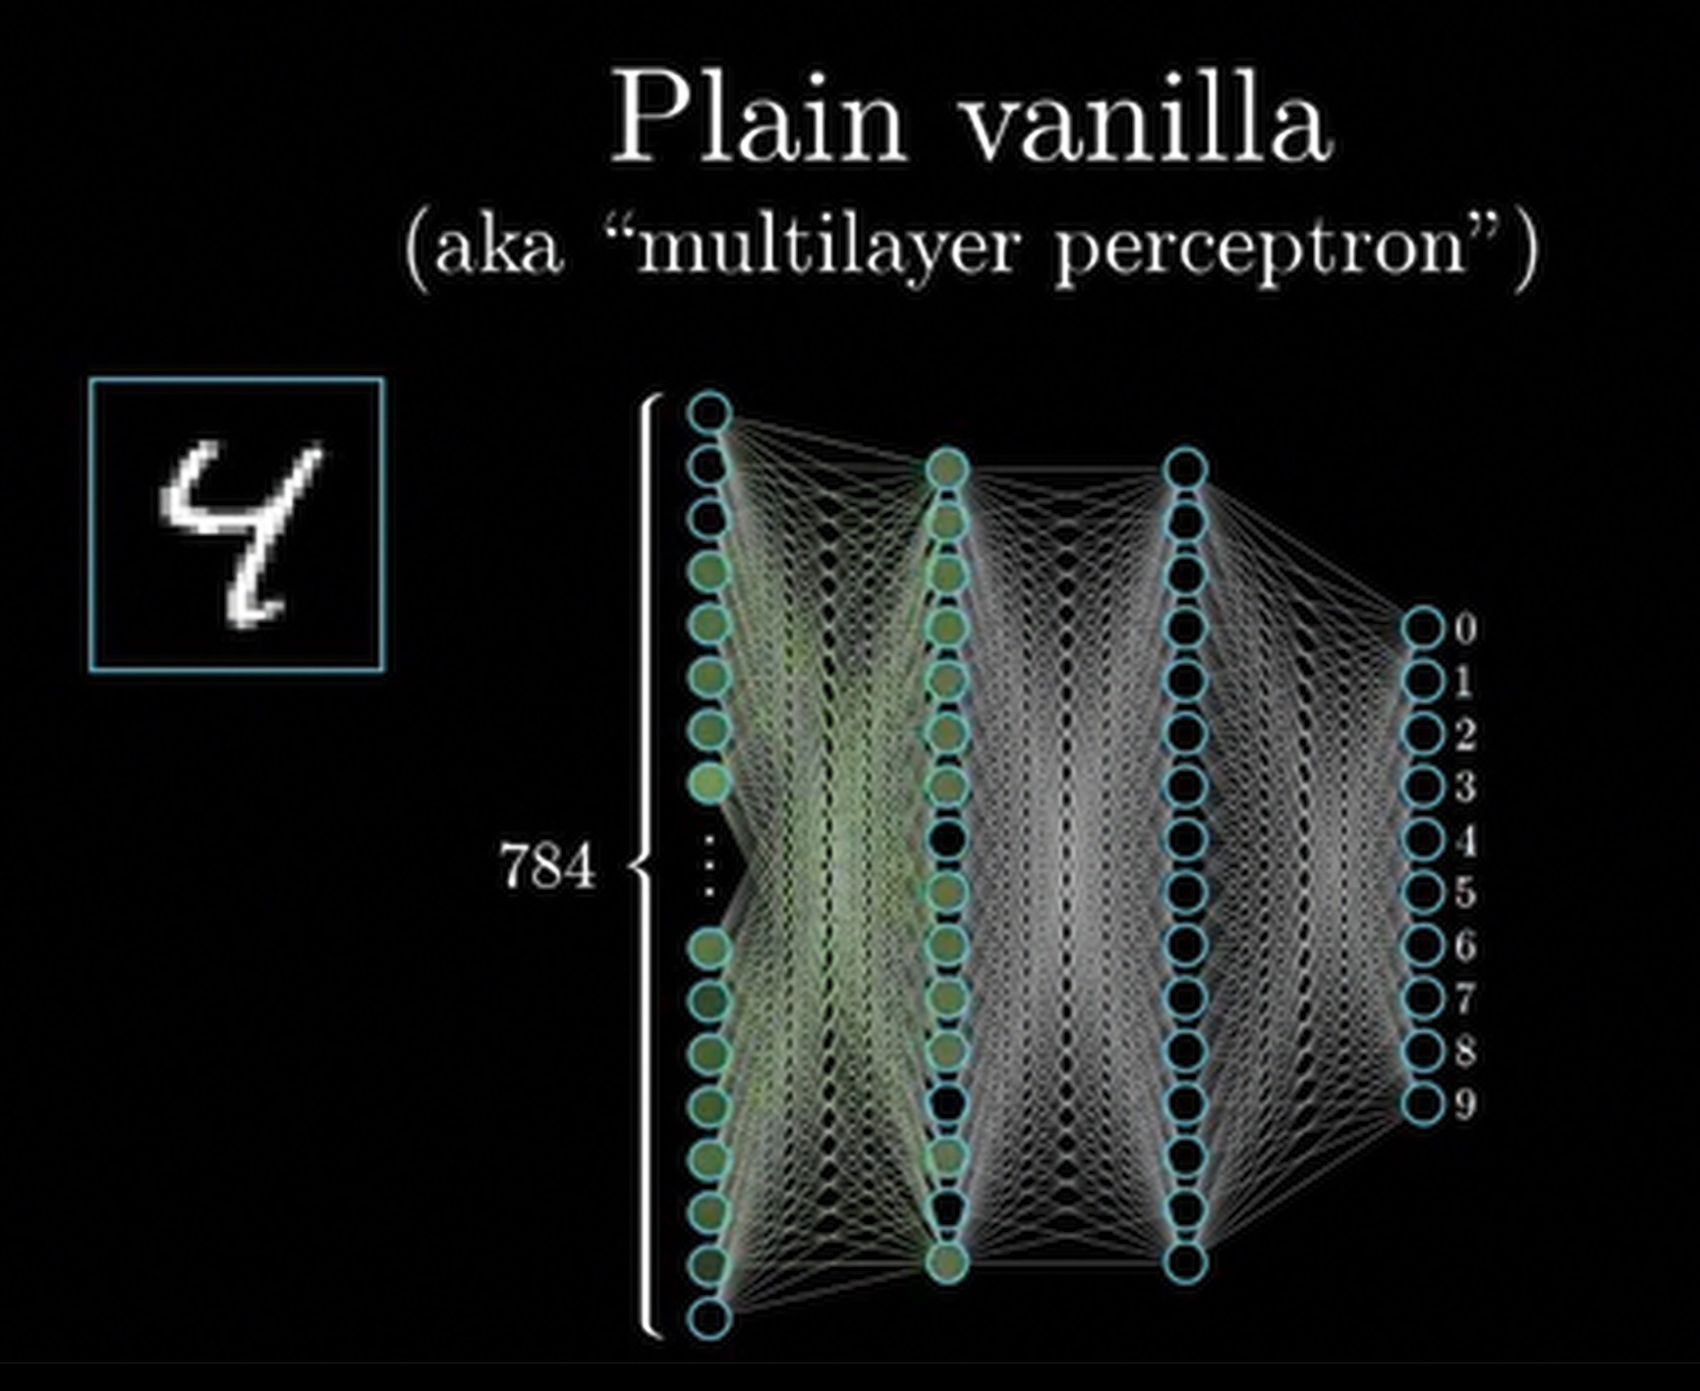

Slide 38
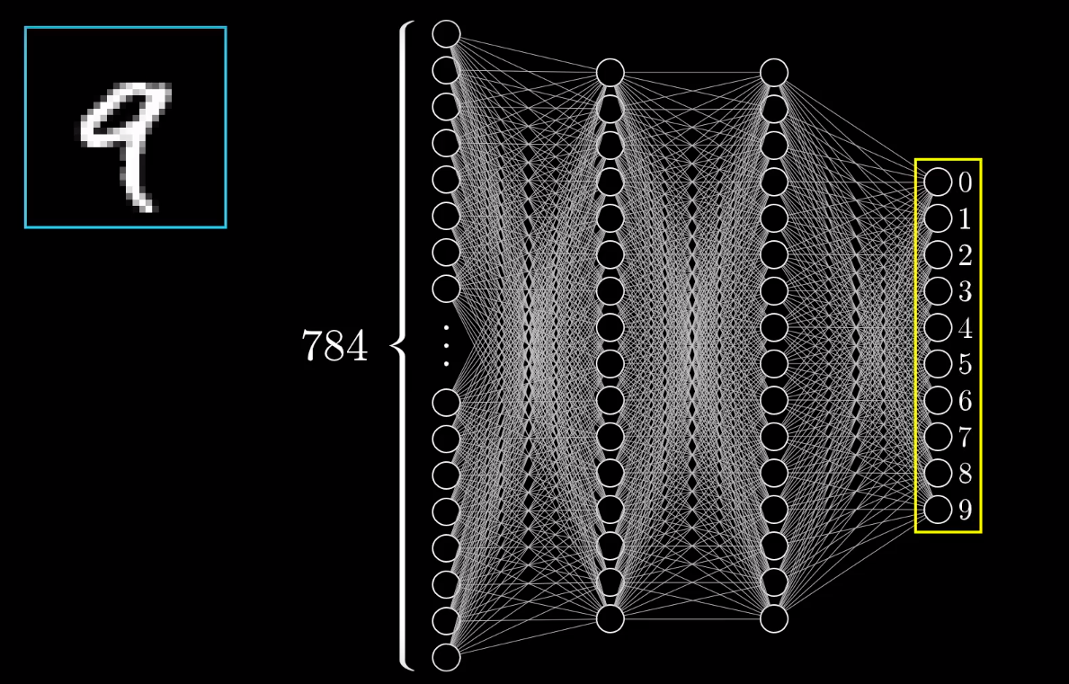
Example: Handwritten Digits Recognition
Output Layer
Notes:
http://yann.lecun.com/exdb/mnist/

Slide 39
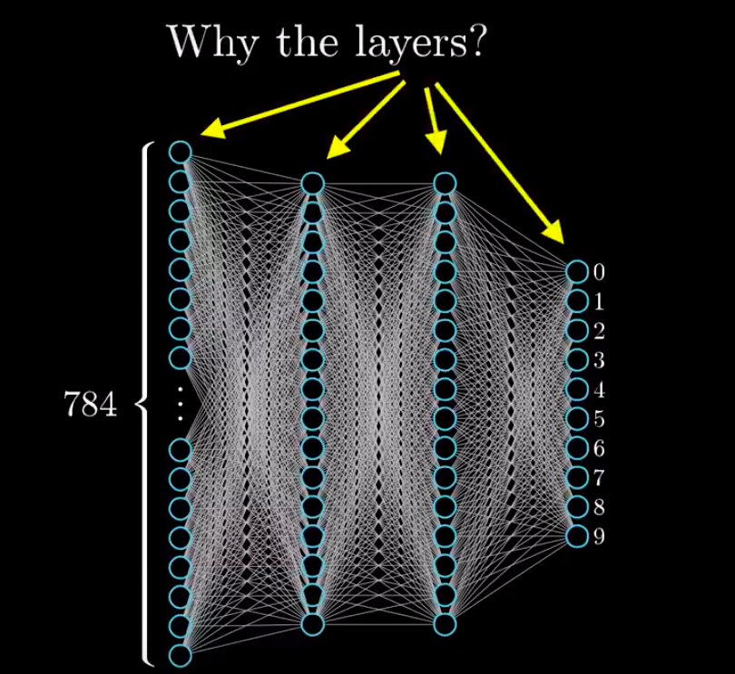
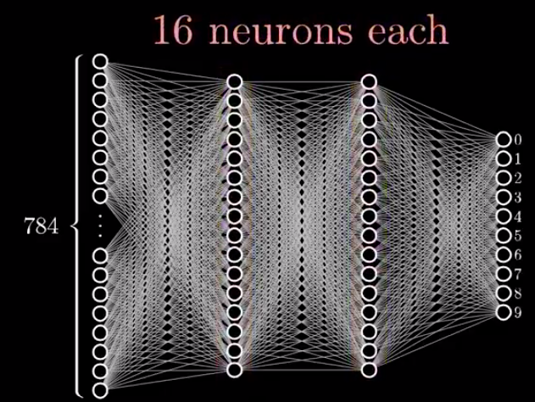
Example: Handwritten Digits Recognition
Why the Layers?
Notes:
http://yann.lecun.com/exdb/mnist/

Slide 40
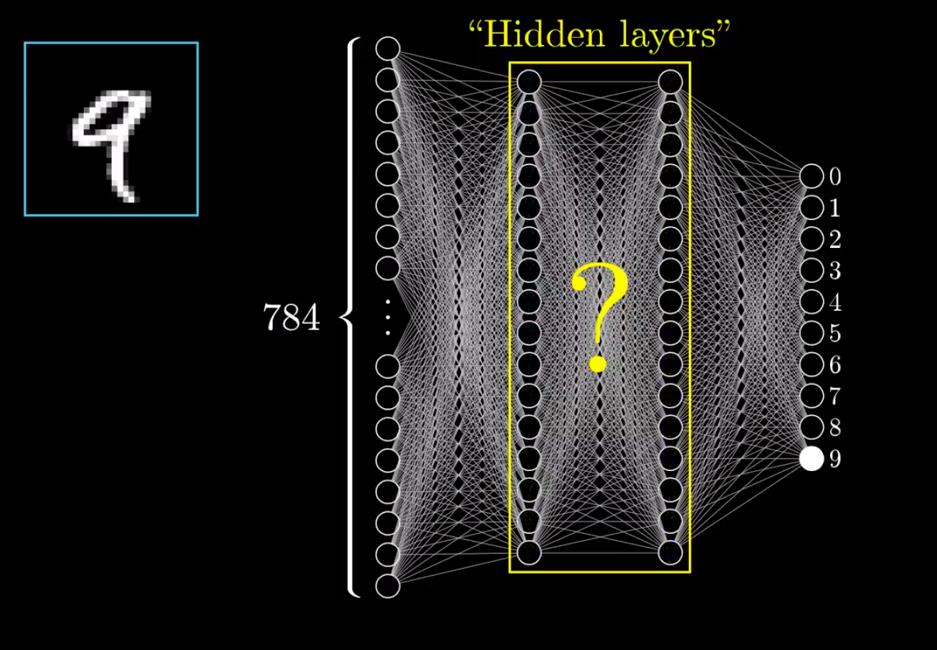
Example: Handwritten Digits Recognition
Hidden Layers
Notes:
http://yann.lecun.com/exdb/mnist/

Slide 41
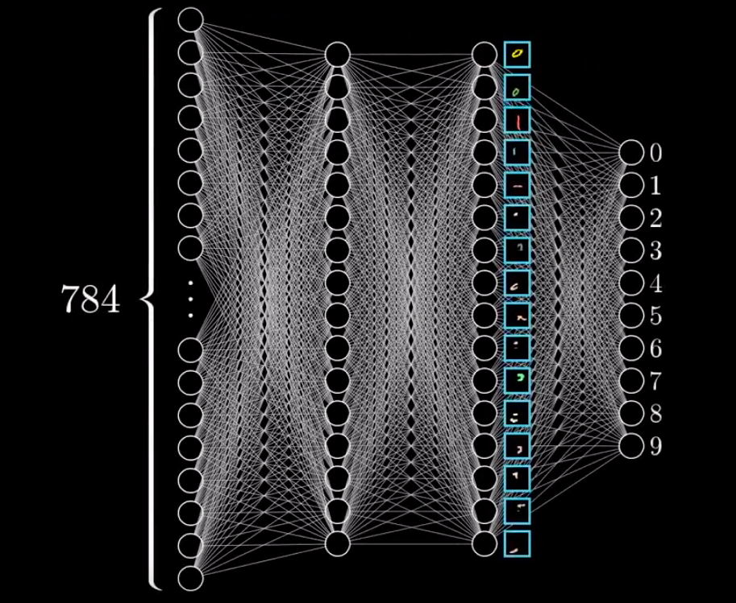
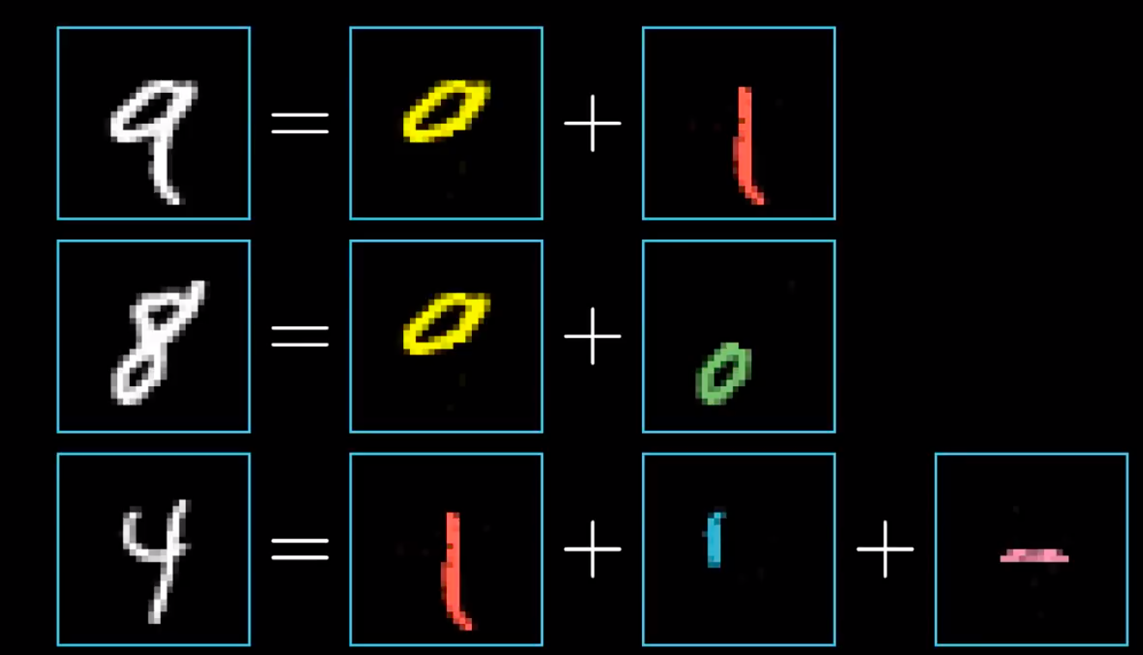
Example: Handwritten Digits Recognition
Why the Layers?
Notes:
http://yann.lecun.com/exdb/mnist/

Slide 42
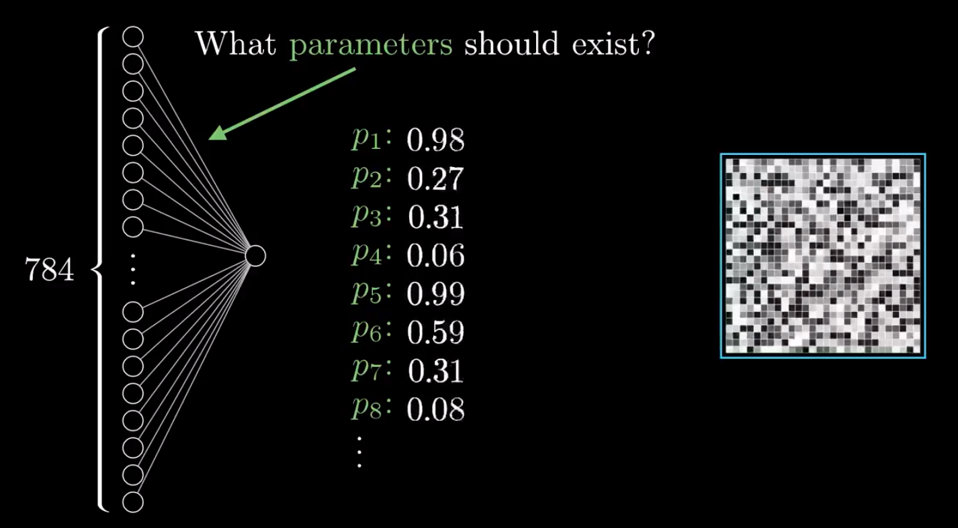
Example: Handwritten Digits Recognition
Active
Notes:
http://yann.lecun.com/exdb/mnist/

Slide 43
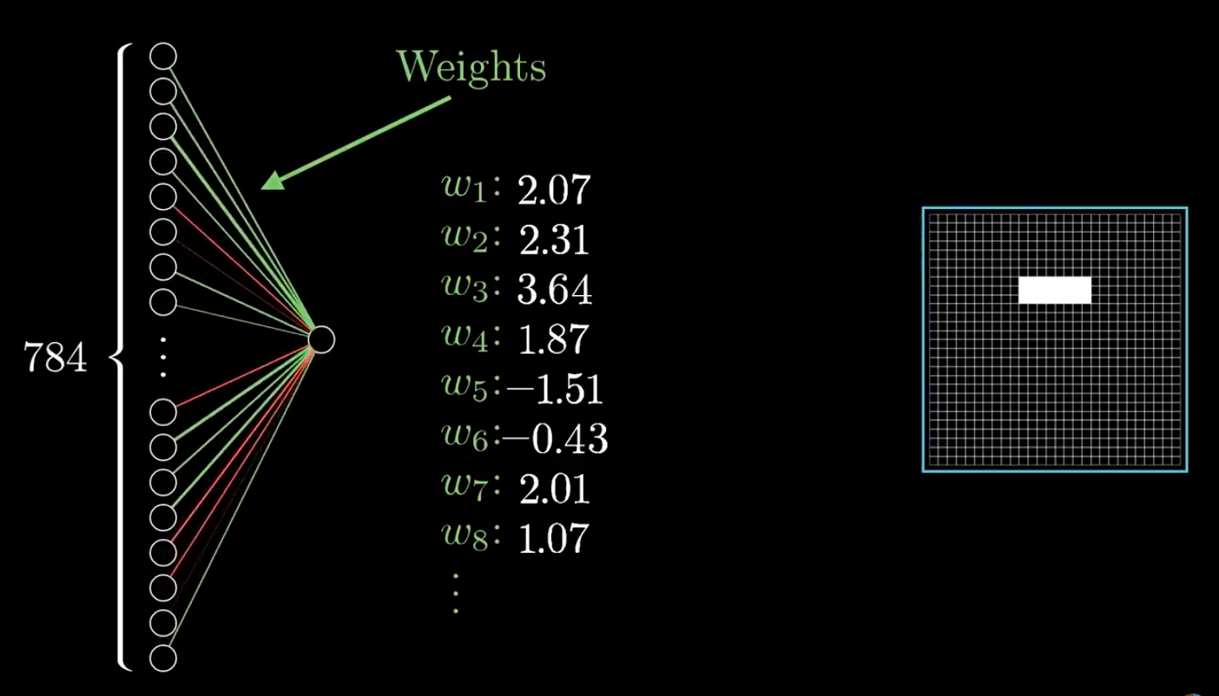
Example: Handwritten Digits Recognition
Active
Notes:
http://yann.lecun.com/exdb/mnist/

Slide 44
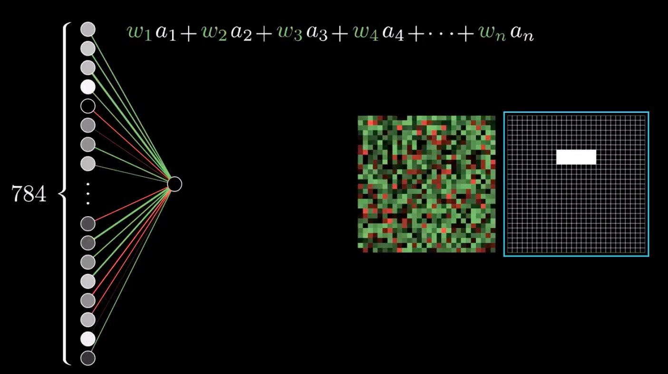
Example: Handwritten Digits Recognition
Active
Notes:
http://yann.lecun.com/exdb/mnist/

Slide 45
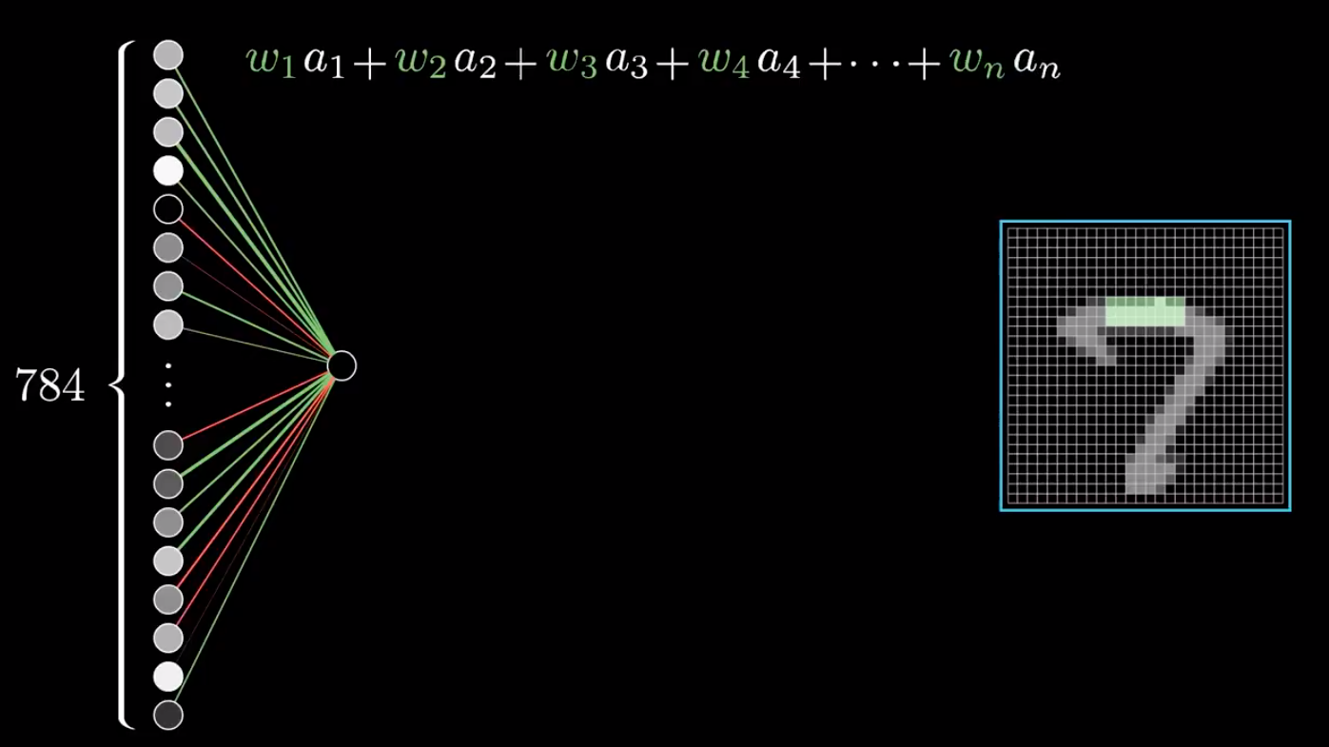
Example: Handwritten Digits Recognition
Active
Notes:
http://yann.lecun.com/exdb/mnist/

Slide 46
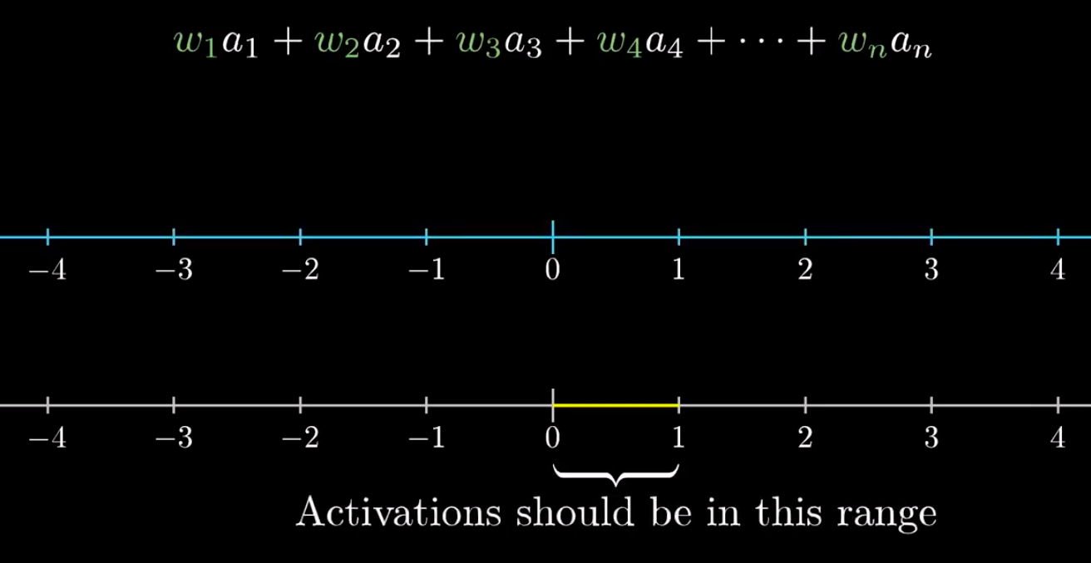
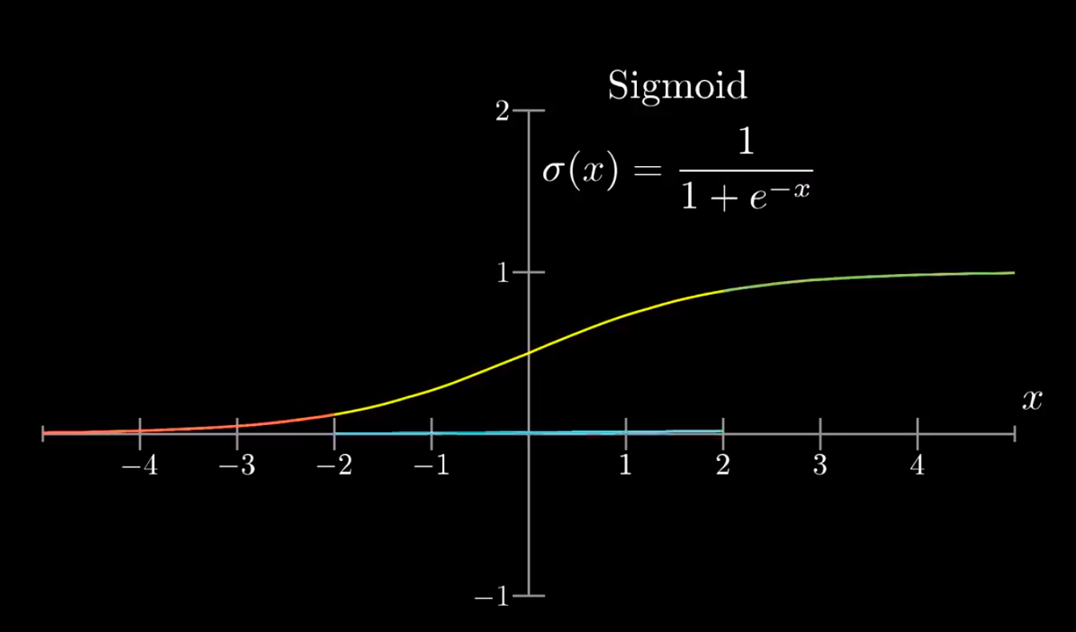
Example: Handwritten Digits Recognition
Notes:
http://yann.lecun.com/exdb/mnist/

Slide 47
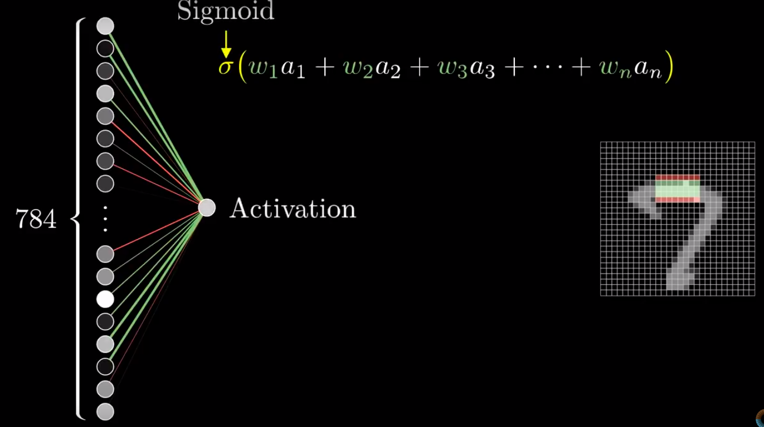
Example: Handwritten Digits Recognition
Notes:
http://yann.lecun.com/exdb/mnist/

Slide 48
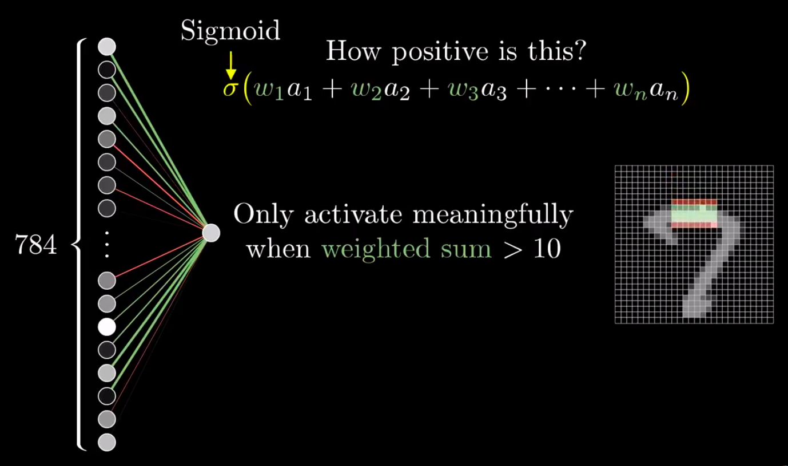
Example: Handwritten Digits Recognition
Notes:
http://yann.lecun.com/exdb/mnist/

Slide 49
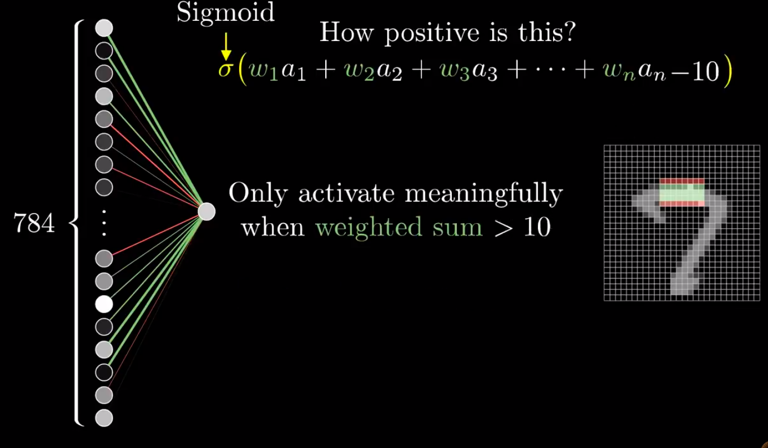
Example: Handwritten Digits Recognition
Notes:
http://yann.lecun.com/exdb/mnist/

Slide 50
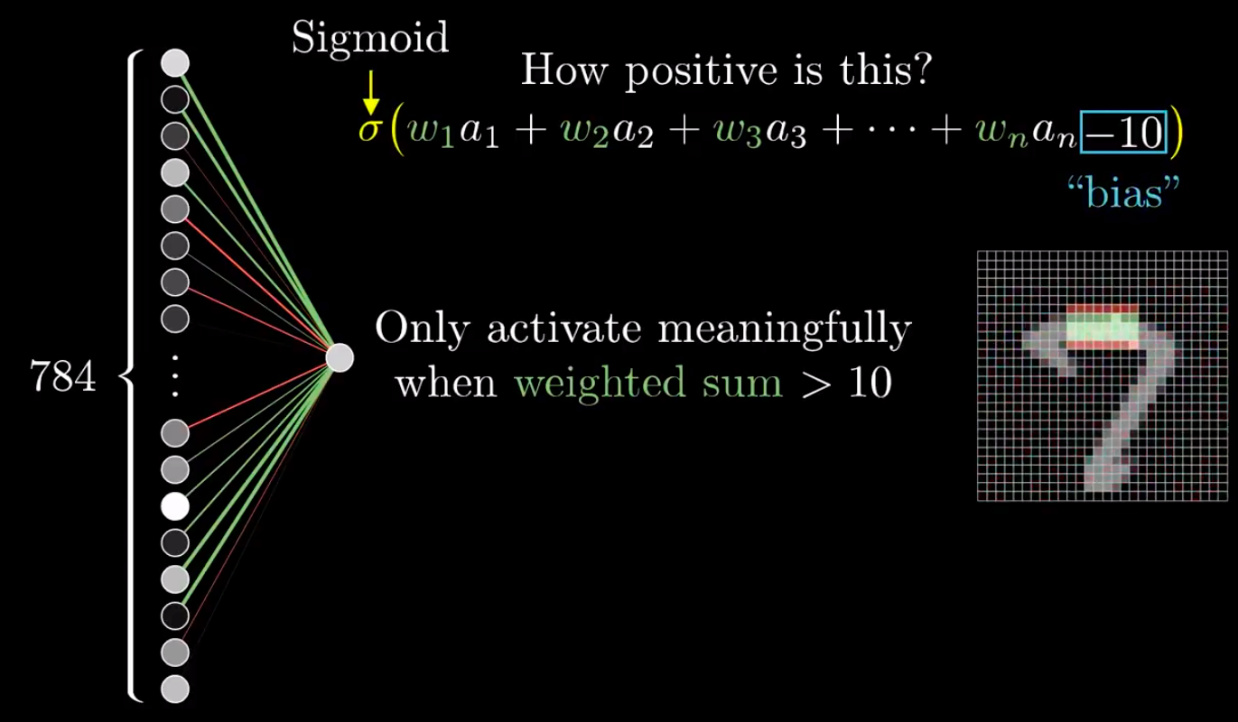
Example: Handwritten Digits Recognition
Notes:
http://yann.lecun.com/exdb/mnist/
Bias helps in controlling the value at which activation function will trigger.

Slide 51
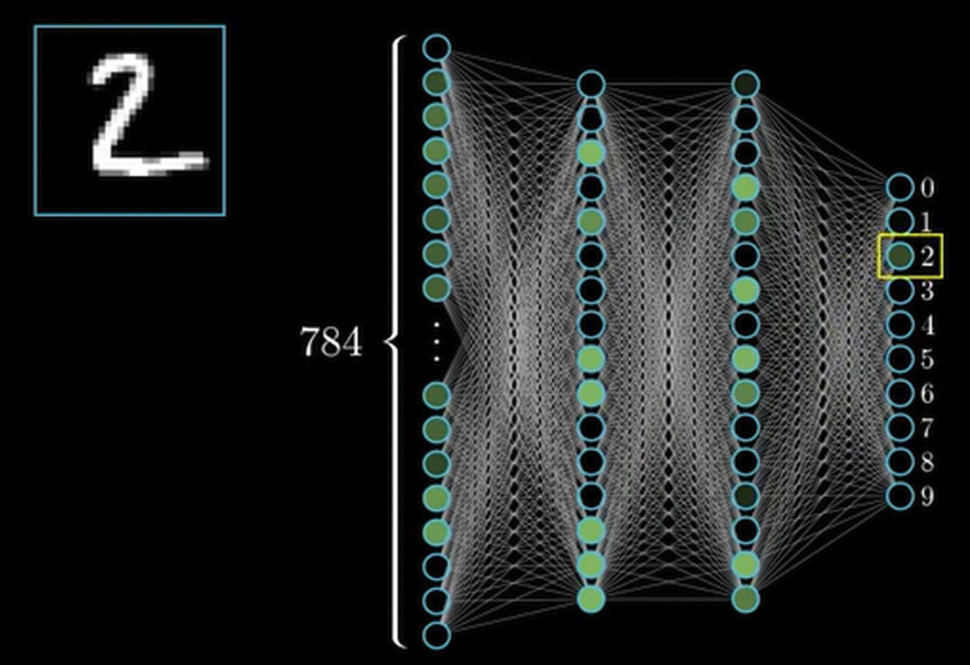

Slide 52
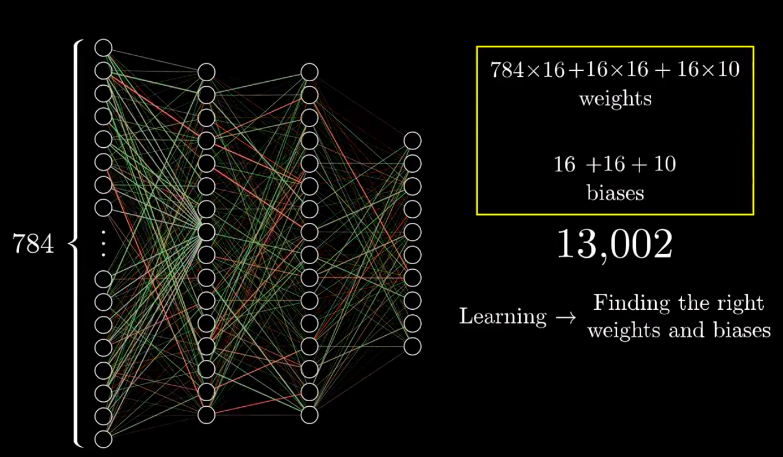
Example: Handwritten Digits Recognition
Learning
Notes:
http://yann.lecun.com/exdb/mnist/

Slide 53
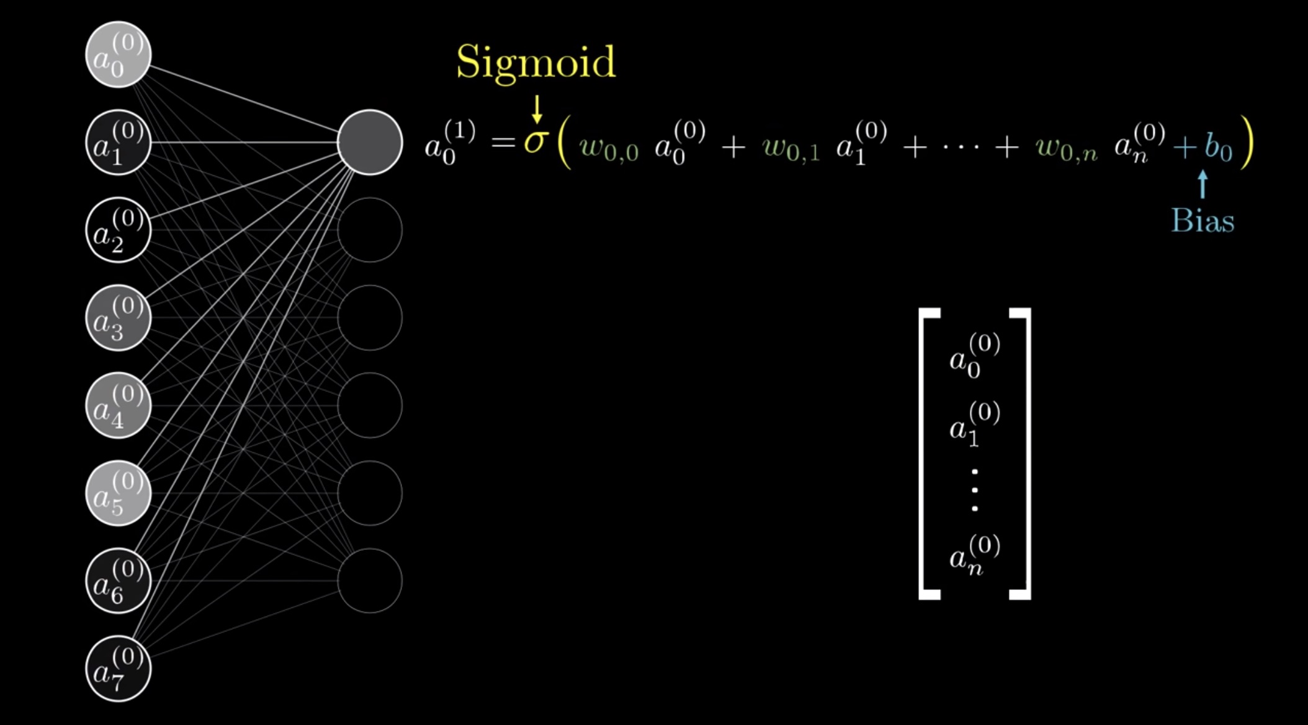

Slide 54
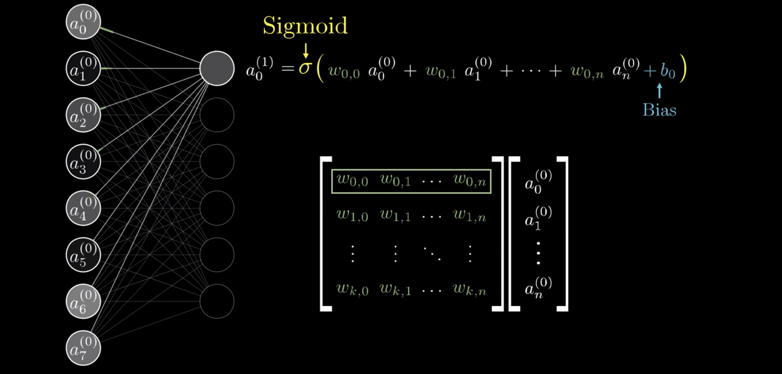

Slide 55
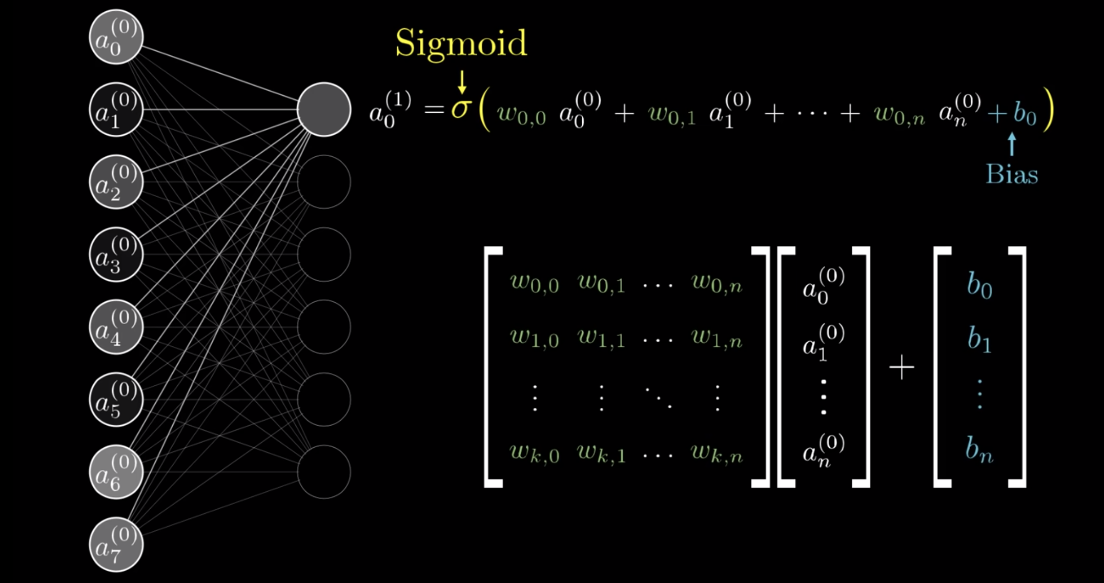

Slide 56
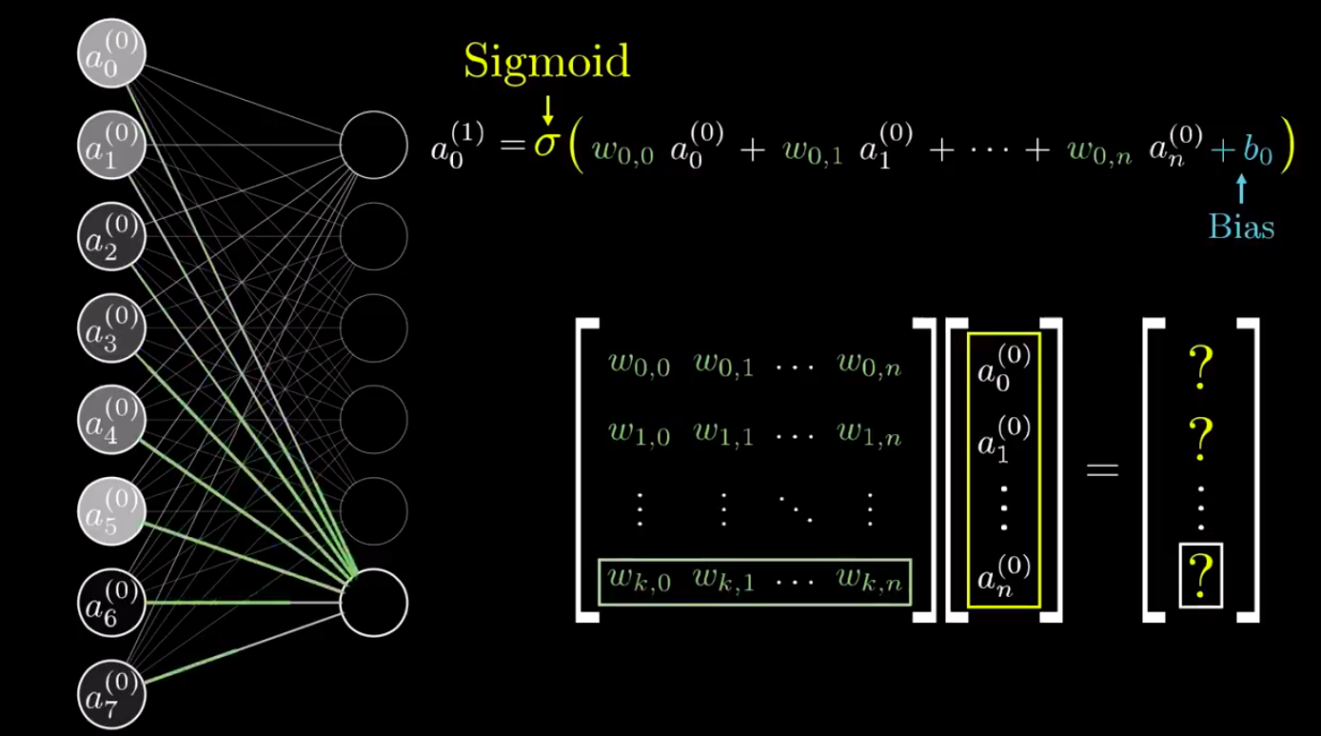
Example: Handwritten Digits Recognition
Matrix
Notes:
http://yann.lecun.com/exdb/mnist/

Slide 57
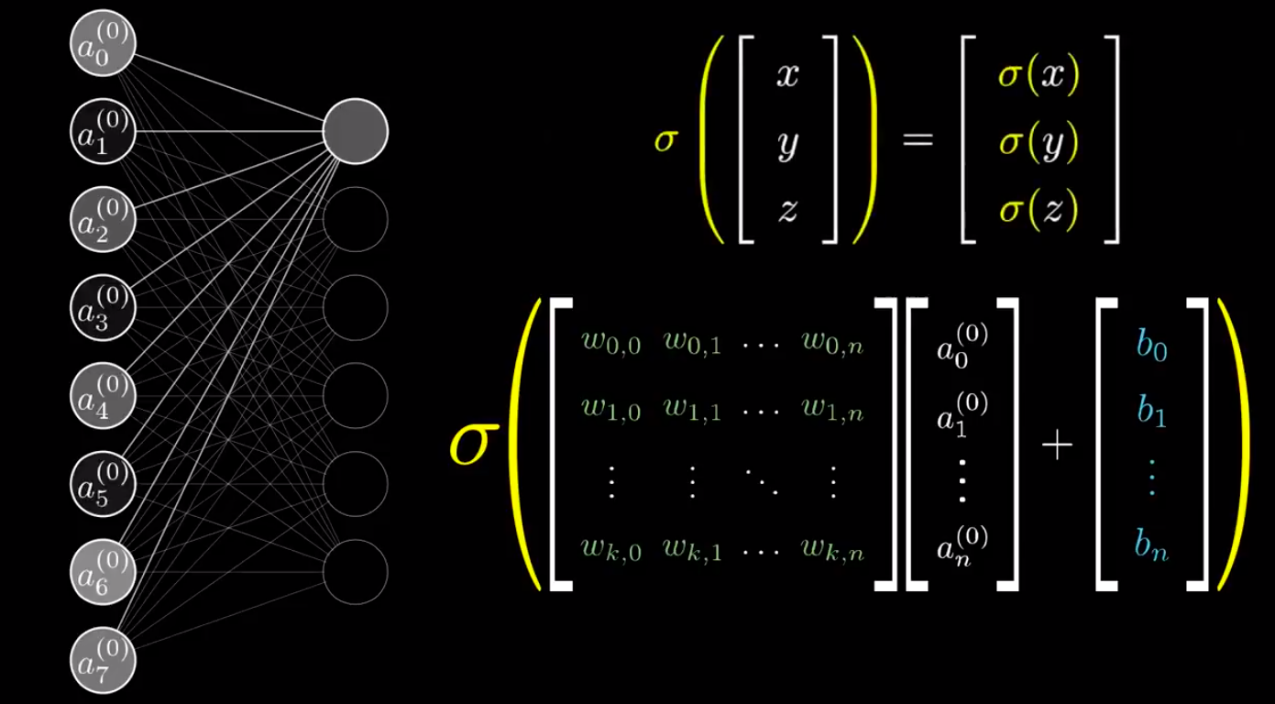
Example: Handwritten Digits Recognition
Matrix
Notes:
http://yann.lecun.com/exdb/mnist/

Slide 58
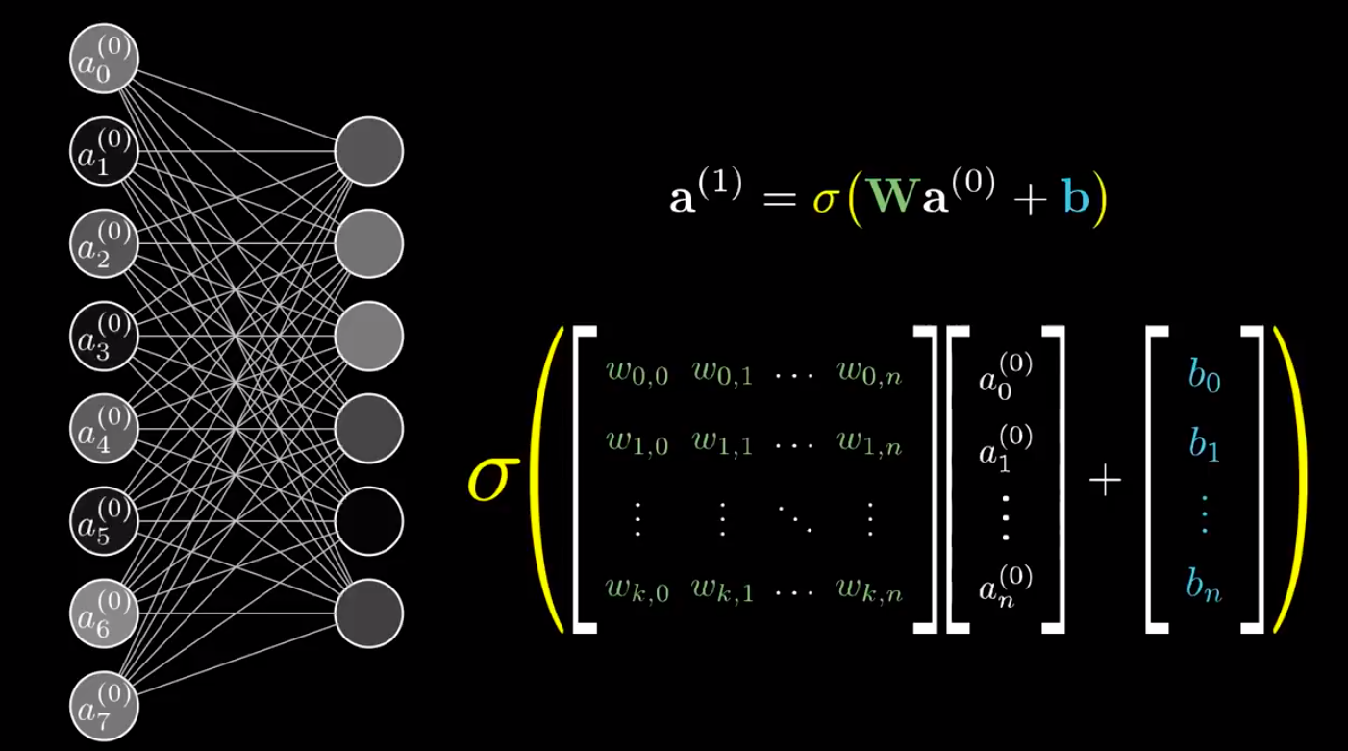
Matrix
Notes:
http://yann.lecun.com/exdb/mnist/

Slide 59
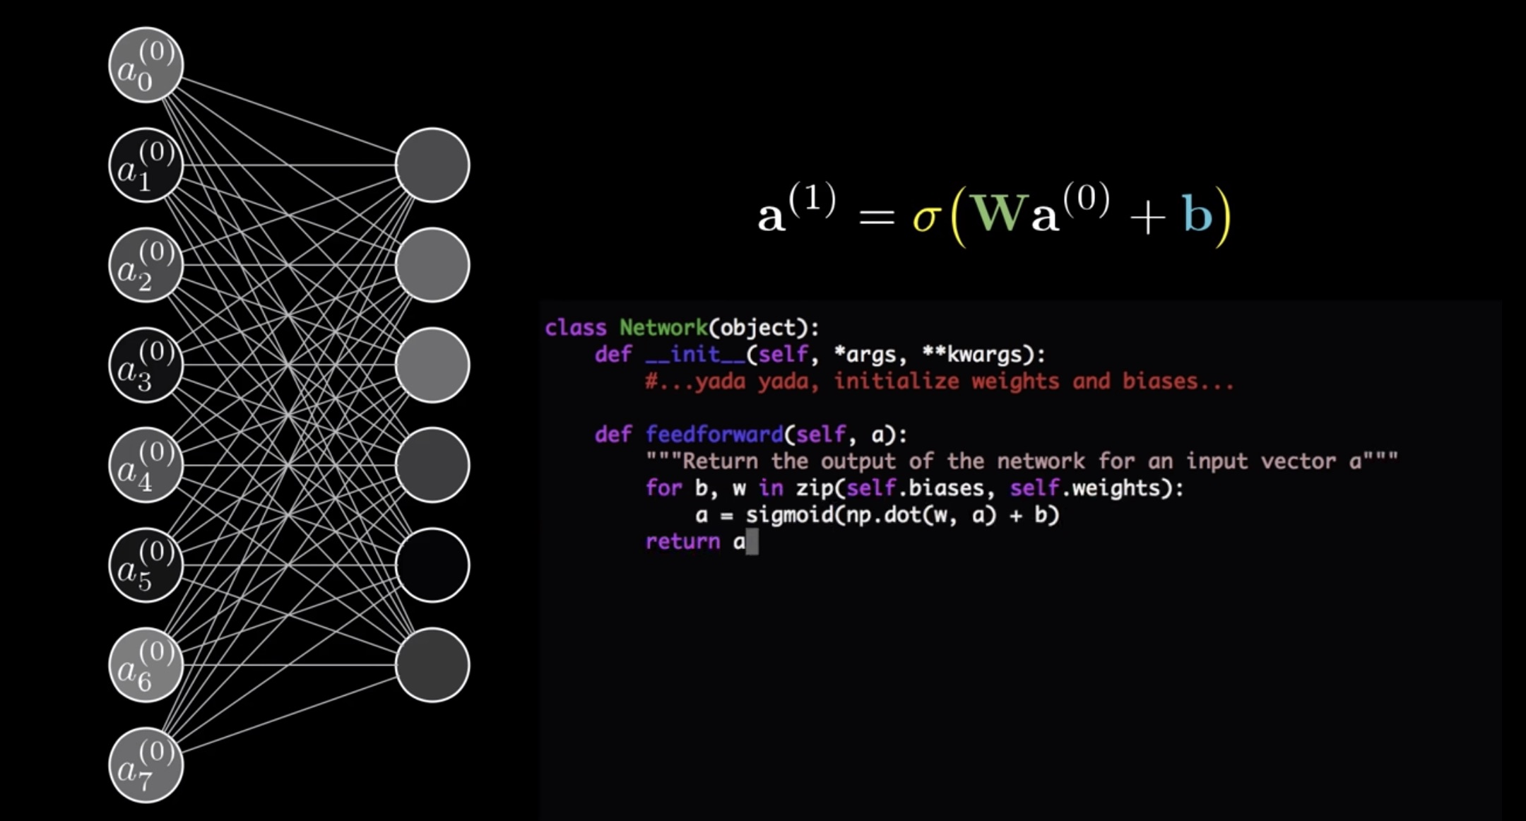
Feedforward function

Slide 60
END
Thank you

