Slide 1
Deep Learning Basics
2: Network Structure
Francis Steen and Xinyu You
Red Hen Lab
October 2019

Slide 2
A. Perceptron
The building blocks of neural networks

Slide 3
Logic-gate neurons
The origins of Neural Networks goes back to 1943, when Warren McCulloch, a neurophysiologist, and a young mathematician, Walter Pitts, wrote a paper on how neurons might work
They proposed that neurons are binary logic gates that receive multiple inputs through their dendrites and convert these to a single output

Slide 5
Classical computationalism
In 1958, the neurobiologist Frank Rosenblatt extended this idea to form an artificial neuron, which he called a Perceptron
It aimed to replicate the function of a neuron, and make it possible to process sensed information, for instance from a camera

Slide 6
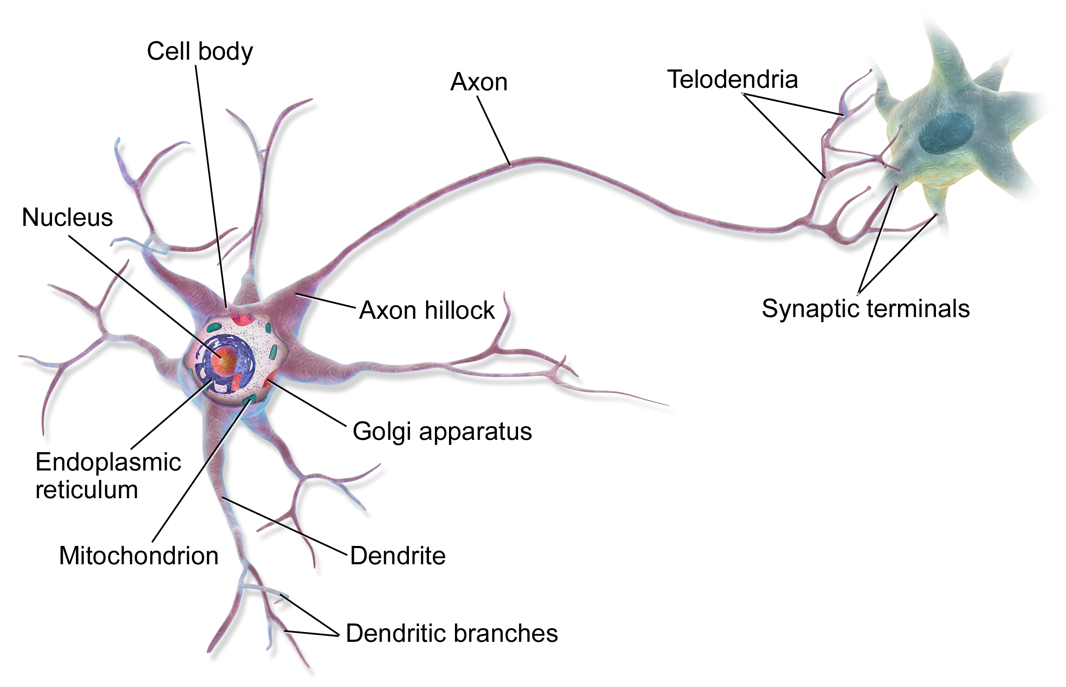
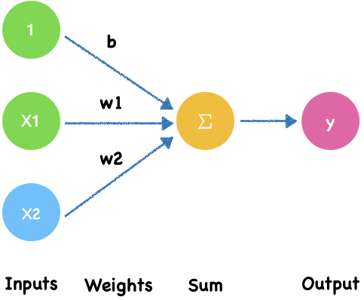
Neuron-like perceptron
Neuron
Perceptron
Notes:
https://www.nature.com/articles/d41586-018-02174-z

Slide 7
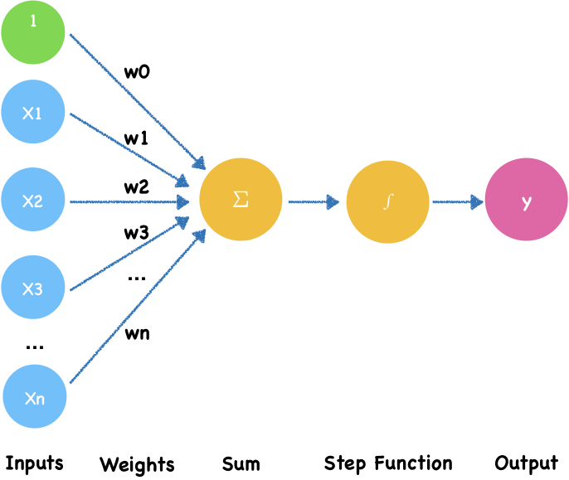
Binary perceptron
Electrical signals -> Input
Electrical signals amounts-> weights
Threshold -> Step Function
$$output=\{\begin{matrix}0∑_{i=0}^{n}w_{i}x_{i}≤threshold & \\ 1∑_{i=0}^{n}w_{i}x_{i}>threshold & \end{matrix}$$
Notes:
In a neuron, the dendrite receives electrical signals from the axons of other neurons. In the perceptron, these electrical signals are represented as numerical **input values**, $x_1,x_2, x_3,...,x_n$.
At the synapses between the dendrite and axons, electrical signals are modulated in various amounts. In the perceptron, this corresponds to each of input value is multiplied by a specific value called the **weight**, $w_0, w_1, w_2,...,w_n$.
Finally, a neuron **triggers** an output only when the total strength of the input signals exceeds a certain **threshold**.
A threshold is like the capacity of a water cup. The cup overflows only when it is filled. It's because neurons don't want to transmit small interfering signals, only strong ones do.
This is simulated by calculating the weighted **sum of the inputs**, $ z = w_0 + w_1x_1 + w_2x_2 + ... + w_nx_n$, and applying a **step function** $f(z)$ on the sum to determine its output $y$.

Slide 8

Imagine a leaky boar fountain

Slide 9
A boar fountain step function
A shishi-odoshi (scareboar) or Indonesian boar fountain is used to scare away boar
In Chinese it’s called a 竹筒敲石 or "knocking stone with bamboo drum"
Imagine a leaky one. If the input is too little to tip it over, it just leaks out. If it’s enough, it tips over and makes a loud noise.

Slide 10
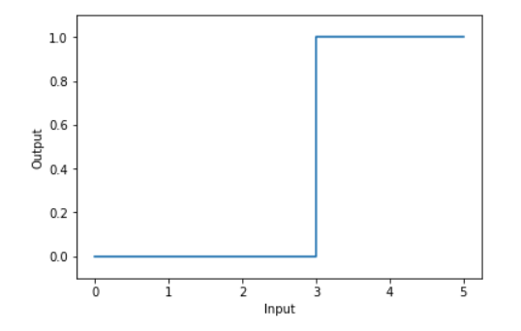
Step Function
threshold = 3
$$output=\{\begin{matrix}0∑_{i=0}^{n}w_{i}x_{i}≤threshold & \\ 1∑_{i=0}^{n}w_{i}x_{i}>threshold & \end{matrix}$$
Notes:
https://www.desmos.com/calculator/oq4vwcjltg

Slide 11
Sigmoid neuron

Slide 12
Neurons are more powerful
A door to new forms of AI
Real neurons are far more complex than the perceptron model
Neuroscience studies suggest a powerful information processing capacity within a single neuron, possibly even face recognition
The ability of single neurons to perform complex tasks indicates that the neuron contains far more internal structure than the perceptron model suggests
A deeper understanding of how neurons process information can lead to new forms of AI
Notes:
https://www.nature.com/articles/d41586-018-02174-z

Slide 13
B. Neural Network
Multilayer networks of perceptrons

Slide 14
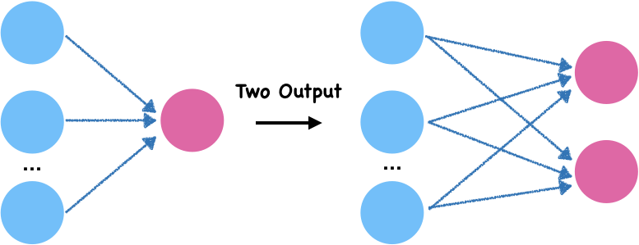
Perceptron networks
Many-to-one and many-to-many connections

Slide 15
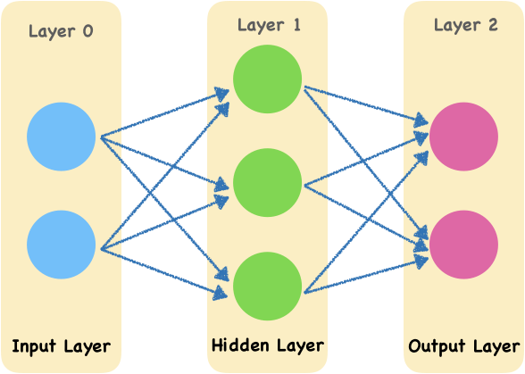
Multilayer perceptron
Multilayer perceptron also named deep feedforward networks.
It adds hidden layers to the previous perceptron.
Notes:
Diagram 3.1 shows an example neural network. To keep the diagram clear, all the weights are unmarked. The leftmost layer 0 is the input layer. The rightmost layer 2 is the output layer. The middle layer 1 is called hidden layer. Here the input layer and output layer have 2 nodes and the hidden layer has 3 nodes. Although there are three layers, only two of them has weight, so we call this network as a two-layer network.

Slide 16
Multilayer perceptron
The leftmost layer 0 is the input layer.
The rightmost layer 2 is the output layer.
The middle layer 1 is called hidden layer.
Here the input layer and output layer have 2 nodes and the hidden layer has 3 nodes.
Although there are three layers, only two of them has weight, so we call this network as a two-layer network.
Notes:
Diagram 3.1 shows an example neural network. To keep the diagram clear, all the weights are unmarked. The leftmost layer 0 is the input layer. The rightmost layer 2 is the output layer. The middle layer 1 is called hidden layer. Here the input layer and output layer have 2 nodes and the hidden layer has 3 nodes. Although there are three layers, only two of them has weight, so we call this network as a two-layer network.

Slide 17
Multilayer perceptron
Animation Process
Layer 0
Layer 1
Layer 2
Input Layer
Hidden Layer
Output Layer

Slide 18
Why is the middle layer called a hidden layer?
The data of the input layer and output layer are strictly observable, while the data value of the hidden layer is learned by the model.
Therefore, we cannot see them in advance. They are "hidden" for us.
Notes:
image source
http://scrummable.com/wp-content/uploads/2017/06/wood-for-trees-1.gif

Slide 19
Activation functions
Space wizard
What is an activation function?
We call the function that takes all the inputs to transform an output the activation function
Notes:
The activation function of the neural network is a group of spatial wizards that twist and flip feature Spaces to find linear boundaries.
Ref:
https://towardsdatascience.com/hyper-parameters-in-action-a524bf5bf1c
https://www.zhihu.com/question/22334626/answer/465380541

Slide 20
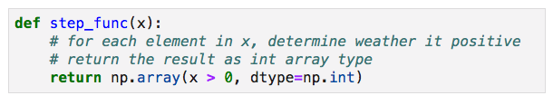
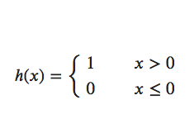
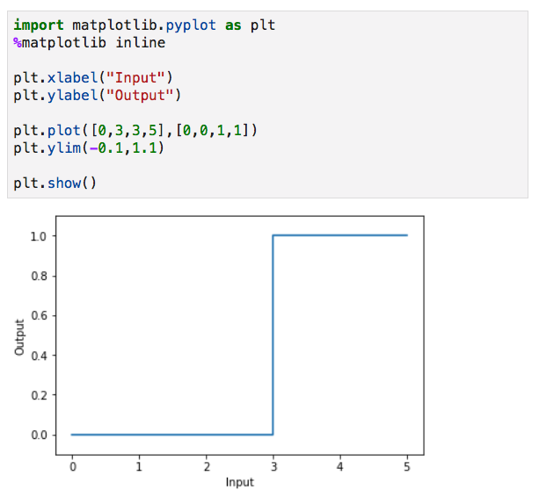
Commonly used activation functions
Step Function
The definition of step function is:
Step is a guy who likes to bounce around and often has a poor performance
Notes:
image:https://towardsdatascience.com/hyper-parameters-in-action-a524bf5bf1c

Slide 21
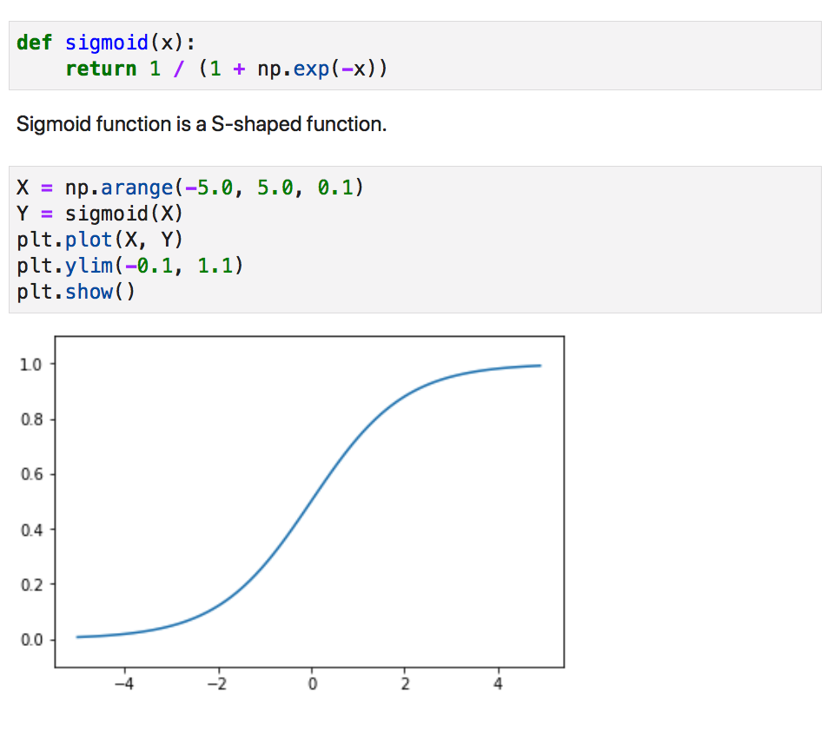
Commonly used activation functions
Sigmoid Function
The definition of sigmoid function is:
$$h(x)=\frac{1}{1+e^{-x}}$$
Sigmoid, a grandmother,
the most senior of the activate functions.
Notes:
image:https://towardsdatascience.com/hyper-parameters-in-action-a524bf5bf1c

Slide 22
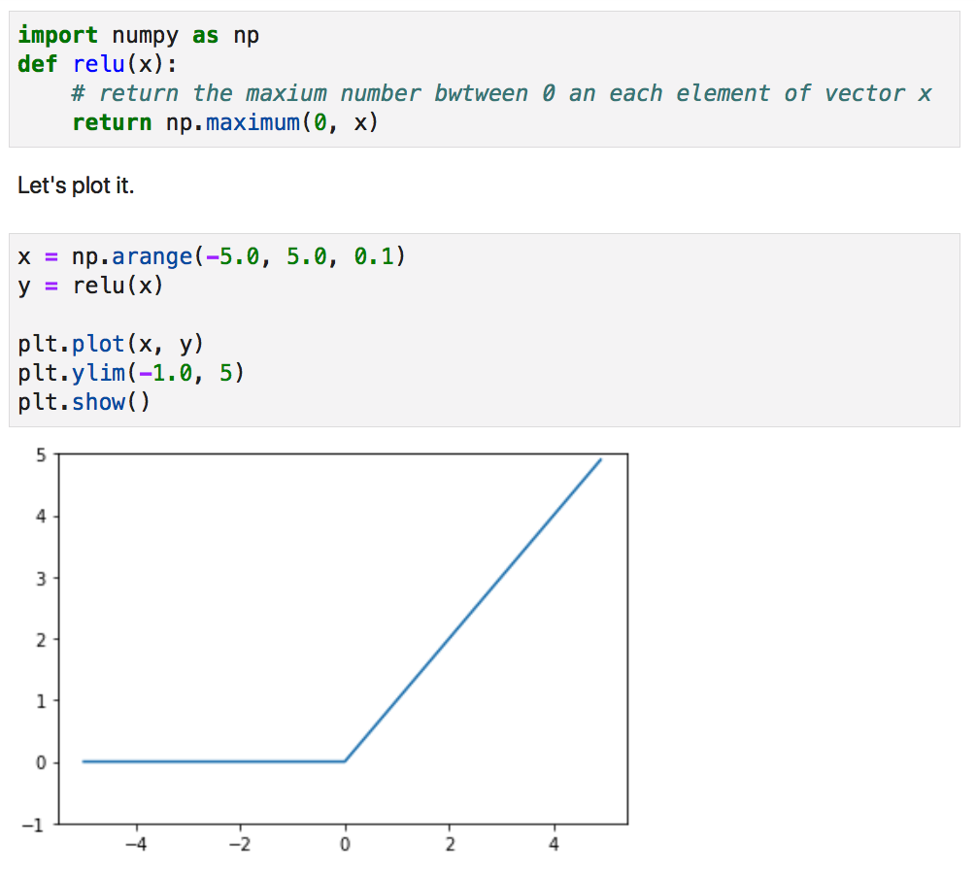
Commonly used activation functions
ReLU Function
The definition of ReLU(rectified linear unit) function is:
$$h(x)=max(x,0)$$
ReLU is a gatekeeper.
Muggles are shut out.
Notes:
image:https://towardsdatascience.com/hyper-parameters-in-action-a524bf5bf1c

Slide 23
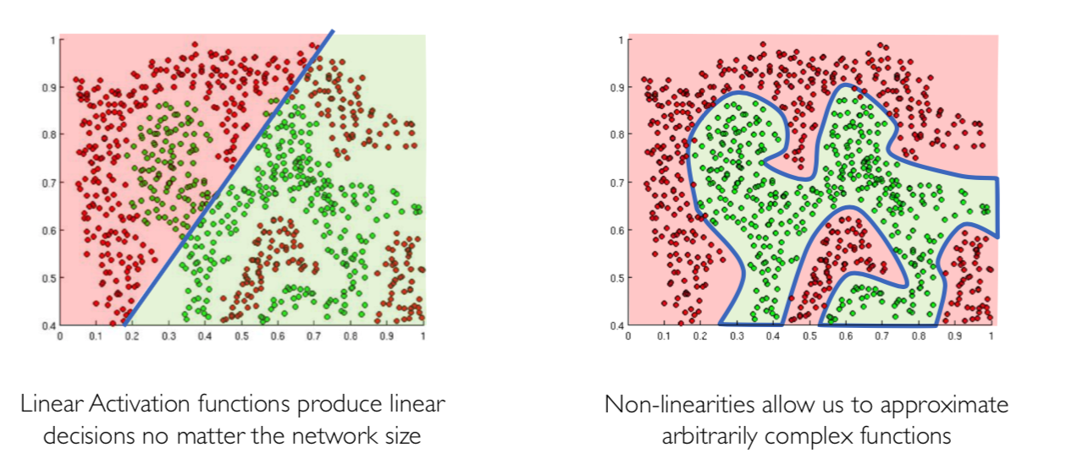
Why must the activation function be non-linear?
All the activation functions we introduced are non-linear functions
Why? Generally speaking, the purpose of activation function is to introduce non-linearities into the network

Slide 24
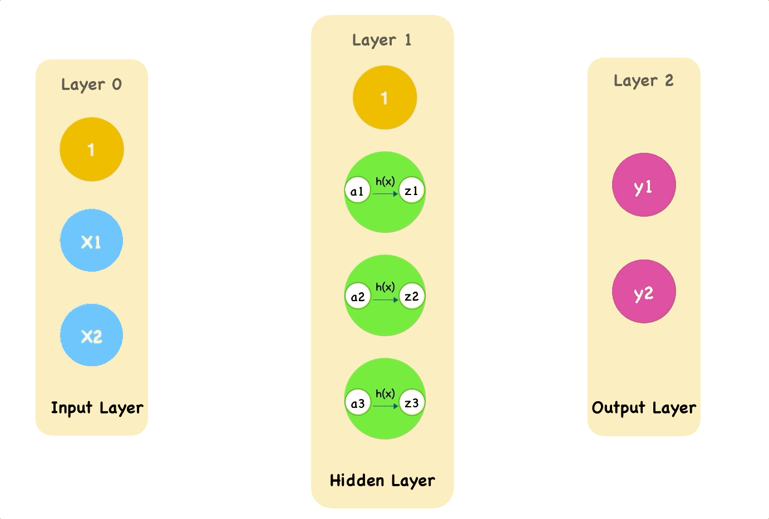
Forward Propagation
This animation shows how the single pass through the network with an activate function h(x):

Slide 25
C. Network Structure
Forward propagation by weights and biases

Slide 26
Example: Handwritten Digits Recognition
The MNIST database of handwritten digits has a training set of 60,000 examples, and a test set of 10,000 examples.
The digits have been size-normalized and centered in a fixed-size image.
Notes:
http://yann.lecun.com/exdb/mnist/

Slide 27


Slide 28
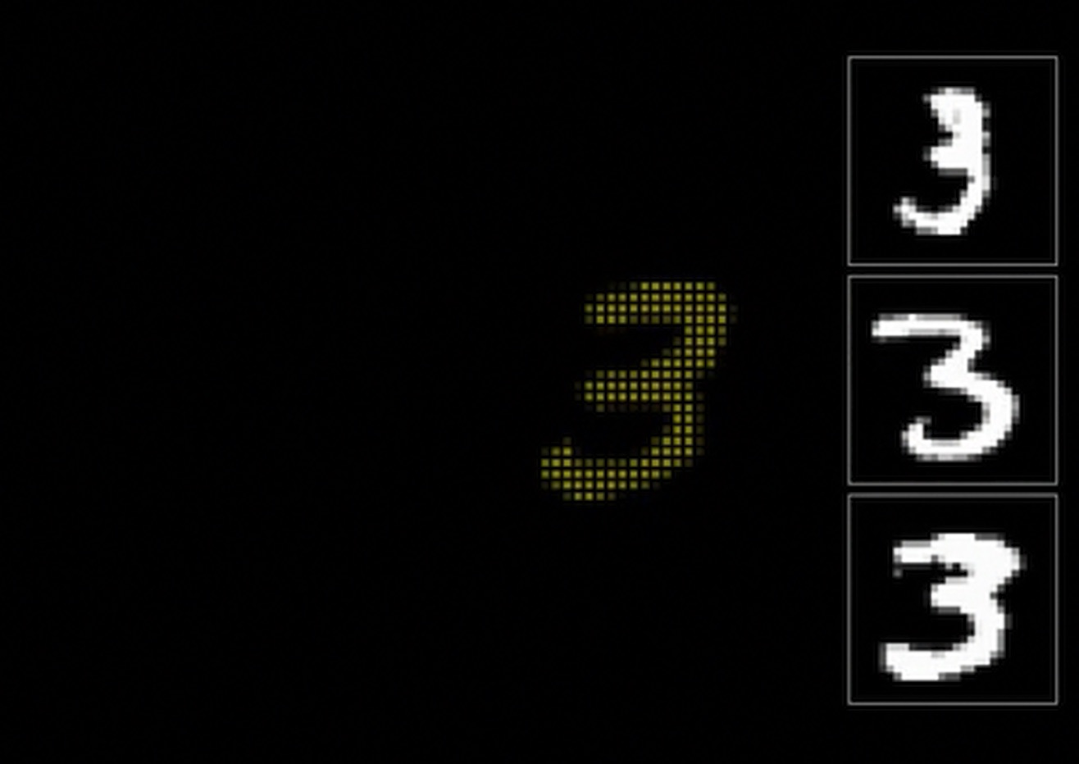

Slide 29
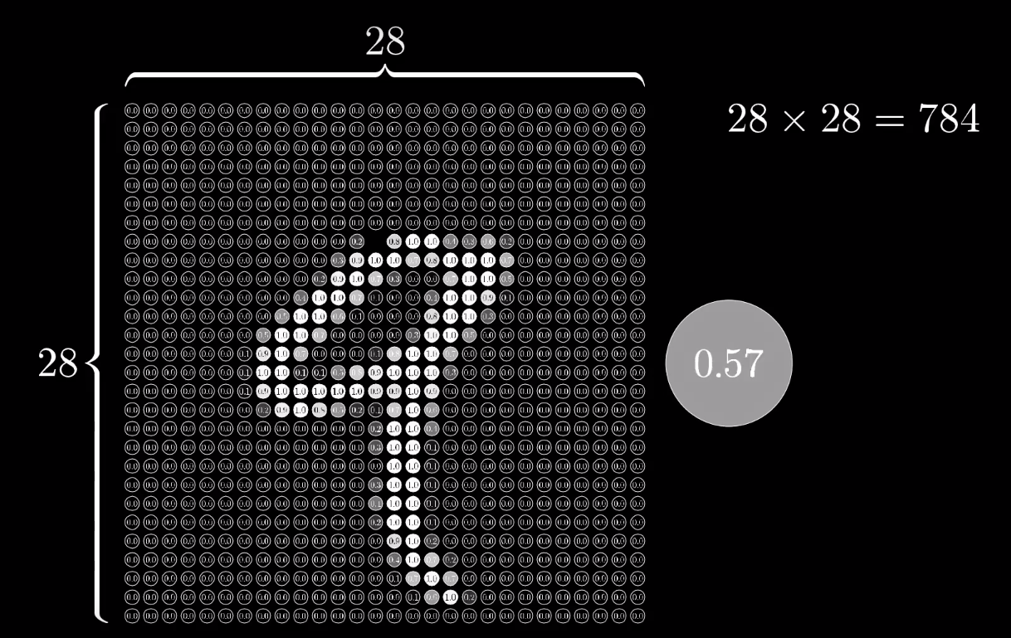
Pixel
Notes:
http://yann.lecun.com/exdb/mnist/

Slide 30
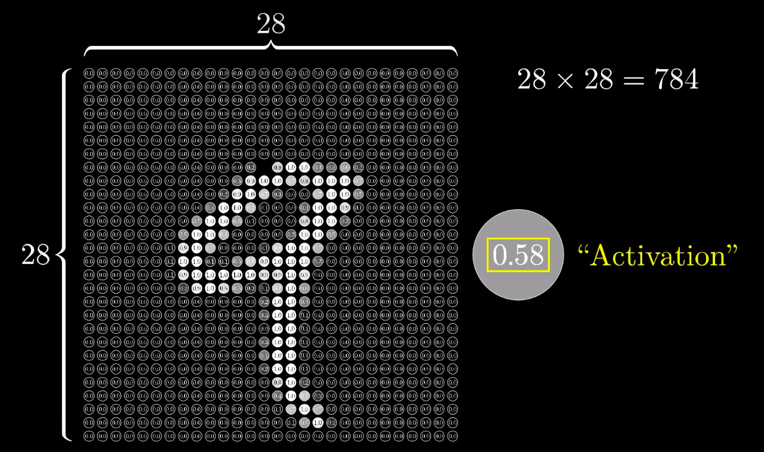
Pixel
Notes:
http://yann.lecun.com/exdb/mnist/

Slide 31
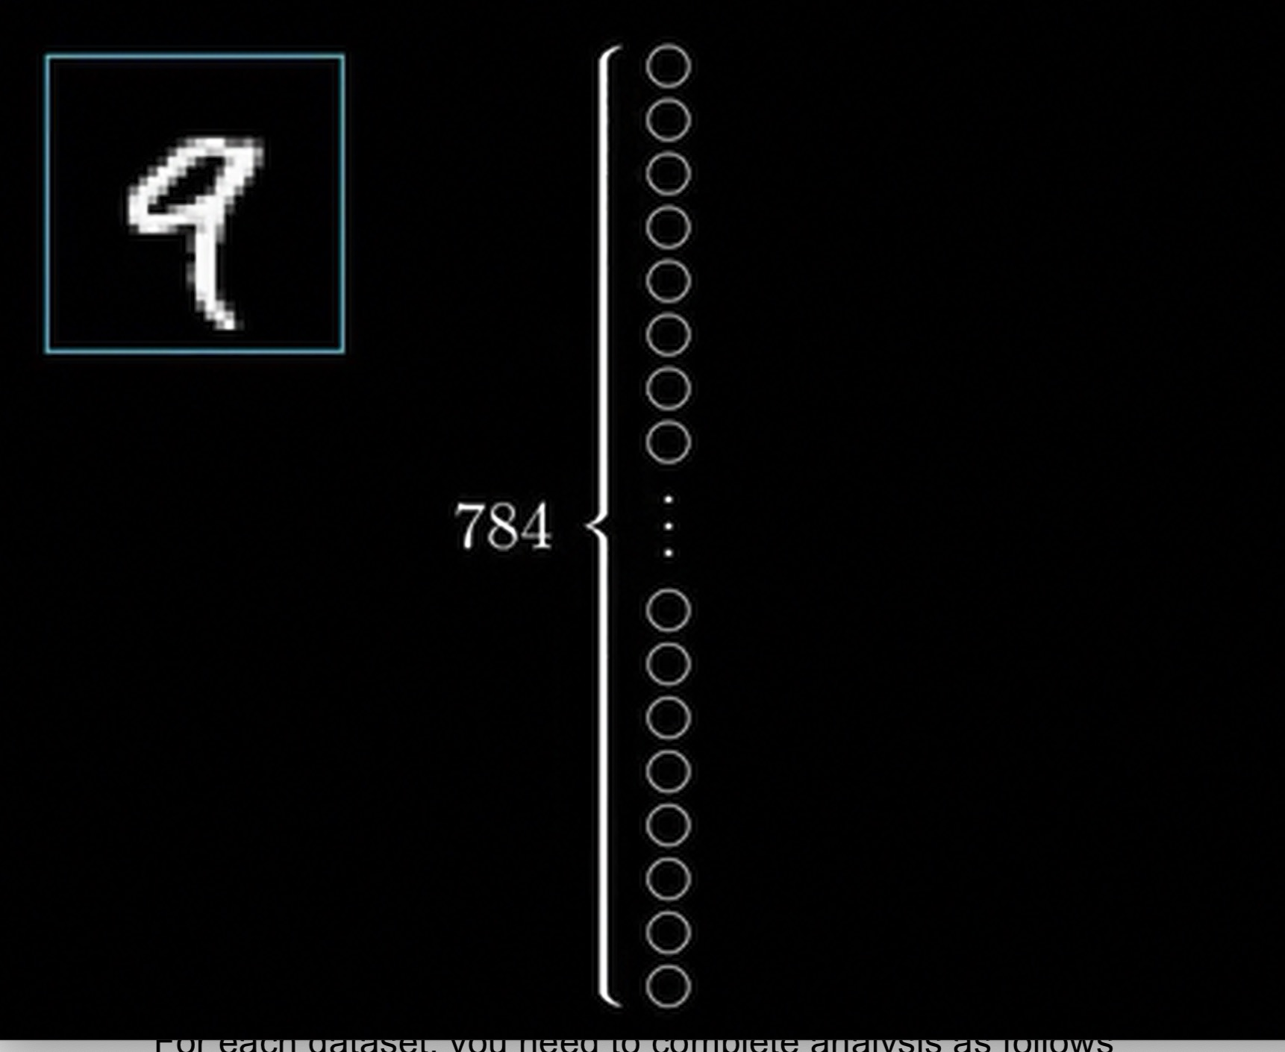

Slide 32
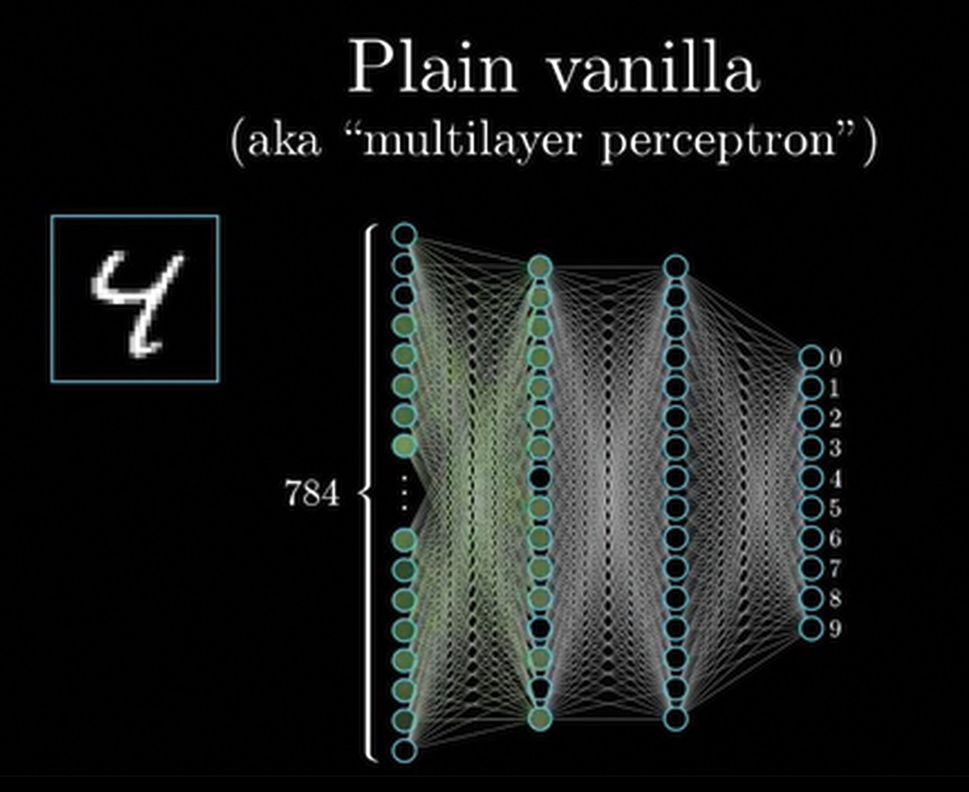

Slide 33
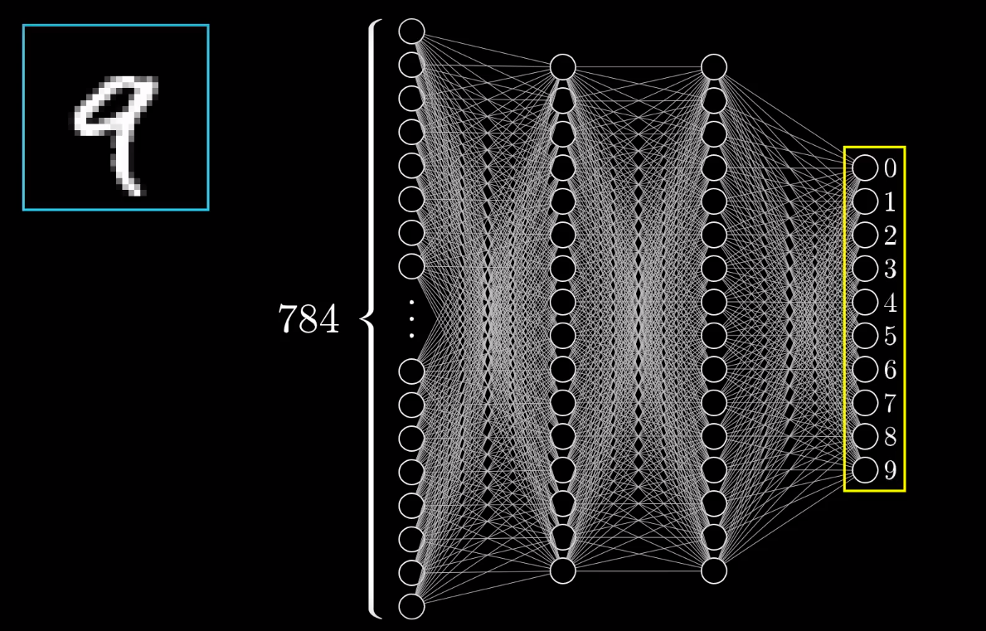
Example: Handwritten Digits Recognition
Output Layer
Notes:
http://yann.lecun.com/exdb/mnist/

Slide 34
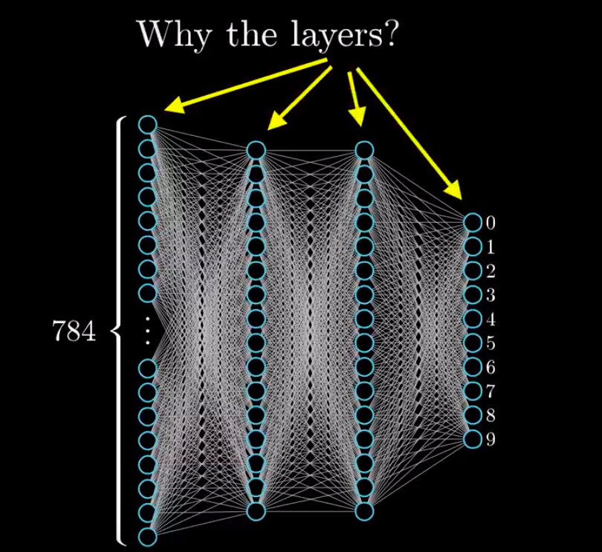
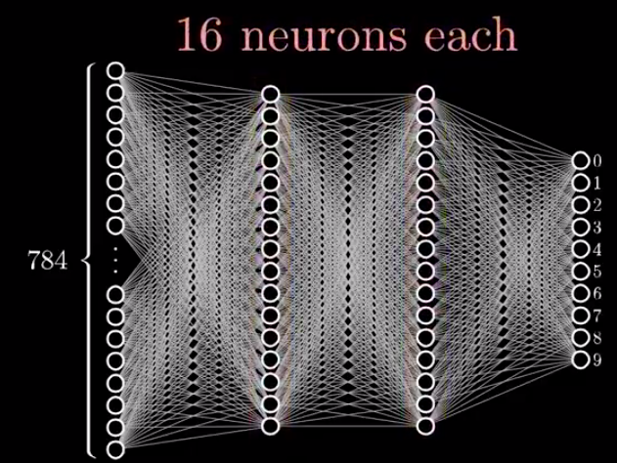
Example: Handwritten Digits Recognition
Why the Layers?
Notes:
http://yann.lecun.com/exdb/mnist/

Slide 35
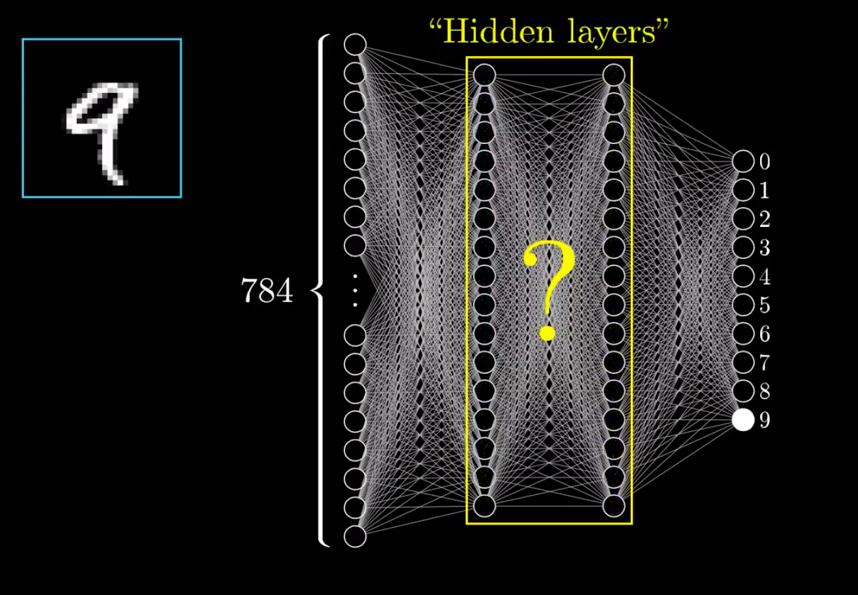
Example: Handwritten Digits Recognition
Hidden Layers
Notes:
http://yann.lecun.com/exdb/mnist/

Slide 36
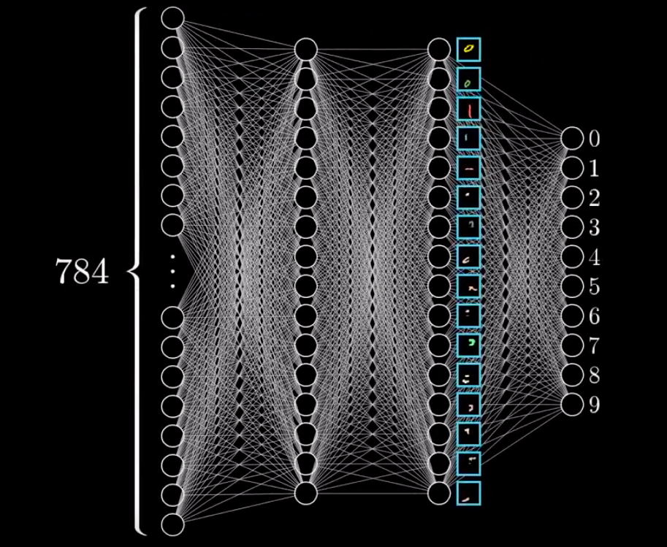
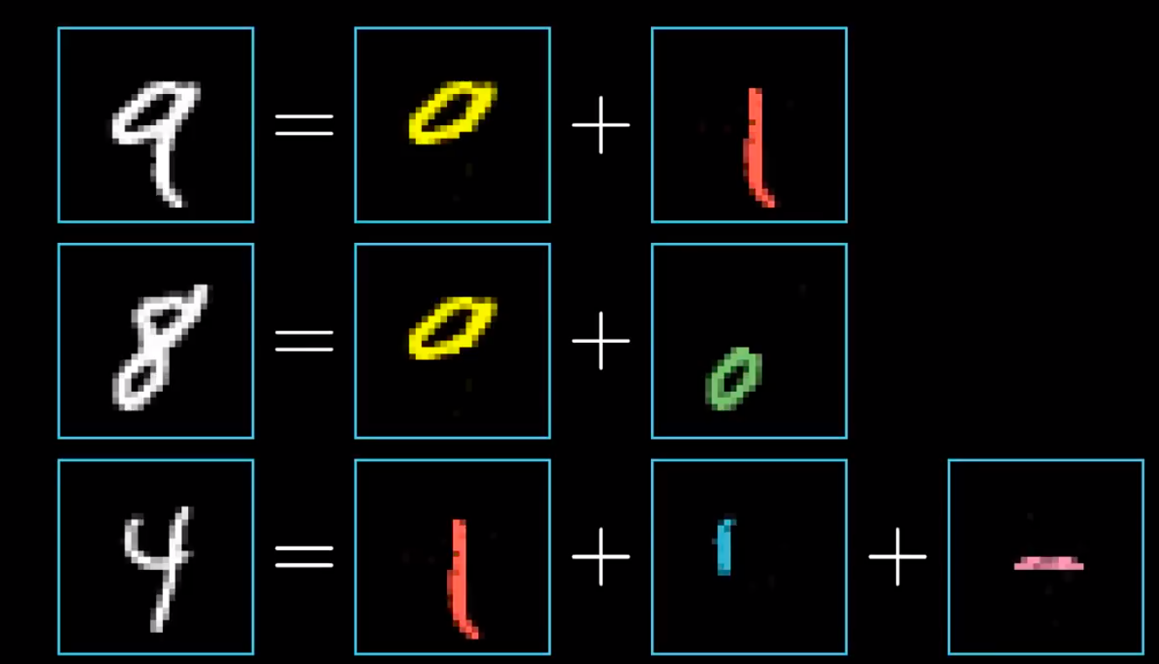
Example: Handwritten Digits Recognition
Why the Layers?
Notes:
http://yann.lecun.com/exdb/mnist/

Slide 37
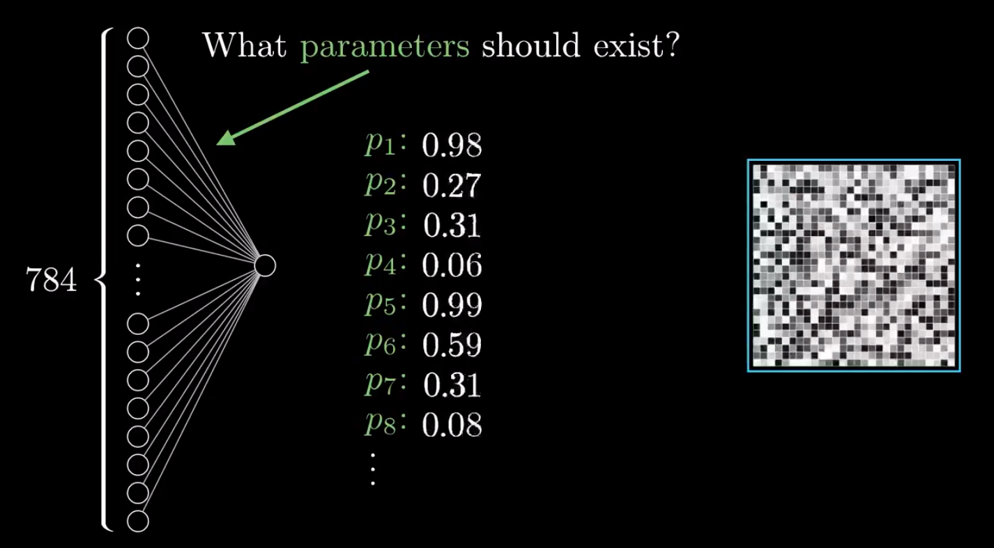
Example: Handwritten Digits Recognition
Active
Notes:
http://yann.lecun.com/exdb/mnist/

Slide 38
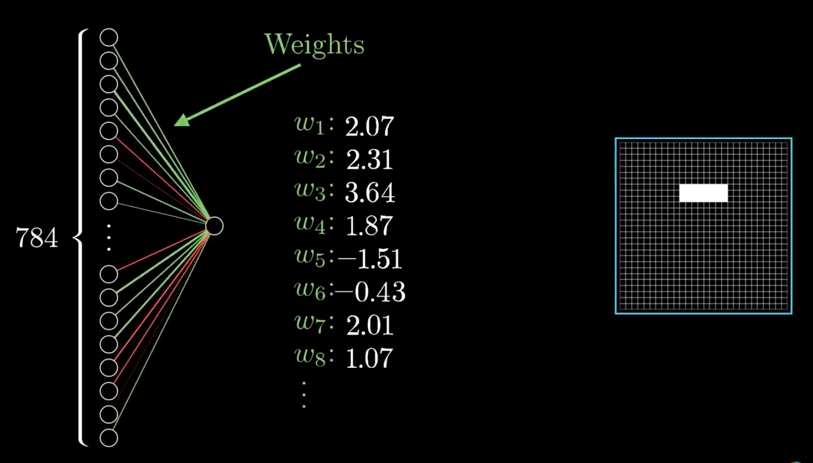
Example: Handwritten Digits Recognition
Active
Notes:
http://yann.lecun.com/exdb/mnist/

Slide 39
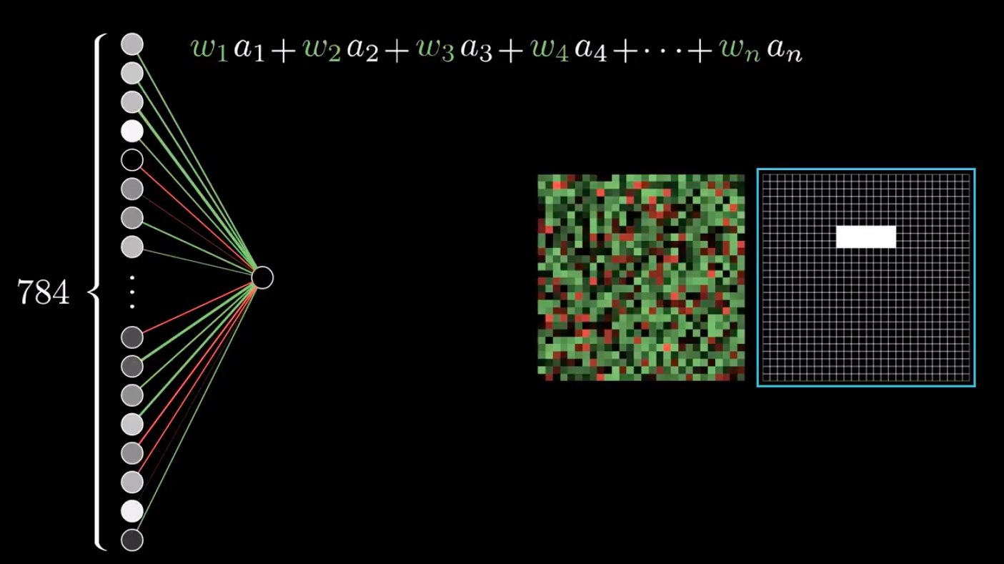
Example: Handwritten Digits Recognition
Active
Notes:
http://yann.lecun.com/exdb/mnist/

Slide 40
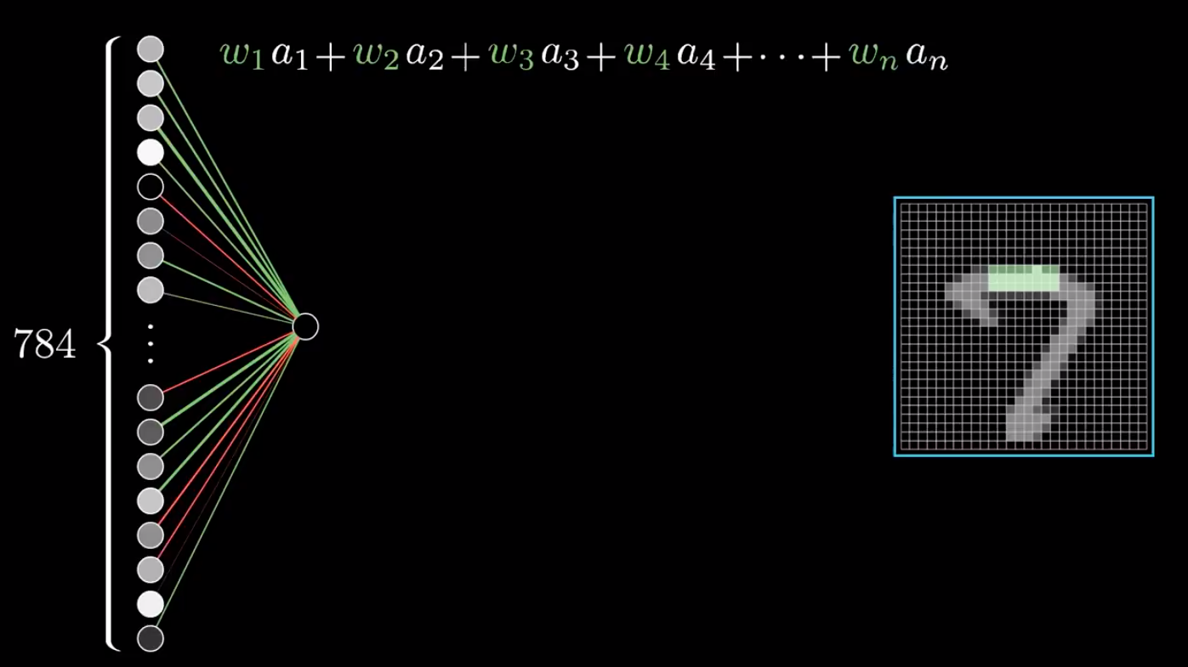
Example: Handwritten Digits Recognition
Active
Notes:
http://yann.lecun.com/exdb/mnist/

Slide 41
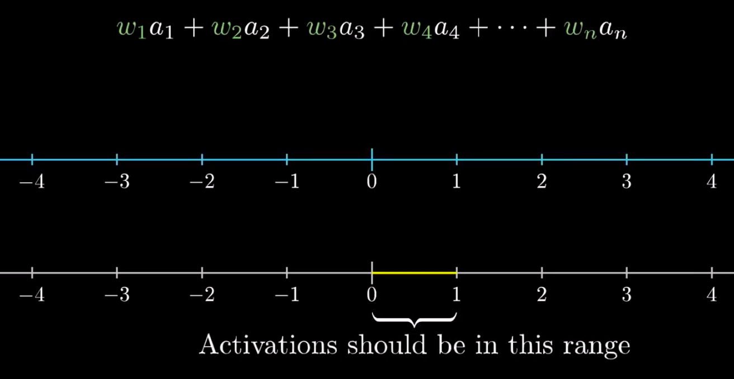
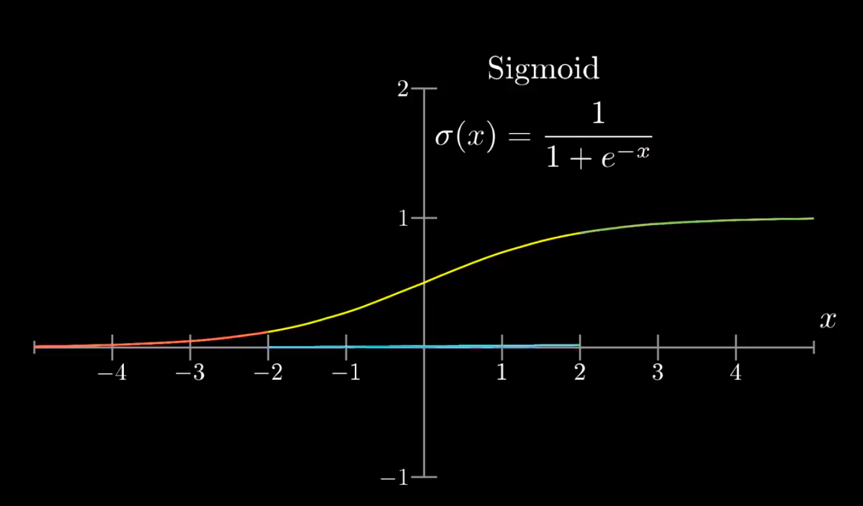
Example: Handwritten Digits Recognition
Notes:
http://yann.lecun.com/exdb/mnist/

Slide 42
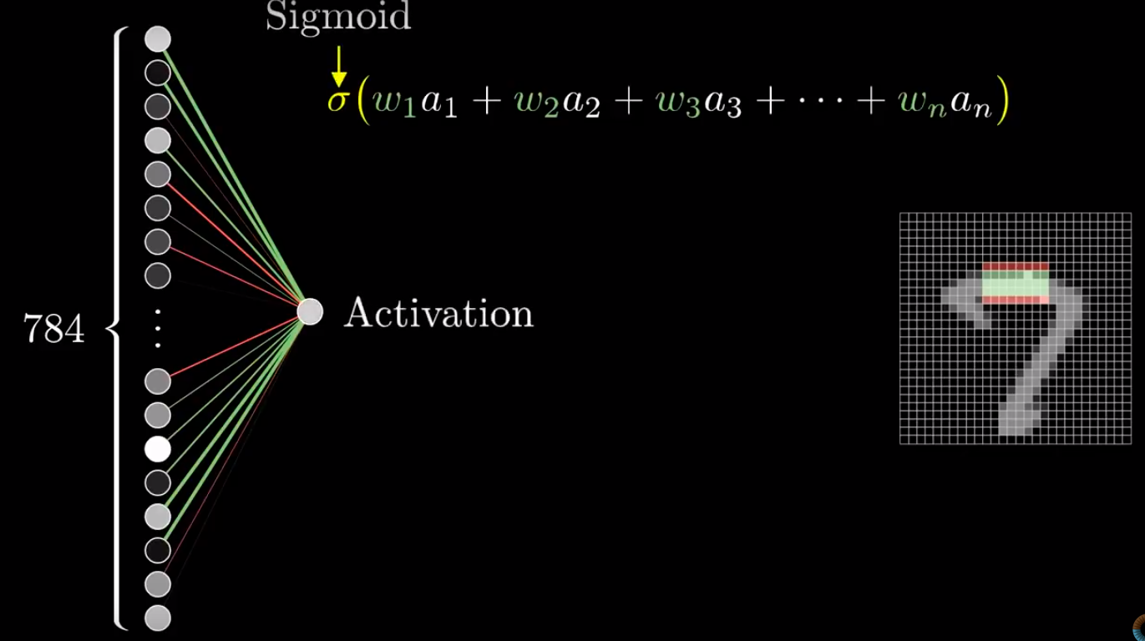
Example: Handwritten Digits Recognition
Notes:
http://yann.lecun.com/exdb/mnist/

Slide 43
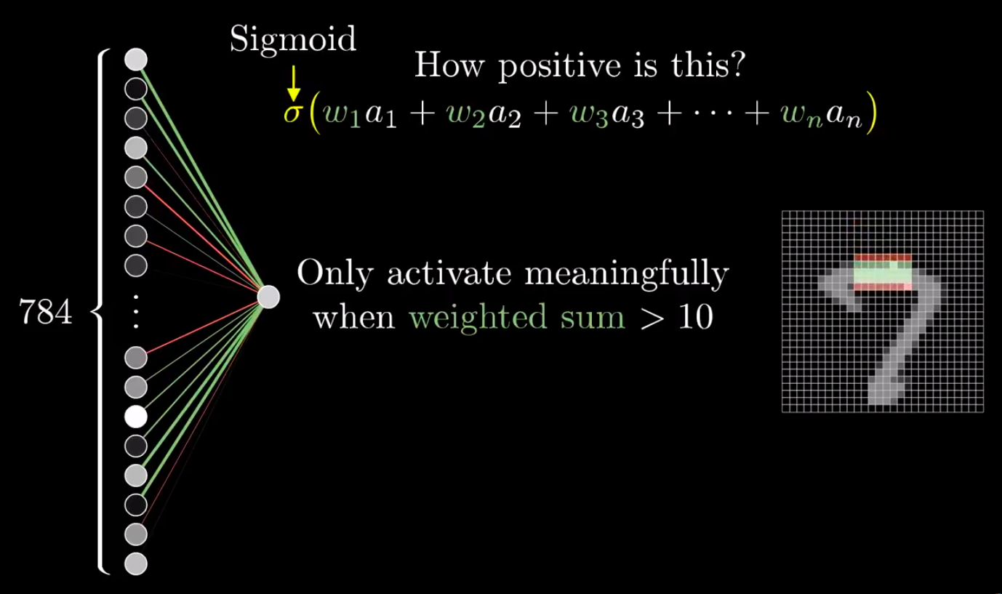
Example: Handwritten Digits Recognition
Notes:
http://yann.lecun.com/exdb/mnist/

Slide 44
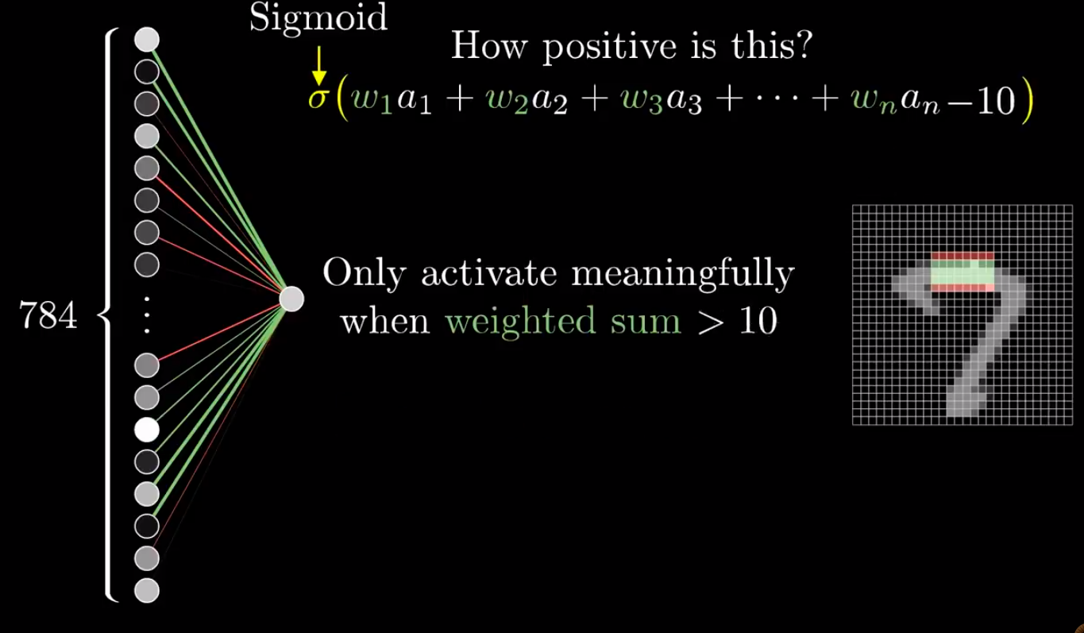
Example: Handwritten Digits Recognition
Notes:
http://yann.lecun.com/exdb/mnist/

Slide 45
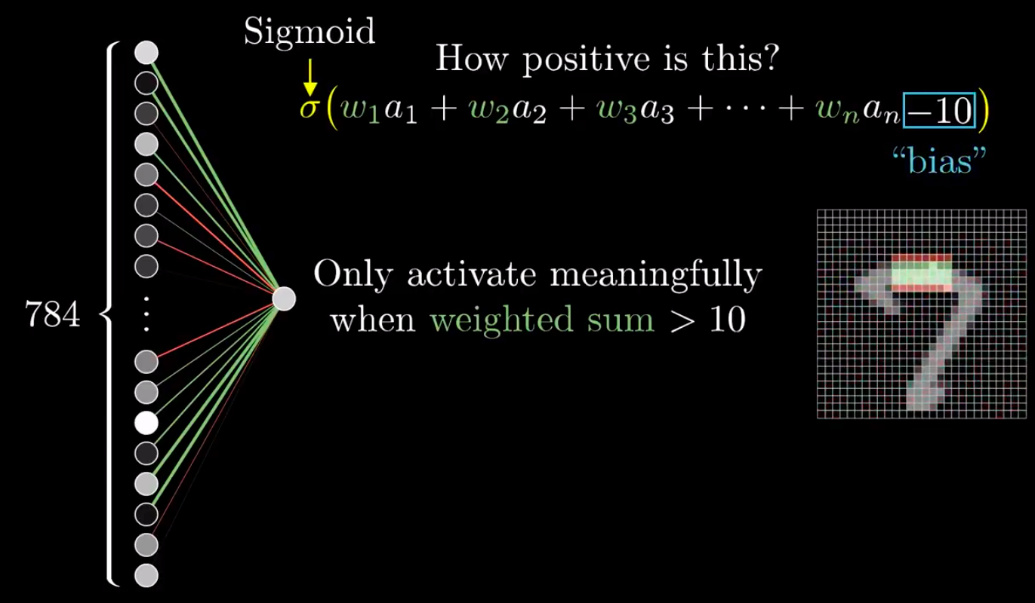
Example: Handwritten Digits Recognition
Notes:
http://yann.lecun.com/exdb/mnist/

Slide 46
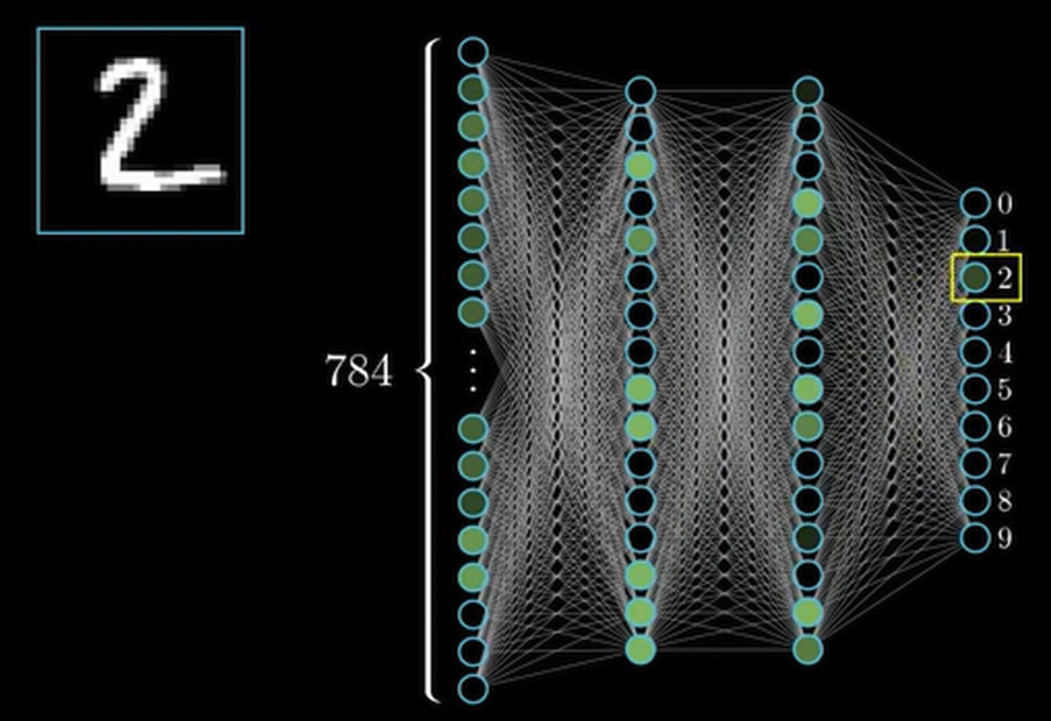

Slide 47
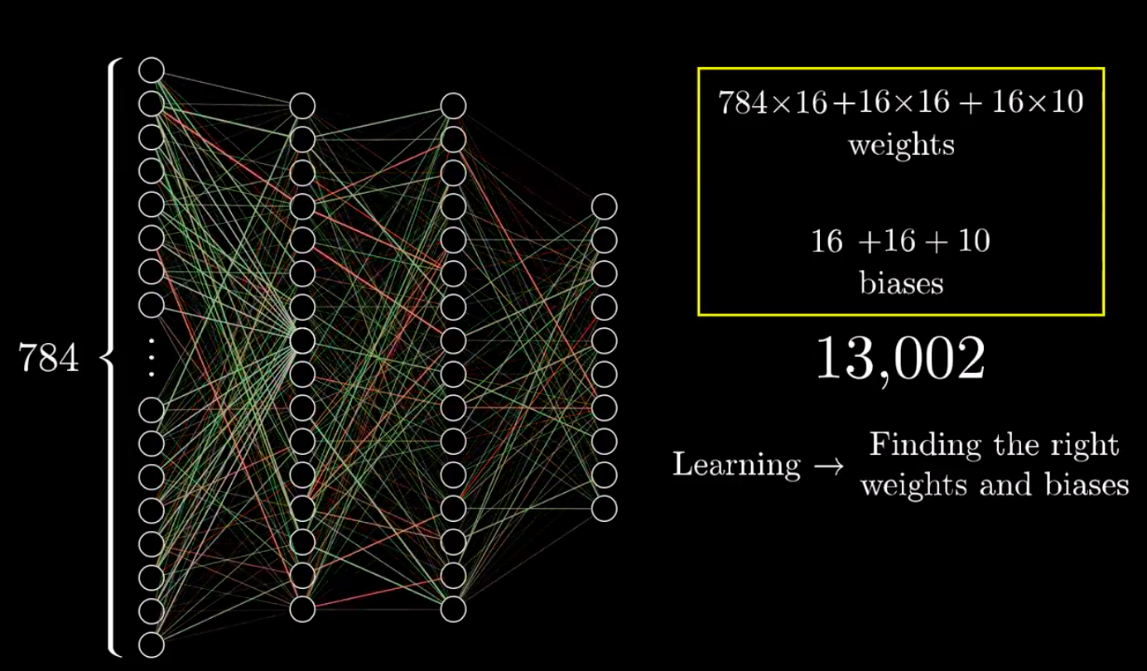
Example: Handwritten Digits Recognition
Learning
Notes:
http://yann.lecun.com/exdb/mnist/

Slide 48
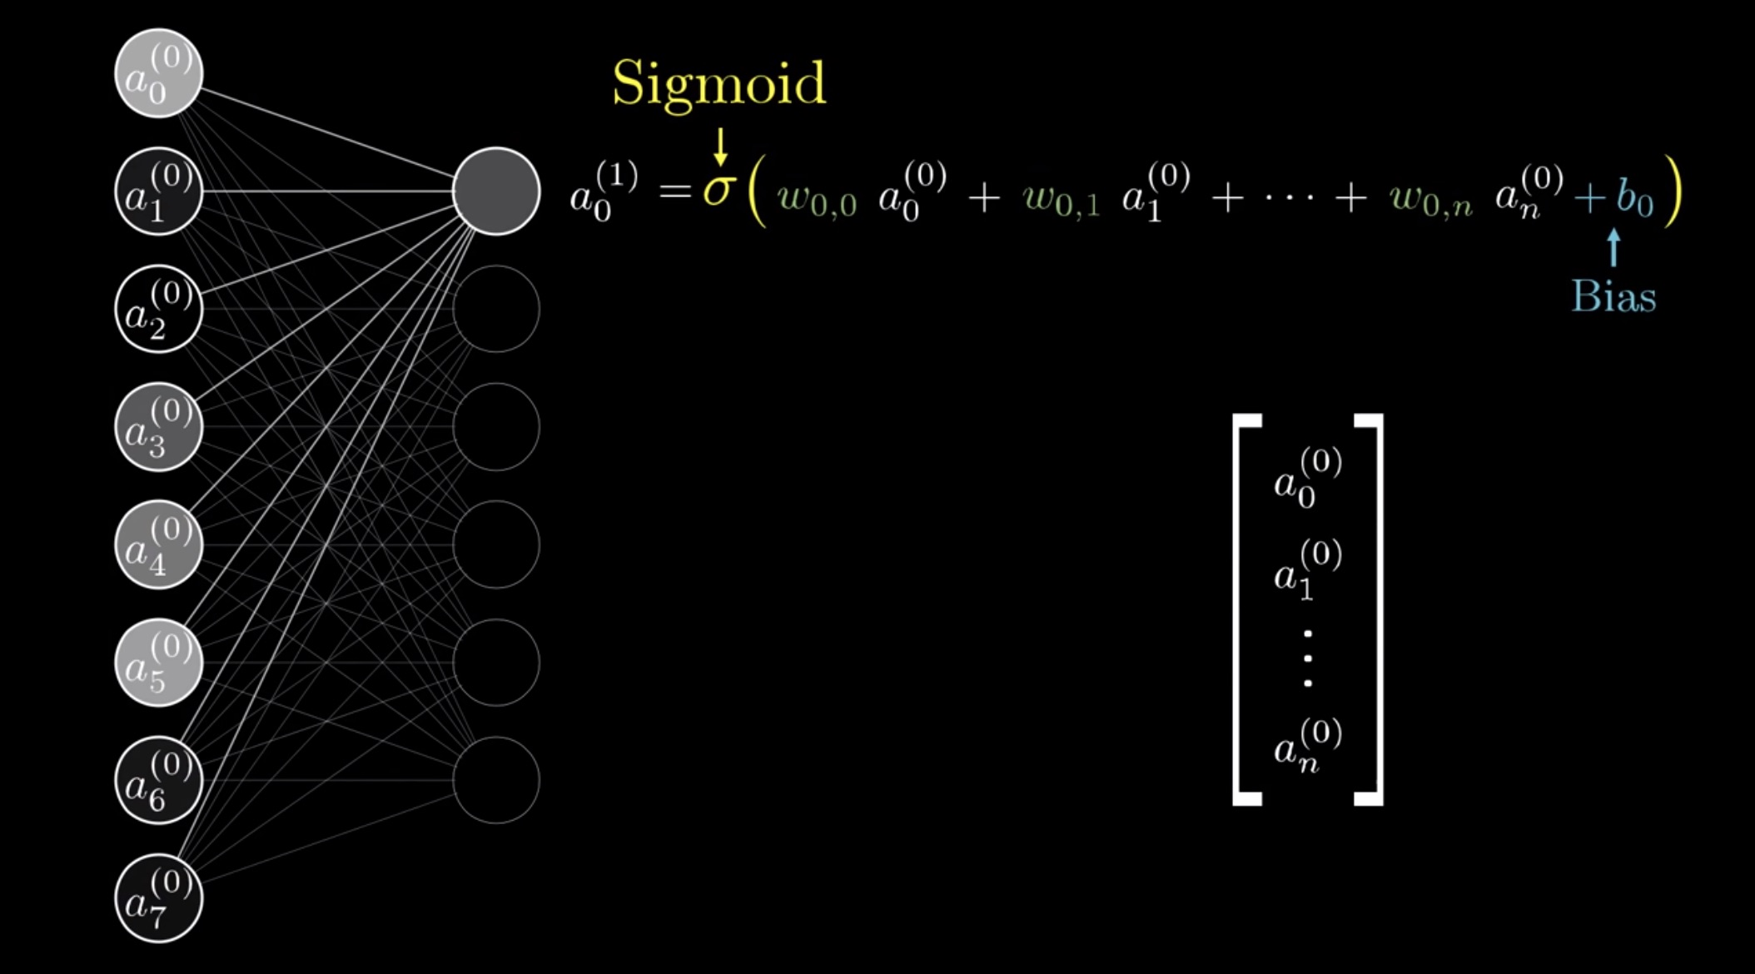

Slide 49
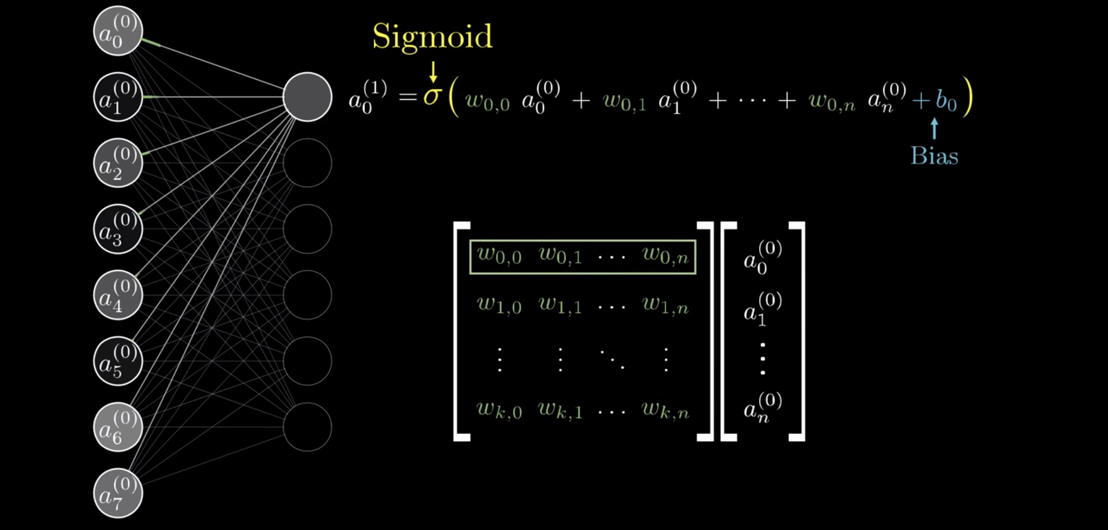

Slide 50
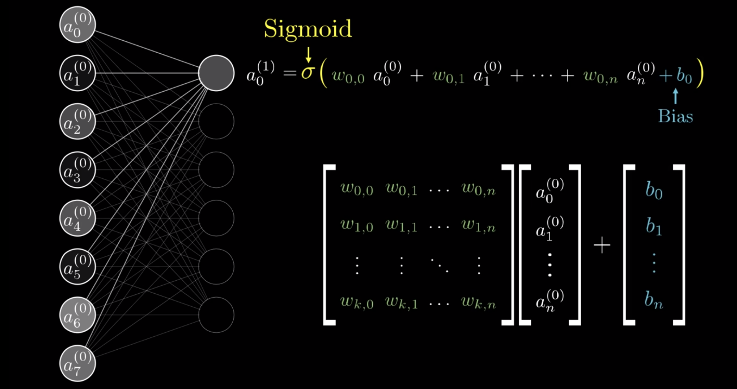

Slide 51
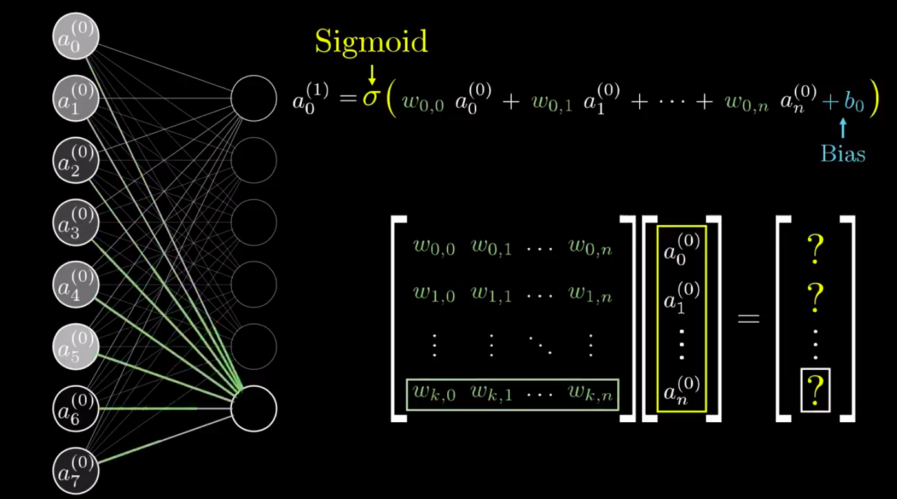
Example: Handwritten Digits Recognition
Matrix
Notes:
http://yann.lecun.com/exdb/mnist/

Slide 52
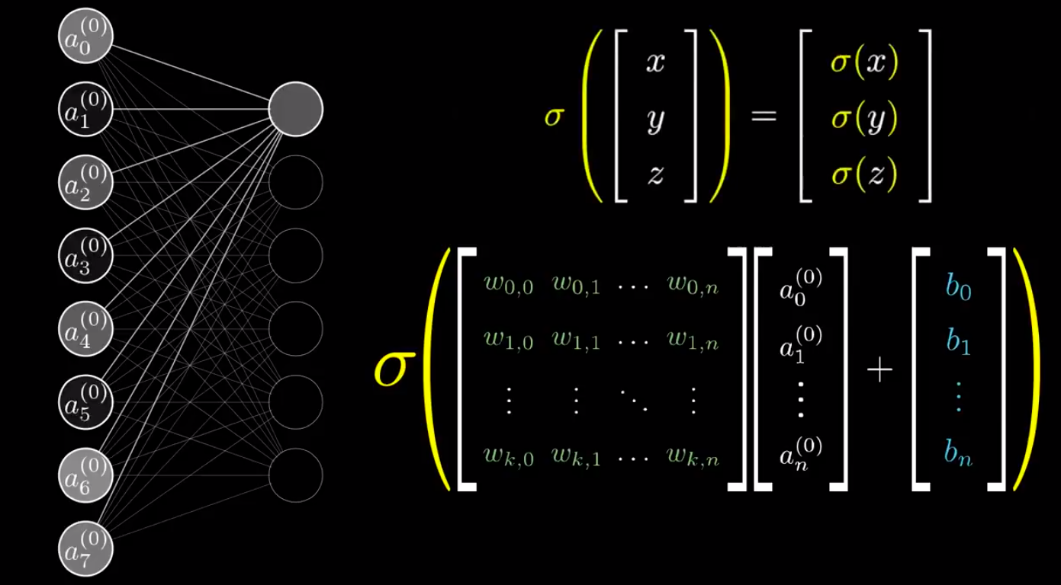
Example: Handwritten Digits Recognition
Matrix
Notes:
http://yann.lecun.com/exdb/mnist/

Slide 53
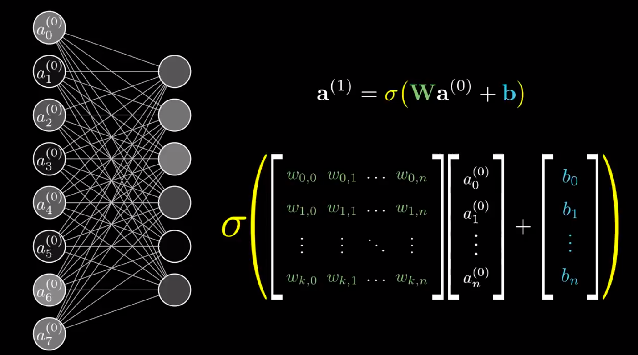
Matrix
Notes:
http://yann.lecun.com/exdb/mnist/

Slide 54
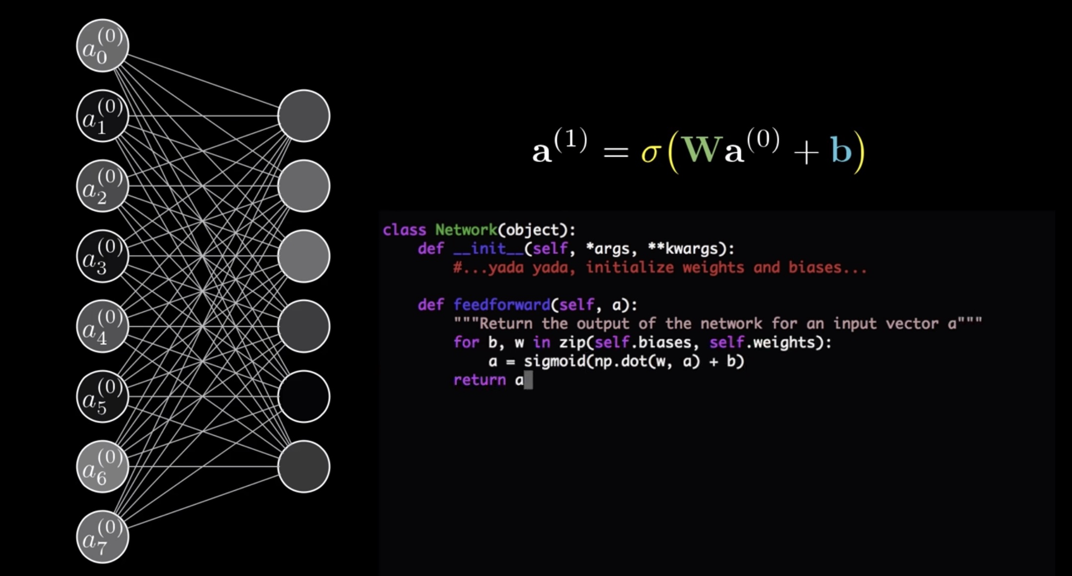
Feedforward function

Slide 55
END
Thank you

