Slide 1
Deep Learning Basics
1: Introduction
Prof Steen
EdTech
Week 5

Slide 2
Introduction to
Deep Learning

Slide 3
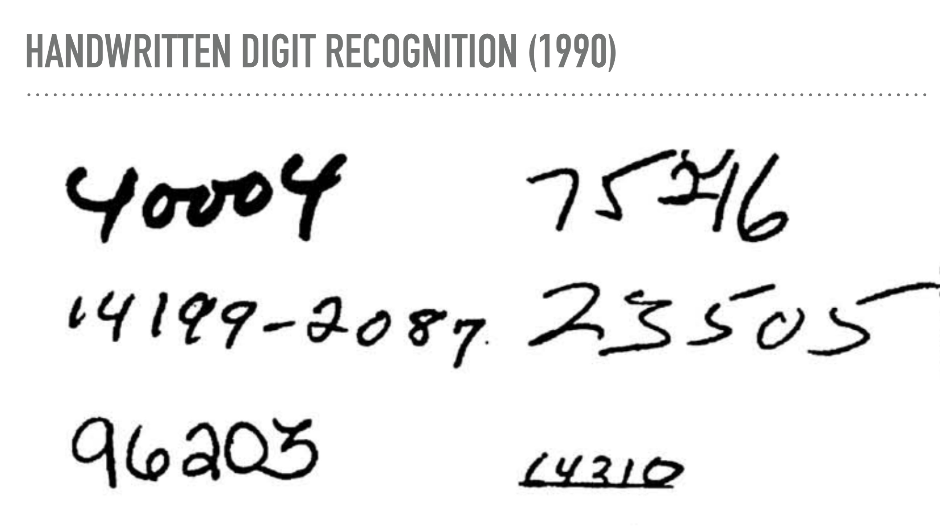

Slide 4
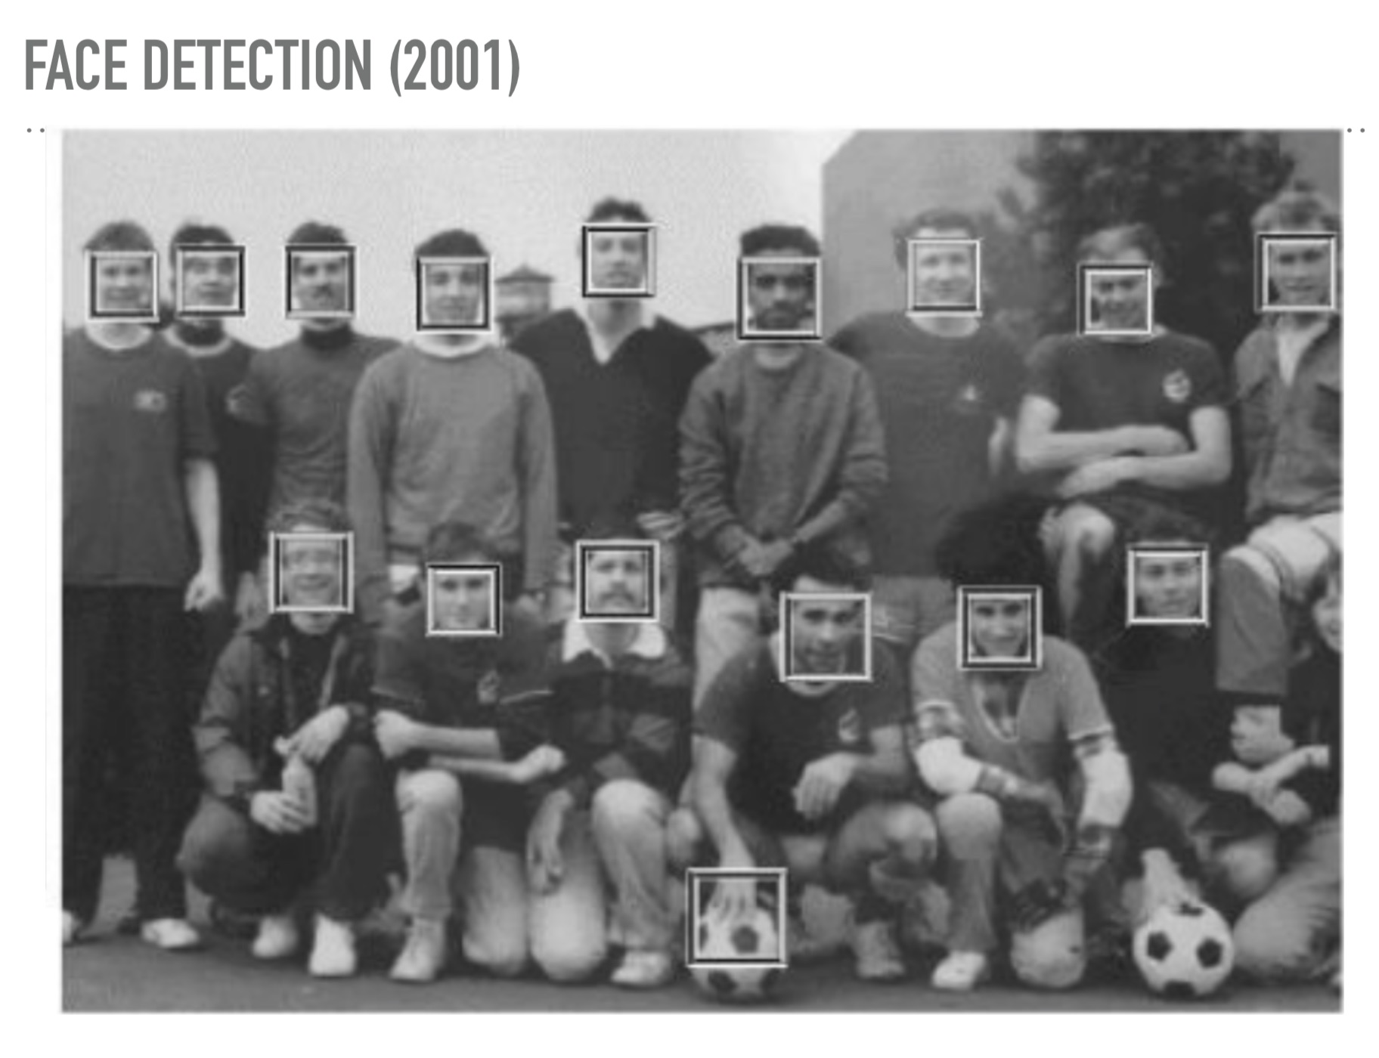

Slide 5
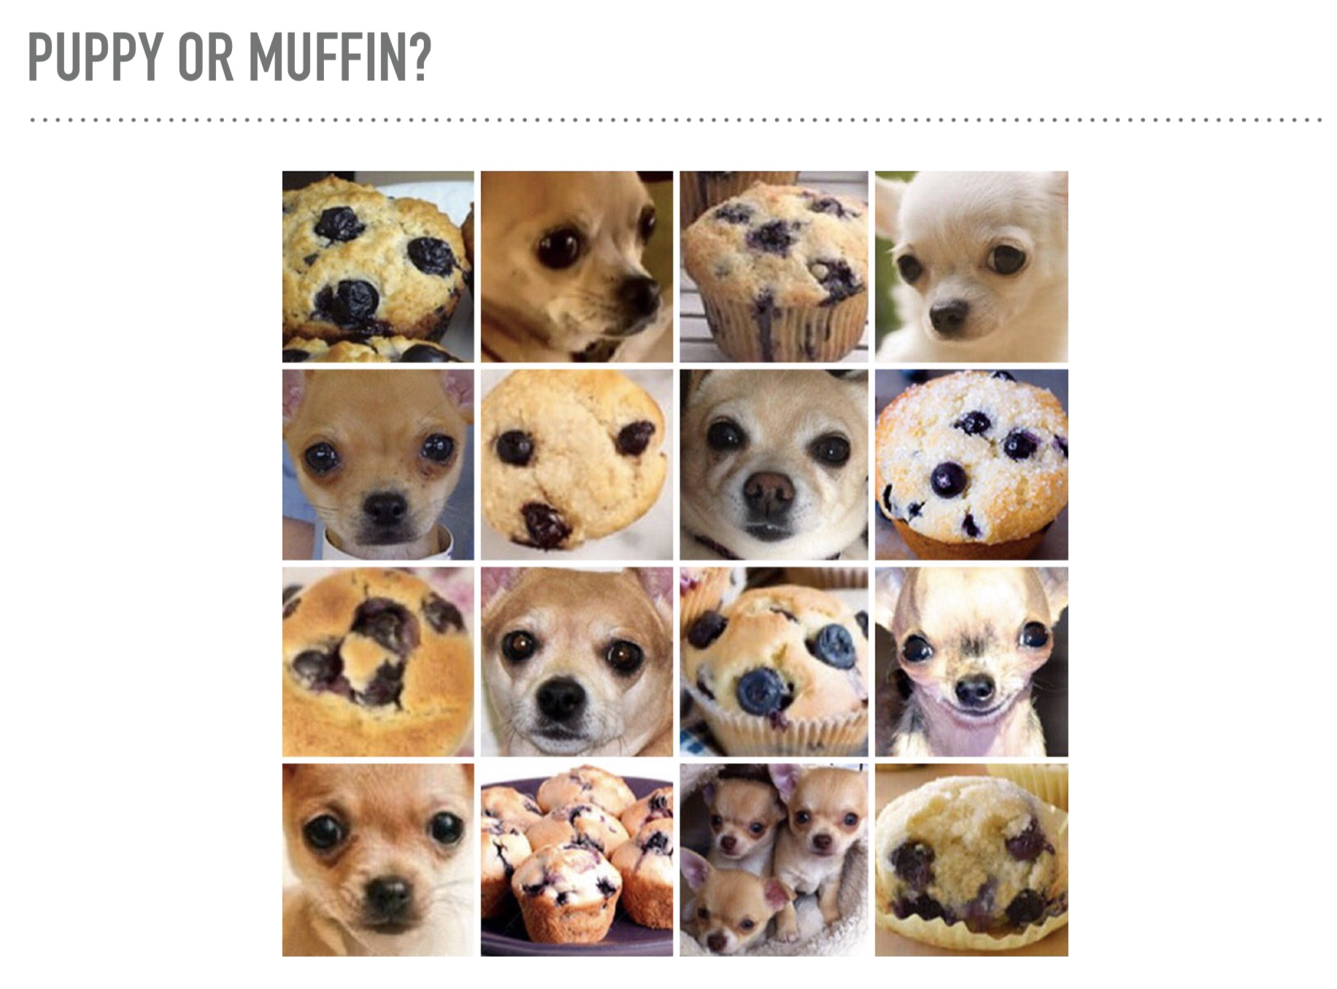

Slide 8
Application of deep learning
Play Go Game
Play StarCraft Game

Slide 9
Application of deep learning
Self driving Car
Self driving Car

Slide 10
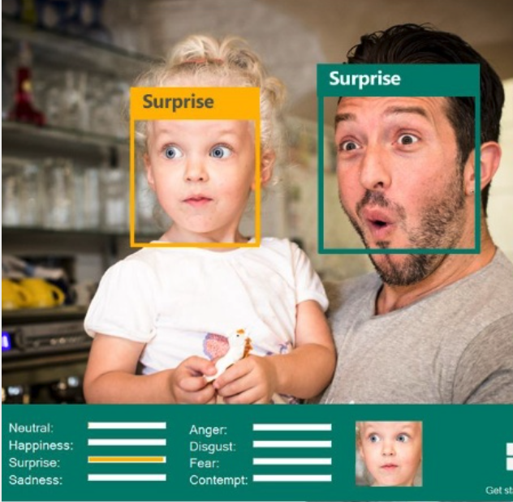
Application of deep learning
Emotion Detection
Style Transfer

Slide 11
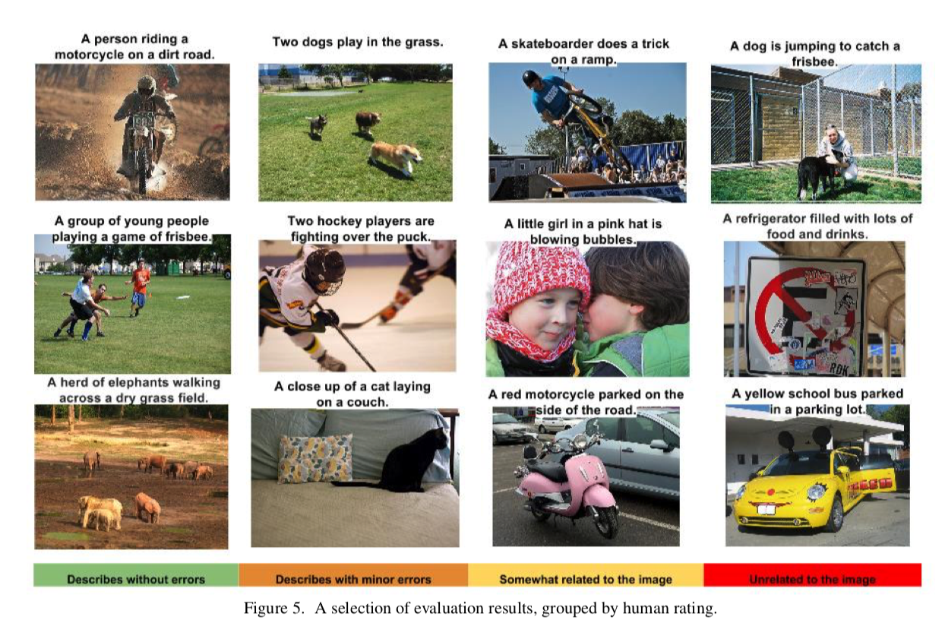
Application of deep learning
Automatic writing poetry
Automatically generate image titles
Reference
https://jiuge.thunlp.cn
https://www.cv-foundation.org/openaccess/content_cvpr_2015/papers/
Notes:
https://jiuge.thunlp.cn
https://www.cv-foundation.org/openaccess/content_cvpr_2015/papers/Vinyals_Show_and_Tell_2015_CVPR_paper.pdf

Slide 12
What is Artificial Intelligence?
The intelligence demonstrated by machines is called Artificial Intelligence.
Colloquially, the term “artificial intelligence” is used to describe machines that mimic “cognitive” functions that humans associate with other human minds, such as “learning” and “problem-solving”.
Notes:
Ref:
https://en.wikipedia.org/wiki/Artificial_intelligence ↩
https://developer.nvidia.com/deep-learning

Slide 13
What is Machine Learning?
A subset of Artificial Intelligence.
It gives computers the ability to learn from data without explicitly being programmed.
Experience
Big Data
Learn
Notes:
Ref:
https://en.wikipedia.org/wiki/Artificial_intelligence ↩
https://developer.nvidia.com/deep-learning
https://towardsdatascience.com/parallel-and-distributed-deep-learning-a-survey-97137ff94e4c

Slide 14
What is Deep Learning?
A subfield of machine learning concerned with algorithms inspired by the structure and function of the brain called artificial neural networks.
Notes:
Ref:
https://en.wikipedia.org/wiki/Artificial_intelligence ↩
https://developer.nvidia.com/deep-learning
https://towardsdatascience.com/parallel-and-distributed-deep-learning-a-survey-97137ff94e4c

Slide 15
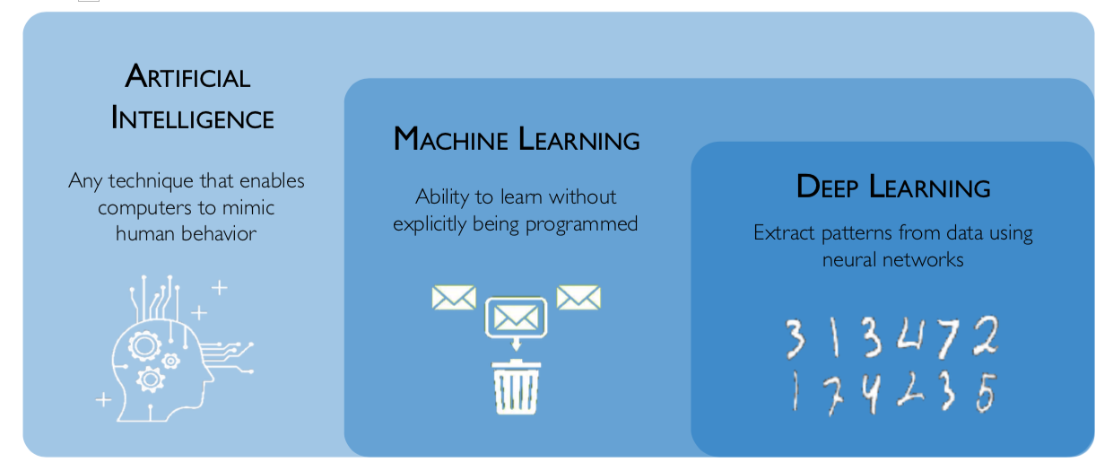
AI, ML & DL
Notes:
Ref:
http://introtodeeplearning.com
https://developer.nvidia.com/deep-learning

Slide 16
Why Now?
Big Data
Hardware
Software
Larger Datasets Easier Collection & Storage
• Graphics Processing Units (GPUs)
Massively Parallelizable
Improved Tools
Notes:
1. Big Data
Larger Datasets Easier Collection & Storage
2. Hardware
• Graphics Processing Units (GPUs)
Massively Parallelizable
3. Software
• Improved Techniques
New Models • Toolboxes
Reference：introtodeeplearning.com

Slide 17
A success story
In medical diagnosis, deep learning can provide excellent results very cheaply — and possibly do better than doctors

Slide 18
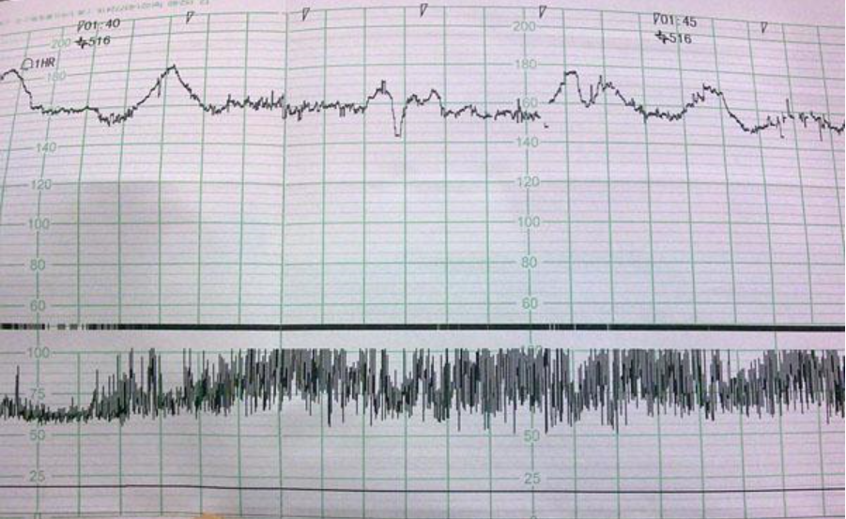
An example of CTG (胎心图)

Slide 19
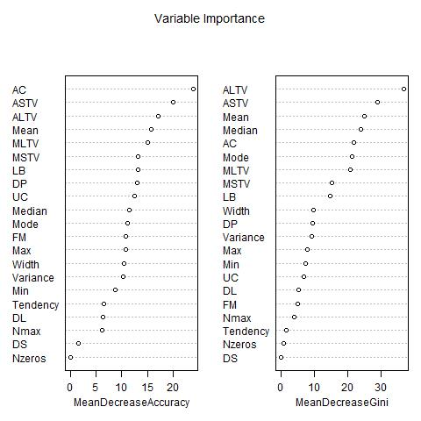

Slide 20
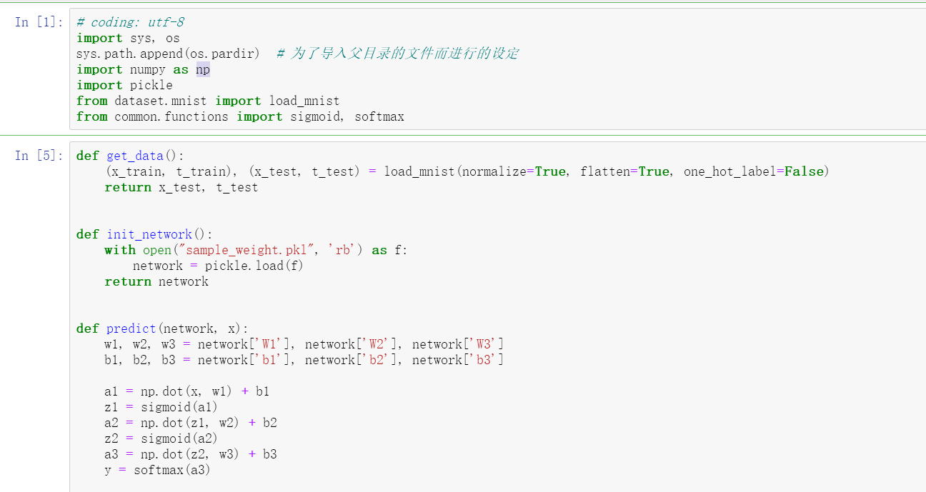
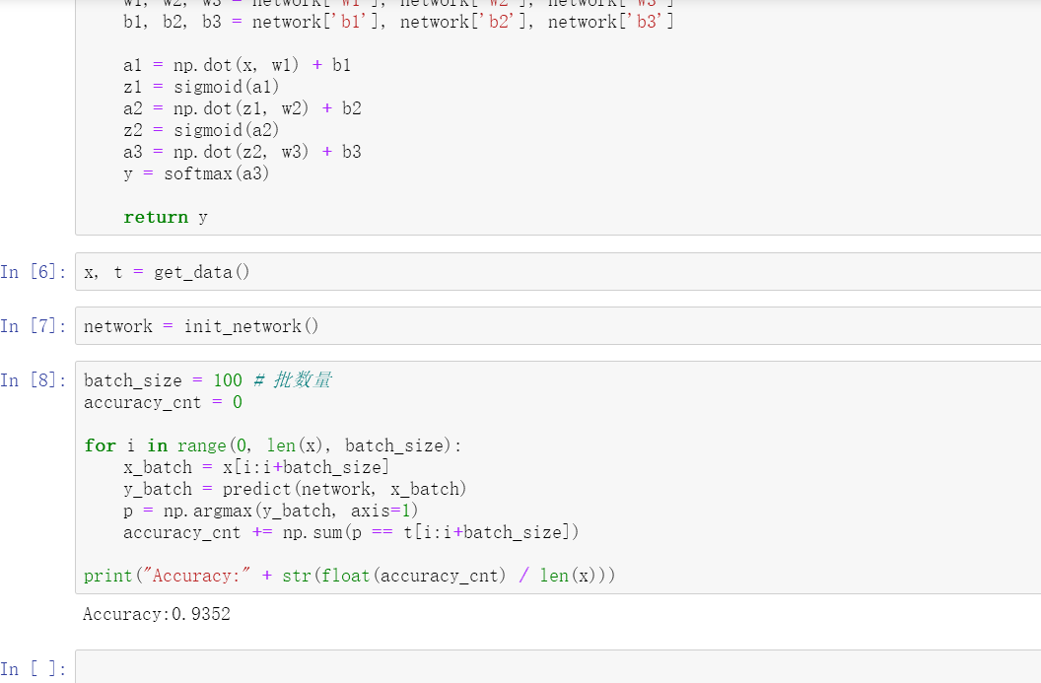

Slide 21
Deep Learning outperforms doctors on cardiotocograms
Existing literature shows that there is no significant difference in potentially preventable deaths between traditional CTG and no CTG
Computerized CTG showed a significant reduction in potentially preventable deaths when comparing with traditional CTG Esra Mahsereci Karabulut, Turgay Ibrikci (2014). Analysis of Cardiotocogram Data for Fetal Distress Determination by Decision Tree Based Adaptive Boosting Approach. Journal of Computer and Communications, 2:32-37.

Slide 22
Limitation of deep learning
Adding to it a "gibbon" gradient, a neural network will classify this panda as a gibbon. This evidences both the brittleness of these models, and the deep difference between the input-to-output mapping that they operate and our own human perception.
Notes:
Ref：https://blog.keras.io/the-limitations-of-deep-learning.html
By taking a picture of a panda and adding to it a "gibbon" gradient, we can get a neural network to classify this panda as a gibbon. This evidences both the brittleness of these models, and the deep difference between the input-to-output mapping that they operate and our own human perception.

Slide 23
Limitation of deep learning
Local generalization versus extreme generalization
Human: ability to adapt to novel, never experienced before situations, using very little data or even no new data at all.
Neural Network “local generalization": the mapping from inputs to outputs performed by deep nets quickly stops making sense if new inputs differ even slightly from what they saw at training time.
Notes:
Ref：https://blog.keras.io/the-limitations-of-deep-learning.html
In short, deep learning models do not have any understanding of their input, at least not in any human sense. Our own understanding of images, sounds, and language, is grounded in our sensorimotor experience as humans—as embodied earthly creatures. Machine learning models have no access to such experiences and thus cannot "understand" their inputs in any human-relatable way. By annotating large numbers of training examples to feed into our models, we get them to learn a geometric transform that maps data to human concepts on this specific set of examples, but this mapping is just a simplistic sketch of the original model in our minds, the one developed from our experience as embodied agents—it is like a dim image in a mirror.

