Slide 1
On not letting a serious crisis go to waste: Opportunities for institutional learning following the 22nd of July attacks
Francis Steen, UCLA and PRIO JD/INN 3 December 2015
Notes:
When something terrible happens, how do we learn from it?

Slide 2
Dataset
UCLA NewsScape Project
International television news
335 000 news videos
3 billion words in subtitles
Notes:
I direct the UCLA NewsScape project for the study of international television news
We capture television in a dozen countries, including Norway and the US

Slide 4
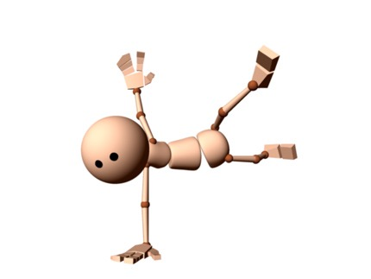
Institutional Learning
Police response
Media criticism
Political response
Notes:
The crisis happens precisely because you didn’t anticipate it — you didn’t see it coming, and you weren’t prepared. You failed, perhaps in ways that upset you, or people you are responsible for.
That upset may be grief, or it may be anger. The system has been destabilized, and this loss of balance is a problem.
And that problem is an opportunity. At three levels: police, media, politics. In this brief presentation, I’ll focus on the police.

Slide 5
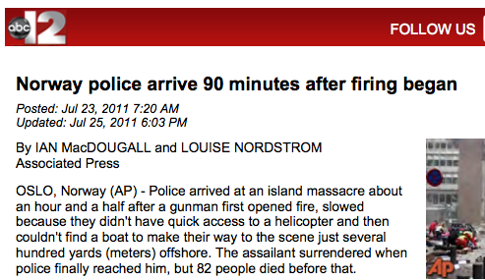
Utenlandsk presse kritiserte tidlig
Notes:
Men den er heller ikke tilbakeholden med direkte kritikk av politiet.

Slide 6
CNN 28. juli 2011
Notes:
Norsk presse er mye mer tilbakeholden. Hva lå bak denne strategien? Var den moralsk og praktisk riktig?

Slide 7
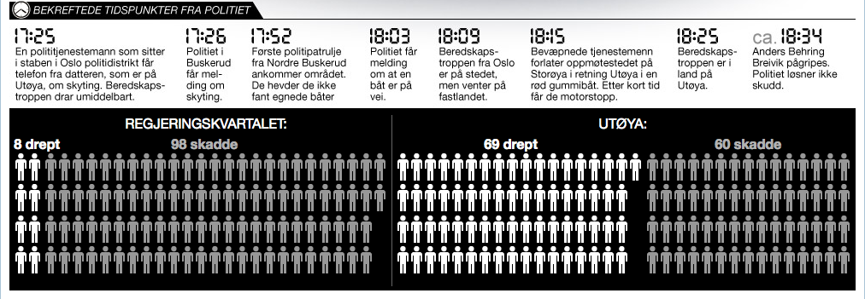
VG 30. april 2012
Notes:
Etter rettsaken beskriver VG hvordan ungdommene på Utøya ser blålysene fra politibilene på land i 42 minutter før politiet ankommer.

Slide 8
Perceiving affordances
The delays in the police response appear to relate to the failure to perceive the affordances in the situation
The police could have established base closer to the island, and commandeered a suitable boat
The urgency of the situation called for creative solutions that may deviate from standard procedure
Notes:
These points were obvious to bystanders, many of whom were famously efficient in helping victims.

Slide 9
ABC rapporterer den 23. juli 2011
Notes:
Vi ser tidlig en generell beredsskapskritikk fra utenlandsk presse. Underforstått: Vår verdensforståelse er bedre enn deres

Slide 10
Politikommisjonen 16. desember 2011
Notes:
Politiet’s interne kommisjon ser imidlertid ingen grunn til å godta kritikken. De unnlater å forestille seg det mulige, som er nødvendig for å skape ny beredskap.

Slide 11
Hvorvidt de valgene som ble gjort denne dagen ville hatt konsekvenser for om menneskeliv kunne vært spart, er spekulasjoner, skriver politimester Hammer i en pressemelding.
Notes:
The appeal is straightforward: the police did what they actually did, and nobody was suggesting malicious intent.
The news disagrees.

Slide 12
Stages of News Processing
Present evidence
Develop an explanation
Imagine what could have happened
Assign responsibility and blame
Plan for the future

Slide 13
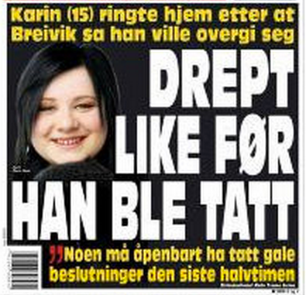
Notes:
VGs forside 17. august 2011: Karin Elena Holst ble symbolet på det som kunne ha vært.
Hun ble skutt på kloss hold på Sydspissen, etter at politiets første patrulje hadde ankommet Utøya 18.25,
en time og ett kvarter etter at massakren startet.
Familien hadde kontakt med henne på telefon under veis.

Slide 14
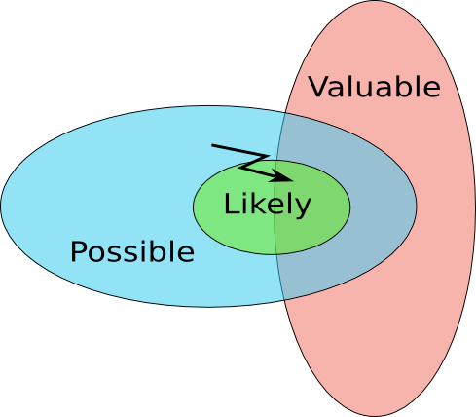
State spaces events in the news
Notes:
What could be the purpose of creating counterfactual scenarios at variance with what actually happened?
As it turns out, this is what you have to do to learn from your mistakes. The resource that you have to improve your performance is to examine in detail exactly what was possible in the past -- what you could have done, but did not.

Slide 15
Causal reasoning
In order to learn from your mistakes, you need to identify the points where you could have done something different
These are privileged points in an event trajectory
Much of the time, you have no control
So you have to reconstruct the moments when you do
Notes:
You are looking for the moments where the world forks

Slide 16
Relinquishing control
Time — windows of opportunity close, and you cannot undo an act or recall the past
Energy — you routinely deploy energies you become hostage to
Speed — you train to act faster than you can consciously control
Knowledge — you are subject to your own ignorance of what is possible
Notes:
This relinquishment may be willing or imposed by circumstances.

Slide 17
… where the world forks
To learn from you mistakes, you must identify those points in an event trajectory where you have the ability to intervene
Typically, these are points where you have ample time, where the energies deployed are low, where the speed is low, and where you have sufficient resources to become well-informed
Notes:
In order to learn from your mistakes, you must first assume that the present moment is amenable to multiple possible actions and is not predetermined, and then you need to project that view back into the past.
Determining what was actually possible is not merely a matter of imagining a better outcome; it is not a frivolous fantasy akin to fiction.
Rather, it requires a realistic assessment of what information was available at the time, cognitive resources for responding to new information, physical resources that could be found and deployed, manpower that could be recruited, actions that could have been made

Slide 18
Notes:
Gjørvkommisjonen fastslår at “en raskere politiaksjon var reelt mulig.”
Dette ble mottatt uten murring fra politiet.

Slide 19
Resistance to learning
The police response to the attacks suggests a failure to identify effective solutions creatively
The police response to criticism suggests an institutional culture that actively blocks learning
The Gjørv Commission functioned to definitively assign blame
Notes:
However, for the police to actually learn from this, they would need examine the choice they made at the time and become aware that they genuinely could have made other choices.
Learning from your mistakes requires the actual realization that you had the ability at the time to act differently.
The reputation of the police suffered as a result

Slide 20
Causal surgery
Accepting blame is not a sufficient condition to learn
You need to actually reconstruct the points in time where you could effectively intervene
Learning from your mistakes requires the realization that you had the ability at the time to act differently
That new understanding changes you, and forms the foundation for strategic planning.

Slide 21
On the strategic use of instability
Rahm Emanuel, while White House Chief of Staff, famously remarked, “You never want a serious crisis to go to waste”
A crisis is "is an opportunity to do things you think you could not do before.”
Notes:
Let me end on a political note.
What this means is that when a crisis happens, people and institutions are destabilized.
This loss of control represents an opportunity to shape and shift the system into a new regime.

Slide 22
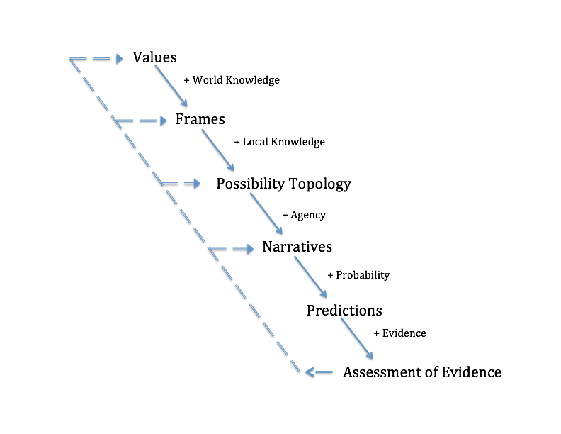
How values govern the determination of evidence
Notes:
Sannheten er underordnet verdier — ikke som en forvridning av solide fakta, men mer grunnleggende fordi det som teller som fakta er drevet av det som anses som verdifullt.

Slide 23
Refleksjoner
Er det urimelig å klandre politiet, som utvilsomt gjorde det beste de kunne?
Er politiet urimelig fokusert på å beskytte sine egne mot kritikk — og dermed nekte å dra lærdom fra det som skjedde?
Er det emosjonelt for tidlig å snakke om beredsskapssvikt?
Er det klart rom for forbedringer, som krever at vi åpner for det kontrafaktiske?
Notes:
Her er det en spenning mellom en selvbeskyttende impuls, urimeligheten ved å klandre noen for noe som ikke skjedde (kontrafaktisk), en emosjonell følsomhet i forhold til traumet, og likevel nødvendigheten av å gjøre det bedre.

